Slide 1
An experiment on ecological restoration
Virginia Cecchini Manara
Lorenzo Spadoni
Eleonora Ciscato
Pietro Guarnieri
University of Milan
University of Milan
University of Pisa
University of Cassino
and Southern Lazio
Workshop
Behavioural Ecological Economics
University of Florence, 10-11 July 2023

Slide 2
After the tragedy
Ecological restoration aims to recreate, initiate, or accelerate the recovery of an ecosystem that has been disturbed.
Notes:
Ecological restoration aims to recreate, initiate, or accelerate the recovery of an ecosystem that has been disturbed.

Slide 3

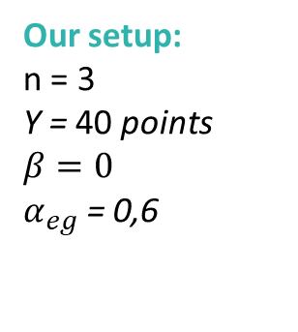
The restoration game
Let n denote the group size, Y is i’s endowment and P the common pool resource.
$U_{i}=Y+e_{i}+β\left(P−\sum_{j=1 …i…n}{e_{j}}\right)−c_{i}+α_{pg}(\sum_{j=1 …i…n}{c_{j})+α_{eg}\left(P−\sum_{j=1 …i…n}{e_{j}}\right)}$ with $α,β∈(0,1)$ and $α_{pg}≤α_{eg}$.
first stage
second stage
extraction game
public good game
Our setup:
n = 3
Y = 40 points
$$β=0$$
$α_{eg}$ = 0,6
Conditions
Baseline: extraction game + public good game
Only Restoration: public good game with extraction decisions from another group
Treatments
$α_{pg}$ Low = 0,45 $α_{pg}$ High 0,6
Notes:
asymmetria_: in equilibrio non tutti fanno la stessa azione

Slide 4
Predictions
Theoretical hypothses:
By backward induction:
2nd stage: Optimal contribution is $c_{i}=0$ if $α_{pg}$< 1
1st stage: Optimal extraction is $e_{i}$=max if$β+α_{eg}<1$
No difference between Baseline and Only Restoration
No difference between $α_{pg}$ Low and $α_{pg}$ High
Behavioral hypotheses
Context dependency: the history of the resource matters
Path-dependency: extraction in the first stage affects restoration decisions
Reciprocity/conditional cooperation: others’ behaviour matters
Levelling up: increasing the efficiency of restoration increases contribution

Slide 5
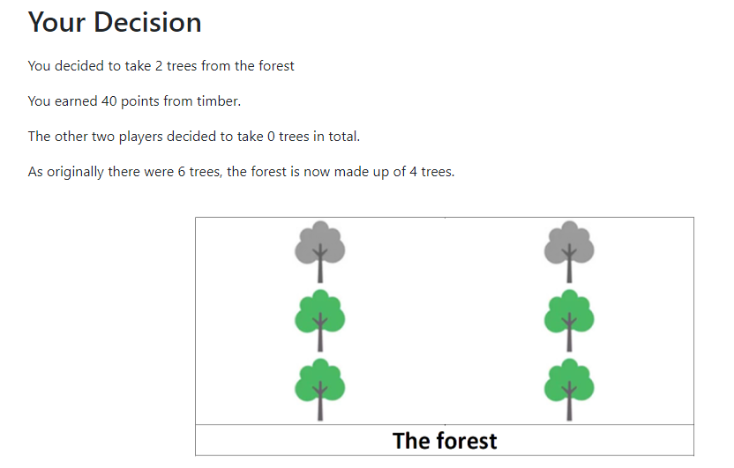
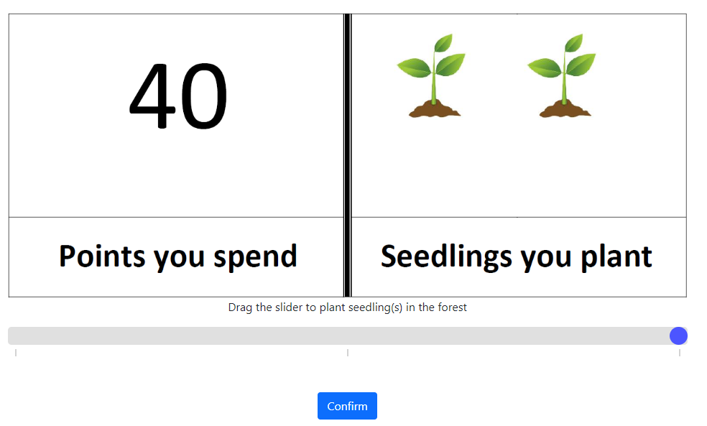

Slide 6
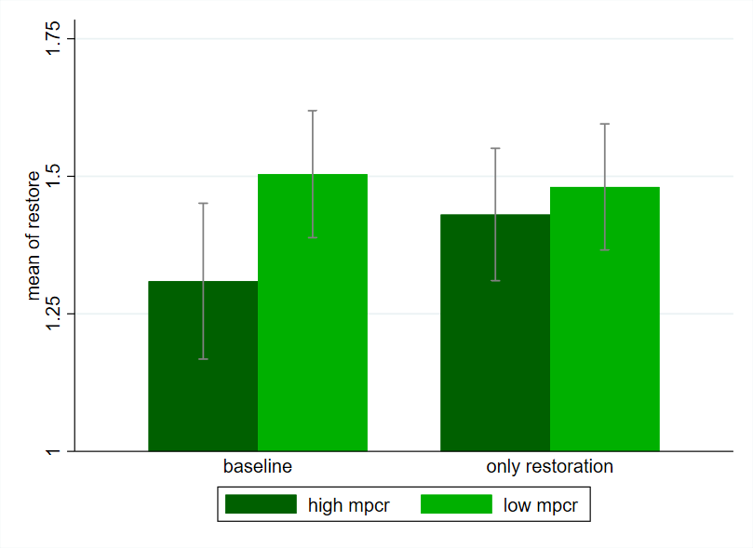
Results (1)
How does the forest condition affect decisions?
How does others’ behaviour affect decisions?
How does personal extraction decision affect restoration decision?
How does restoration efficiency affect decision?

Slide 7
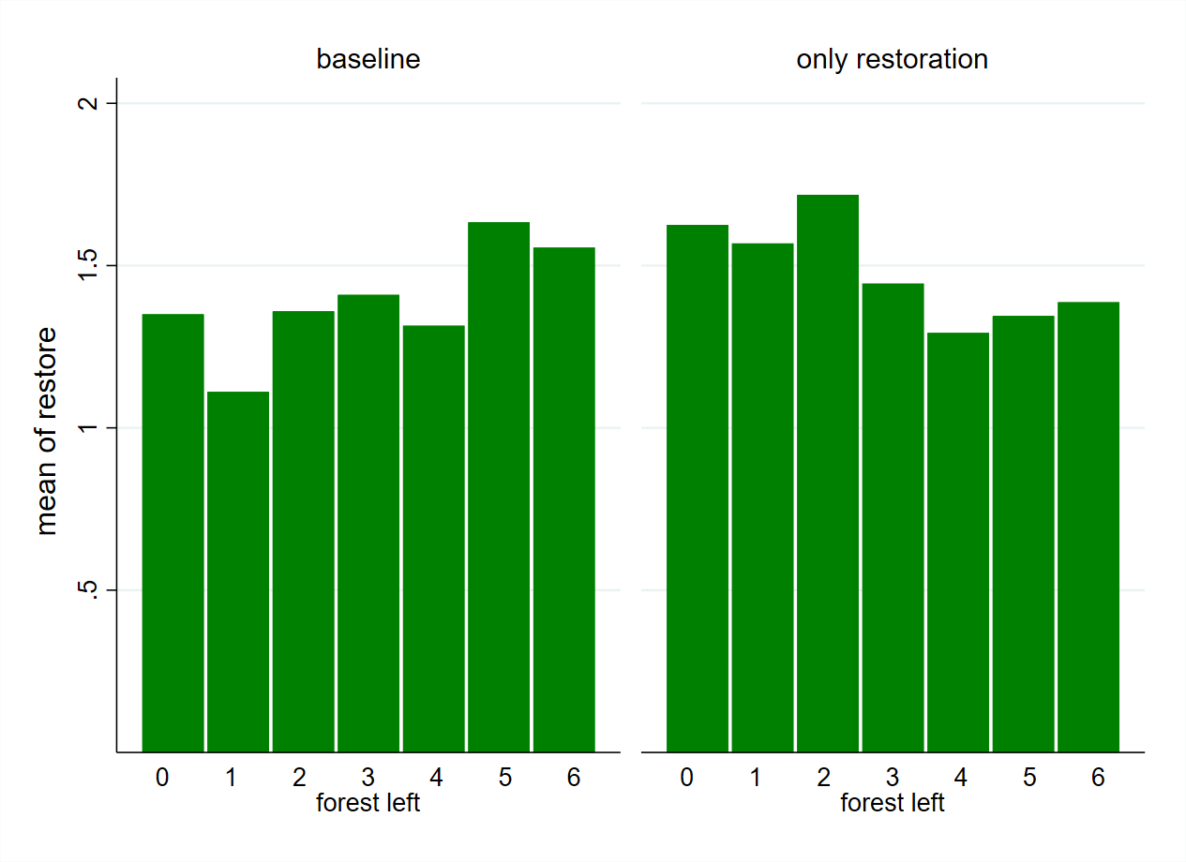
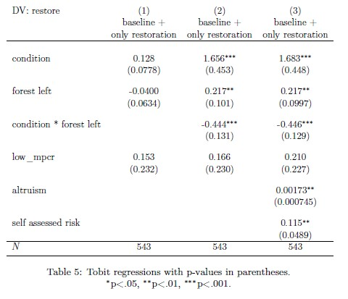
Results (2)
Notes:
Reciprocity, optimism.
Se non ho partecipato allo sfruttamento della risorsa ristoro di più.

Slide 8
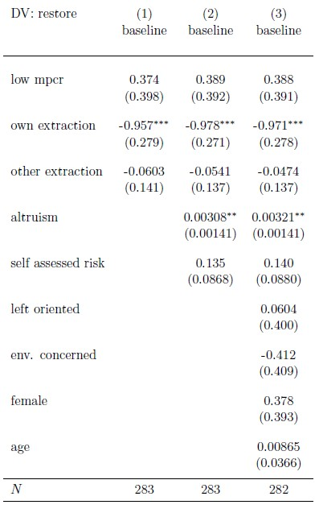
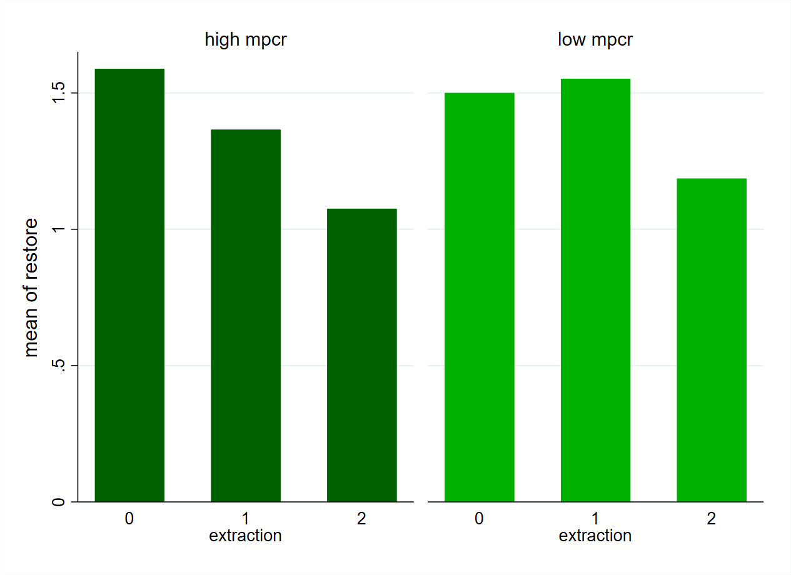
Results (3)
Notes:
Più ho estratto meno ristoro (tipi prosociali, )

Slide 9
Highlights
The generation who does not take part in the exploitation is more responsible towards restoration (no lock-in)
The history of the resource matter and condition decision-making via reciprocity/conformism (in baseline) via responsibility (in only restoration)
Restoration efficiency has a negligible role
Pro-social attitudes matter and obstacle behavioural change
Notes:
Più ho estratto meno ristoro (tipi prosociali, )

Slide 10
Thank you!
pietro.guarnieri@unipi.it

