Slide 1
Collective Institutions, Private Property, Equity and Forest Protection: the case of Peasant Reserve Zones in Colombia
Carolina Castro Osorio
PhD student
Universidad de los Andes
Economy faculty
c.castroo@uniandes.edu.co
Tutors: Juan Camilo Cárdenas, Nicolás de Roux.

Slide 2
Main results
I analyzed the causal impact of PRZ which stands for “Peasant (small farmers) Reserve Zones” on deforestation.
PRZ is a particular local institution in Colombia. It’s a hybrid of collective governance, private property land and control of land market in zones of high environmental relevance.
I found that PRZ have contributed to reducing the probability of deforestation by 2 percentual points.
I used processed satellite images and implemented a difference-in-difference regression.
The declaration of 5 PRZ at the end of the 1990s had the effect of reducing the probability of deforestation by 19,2% percent equal to more than a thousand hectares (1.242 ha=173.950 soccer fields).
The mechanisms behind this effect are: collective governance, private property and better distribution of land.

Slide 3
Motivation
Since 2000, Colombia has faced massive deforestation processes inside and outside the agricultural frontier.
(INSIDE) In areas of historical colonization, this problem has been related to:
Land accumulation (rural land gini: 0,83),
High levels of informality of the land (more than 60% of the farmers don´t have land titles)
Agroindustrial exploitation and
Lack of agro-sustainable practices.
(OUTSIDE) The expansion of the agricultural frontier to reserve and special environmental management zones are related to the lack of State capacity and the absence of local institutions.
Notes:
- by 2018 Colombia was the fourth country with the highest deforestation in the world, with an average of more than 111 hectares deforested daily.

Slide 4
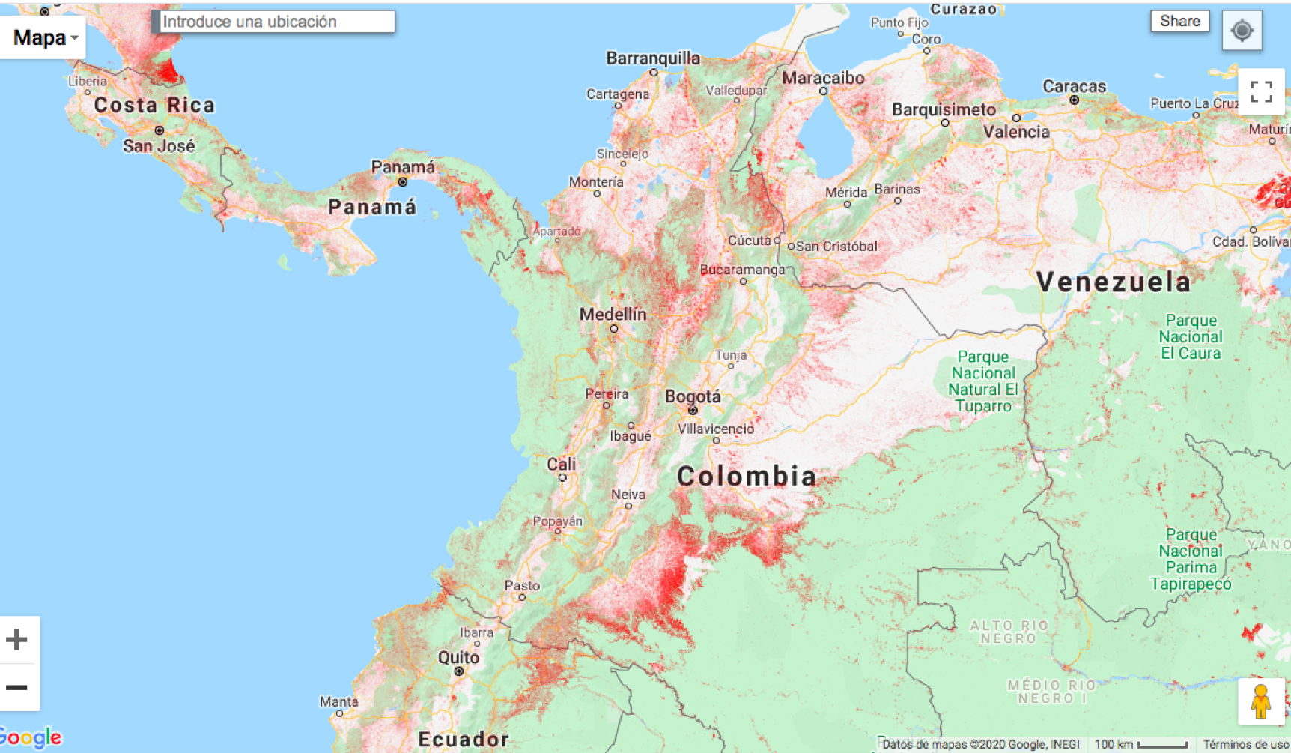
Fuente: Hansen et. al. 2019, Global Forest Change.

Slide 5
Research framework
This research contributes to answering main questions from the literature of commons:
“What types of policy interventions will help to support or create local institutions, (…) to protect forests and encourage positive local forest transitions?” (Ostrom & Nagendra, 2006)
What are the types of property systems associated with these institutions?
What factors affect the likelihood of sustaining and enhancing existing forests and regeneration of past forested areas?
Are there any measures to regulate the land market that can contribute to the control of deforestation?

Slide 6
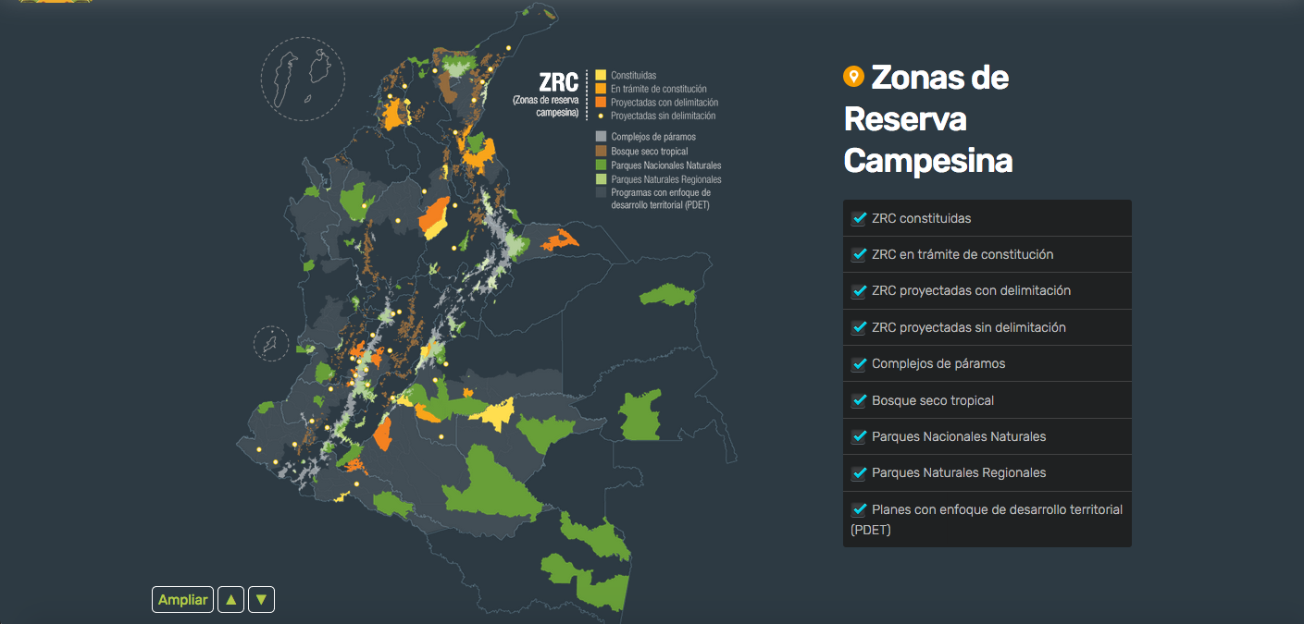
Fuente: Osejo Varona, A., Marín Marín, W. J., Posada Molina, V., Sánchez, S. A. y S. C. Torres Quijano (2018). Zonas de Reserva Campesina en el escenario del posconflicto: Una herramienta comunitaria para el manejo de la biodiversidad. En Moreno, L. A., Rueda, C. y Andrade, G. I. (Eds.). 2018. Biodiversidad 2017. Estado y tendencias de la biodiversidad continental de Colombia. Instituto de Investigación de Recursos Biológicos Alexander von Humboldt. Bogotá, D. C., Colombia.

Slide 7
The Peasant Reserve Zones (PRZ)
PRZs were included in the agrarian reform law (Law 160 of 1994) to link the promotion of small property with commitments to conservation.
Three relevant characteristics of these zones:
a) Collective governance: each zone must formulate sustainable development plans and define the zones of special environmental management, either in collective zones or private properties;
b) the inhabitants of the area are assigned private property rights over the land; and
c) there is a limitation to the free land market, through the prohibition of the accumulation of properties for the same owner.

Slide 8
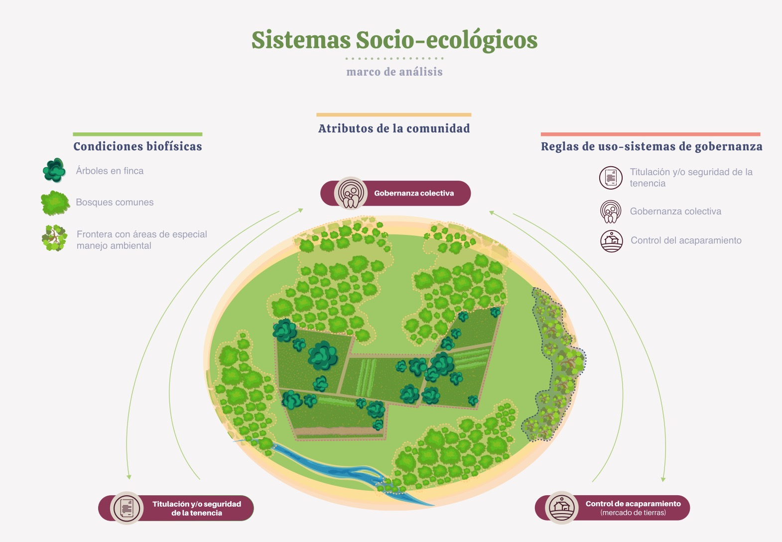

Slide 9
Literature review and contribution.
(+)Forest
Rural comunities on forest reserves: Luintel et al., 2018; Rasolofoson et al., 2015; Santika et al., 2019)
Collective governance and property (Conservation zones)
Ethnic communities: Baragwanath & Bayi, 2020; Blackman et al., 2017; Jusys, 2018; Nepstad et al., 2006; Soares-Filho et al., 2010; Romero & Saavedra, 2020; Velez et. Al., 2020; Walker et al., 2020
Collective governance
From prisoner's dilemma to repeated games and nice tit for tat.
Contribution 1: Collective schemes have been implemented mainly in territories with an environmental vocation and with ethnic communities with ancestral roots in the territory. The first main contribution of this research is that the small farmers reserve has been designed for territories with an agricultural vocation and with peasant communities with greater heterogeneous identity.

Slide 10
Literature review and contribution.
(+)Forest
Land titles (private property) and secure tenency
Land titling programs
Amacher et al., 2009; Barbier & Burgess, 2001; Robinson et al., 2014; Wren-Lewis et al., 2020
No need to demonstrate tenancy through clearing the forest

Slide 11
Literature review and contribution.
Land grabbing control
Equity on land distribution
(+)Forest
Better social ties and disposition to social cooperation
Cárdenas, 2005 y 2007; Yanai et al., 2012;
Sant’anna, 2017

Slide 12
Literature review and contribution.
(+)Forest
Collective governance and property (Conservation zones)
Rural comunities in forest reserves: Luintel et al., 2018; Rasolofoson et al., 2015; Santika et al., 2019)
Collective governance
Ethnic communities: Baragwanath & Bayi, 2020; Blackman et al., 2017; Jusys, 2018; Nepstad et al., 2006; Soares-Filho et al., 2010; Romero & Saavedra, 2020; Velez et. Al., 2020; Walker et al., 2020
From prisoner's dilemma to repeated games and nice tit for tat.
(+)Forest
Land titles (private property) and secure tenency
Land titling programs
Amacher et al., 2009; Barbier & Burgess, 2001; Robinson et al., 2014; Wren-Lewis et al., 2020
No need to demonstrate tenancy through clearing the forest
Land grabbing control
Equity on land distribution
(+)Forest
Better social ties and disposition to social cooperation
Cárdenas, 2005 y 2007; Yanai et al., 2012;
Sant’anna, 2017
Contribution 2: It advances in the study of the interaction between various mechanisms previously analysed by the literature on commons in a fragmented way.

Slide 13
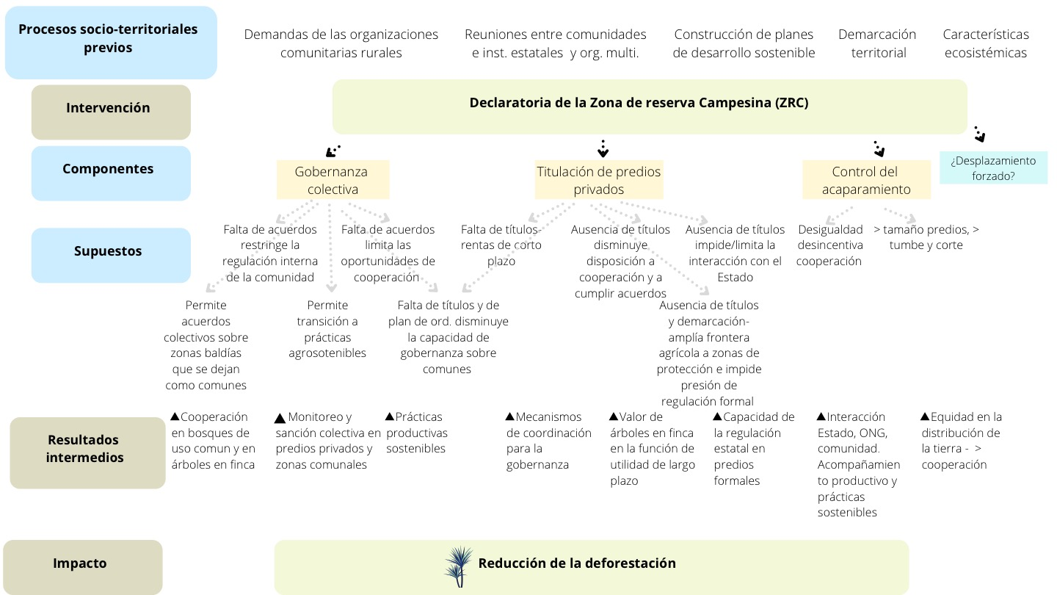

Slide 14
a)Definición colectiva zonas de uso común y las zonas de alto valor ambiental en predios privados
b) Prácticas de explotación sostenible que protejan el bosque,
c) Construir o afianzar normas sociales sobre la relación con la naturaleza,
d) mecanismos de sanción y control sobre las normas sociales definidas y
e) sistema de gobierno y liderazgo
Normas sociales
Gobernanza
colectiva
Cooperación (común y en finca)
Confianza
a) Incorporar capital natural en las funciones de utilidad;
b) Tenencia formal y construcción de una relación con la institucionalidad formal
c) Aumentar la cooperación técnica y económica
d) Construcción de lazos sociales de largo plazo
↑ Capital social
Mutua regulación (Monitoreo y sanción)
Propiedad
Privada
Transformación de prácticas
Regulación externa
Control del
acaparamiento
Límites a la tenencia de UAF en cabeza de un mismo propietario
Mayor equidad y lazos sociales

Slide 15
Methodology
Difference-in-differences methodology allows to compare the probability of deforestation before and after the declaration of the PRZ between the internal pixels (treated) and the external ones (controls). The following panel model with fixed effects is estimated:
$${Deforesta}_{irt}=α_{i}+{δ_{t}+β}_{1}{Post}_{t}{× dentro}_{i}+ε_{irt}$$
i=pixel, r=ZRC
Deforesta= 1 if there was deforestation in pixel i in period t and 0 otherwise, the pixels that are 2 km (inside and outside) from the border of each PRZ (r) are included
$α_{i}$ corresponds to pixel fixed effects to control any characteristic at the pixel level that can determine the result, this allows to control the variables that correspond to characteristics that do not change with time
$δ_{t}$ corresponds to time fixed effects to control any change between period 1 and 2 that may affect all pixels simultaneously
${Post}_{t}$ =1 if it is the value corresponding to the period (2000-2005 or 2006-2010) identified as the periods after the date of creation of five reserve zones
$dentro$that is equal to 1 if the pixel is inside the PRZ polygon .
$$ε_{irt=error term}$$
The estimator of interest will be $β_{1}$that will indicate the impact of the PRZ declaration on the probability that a pixel will be deforested.

Slide 16
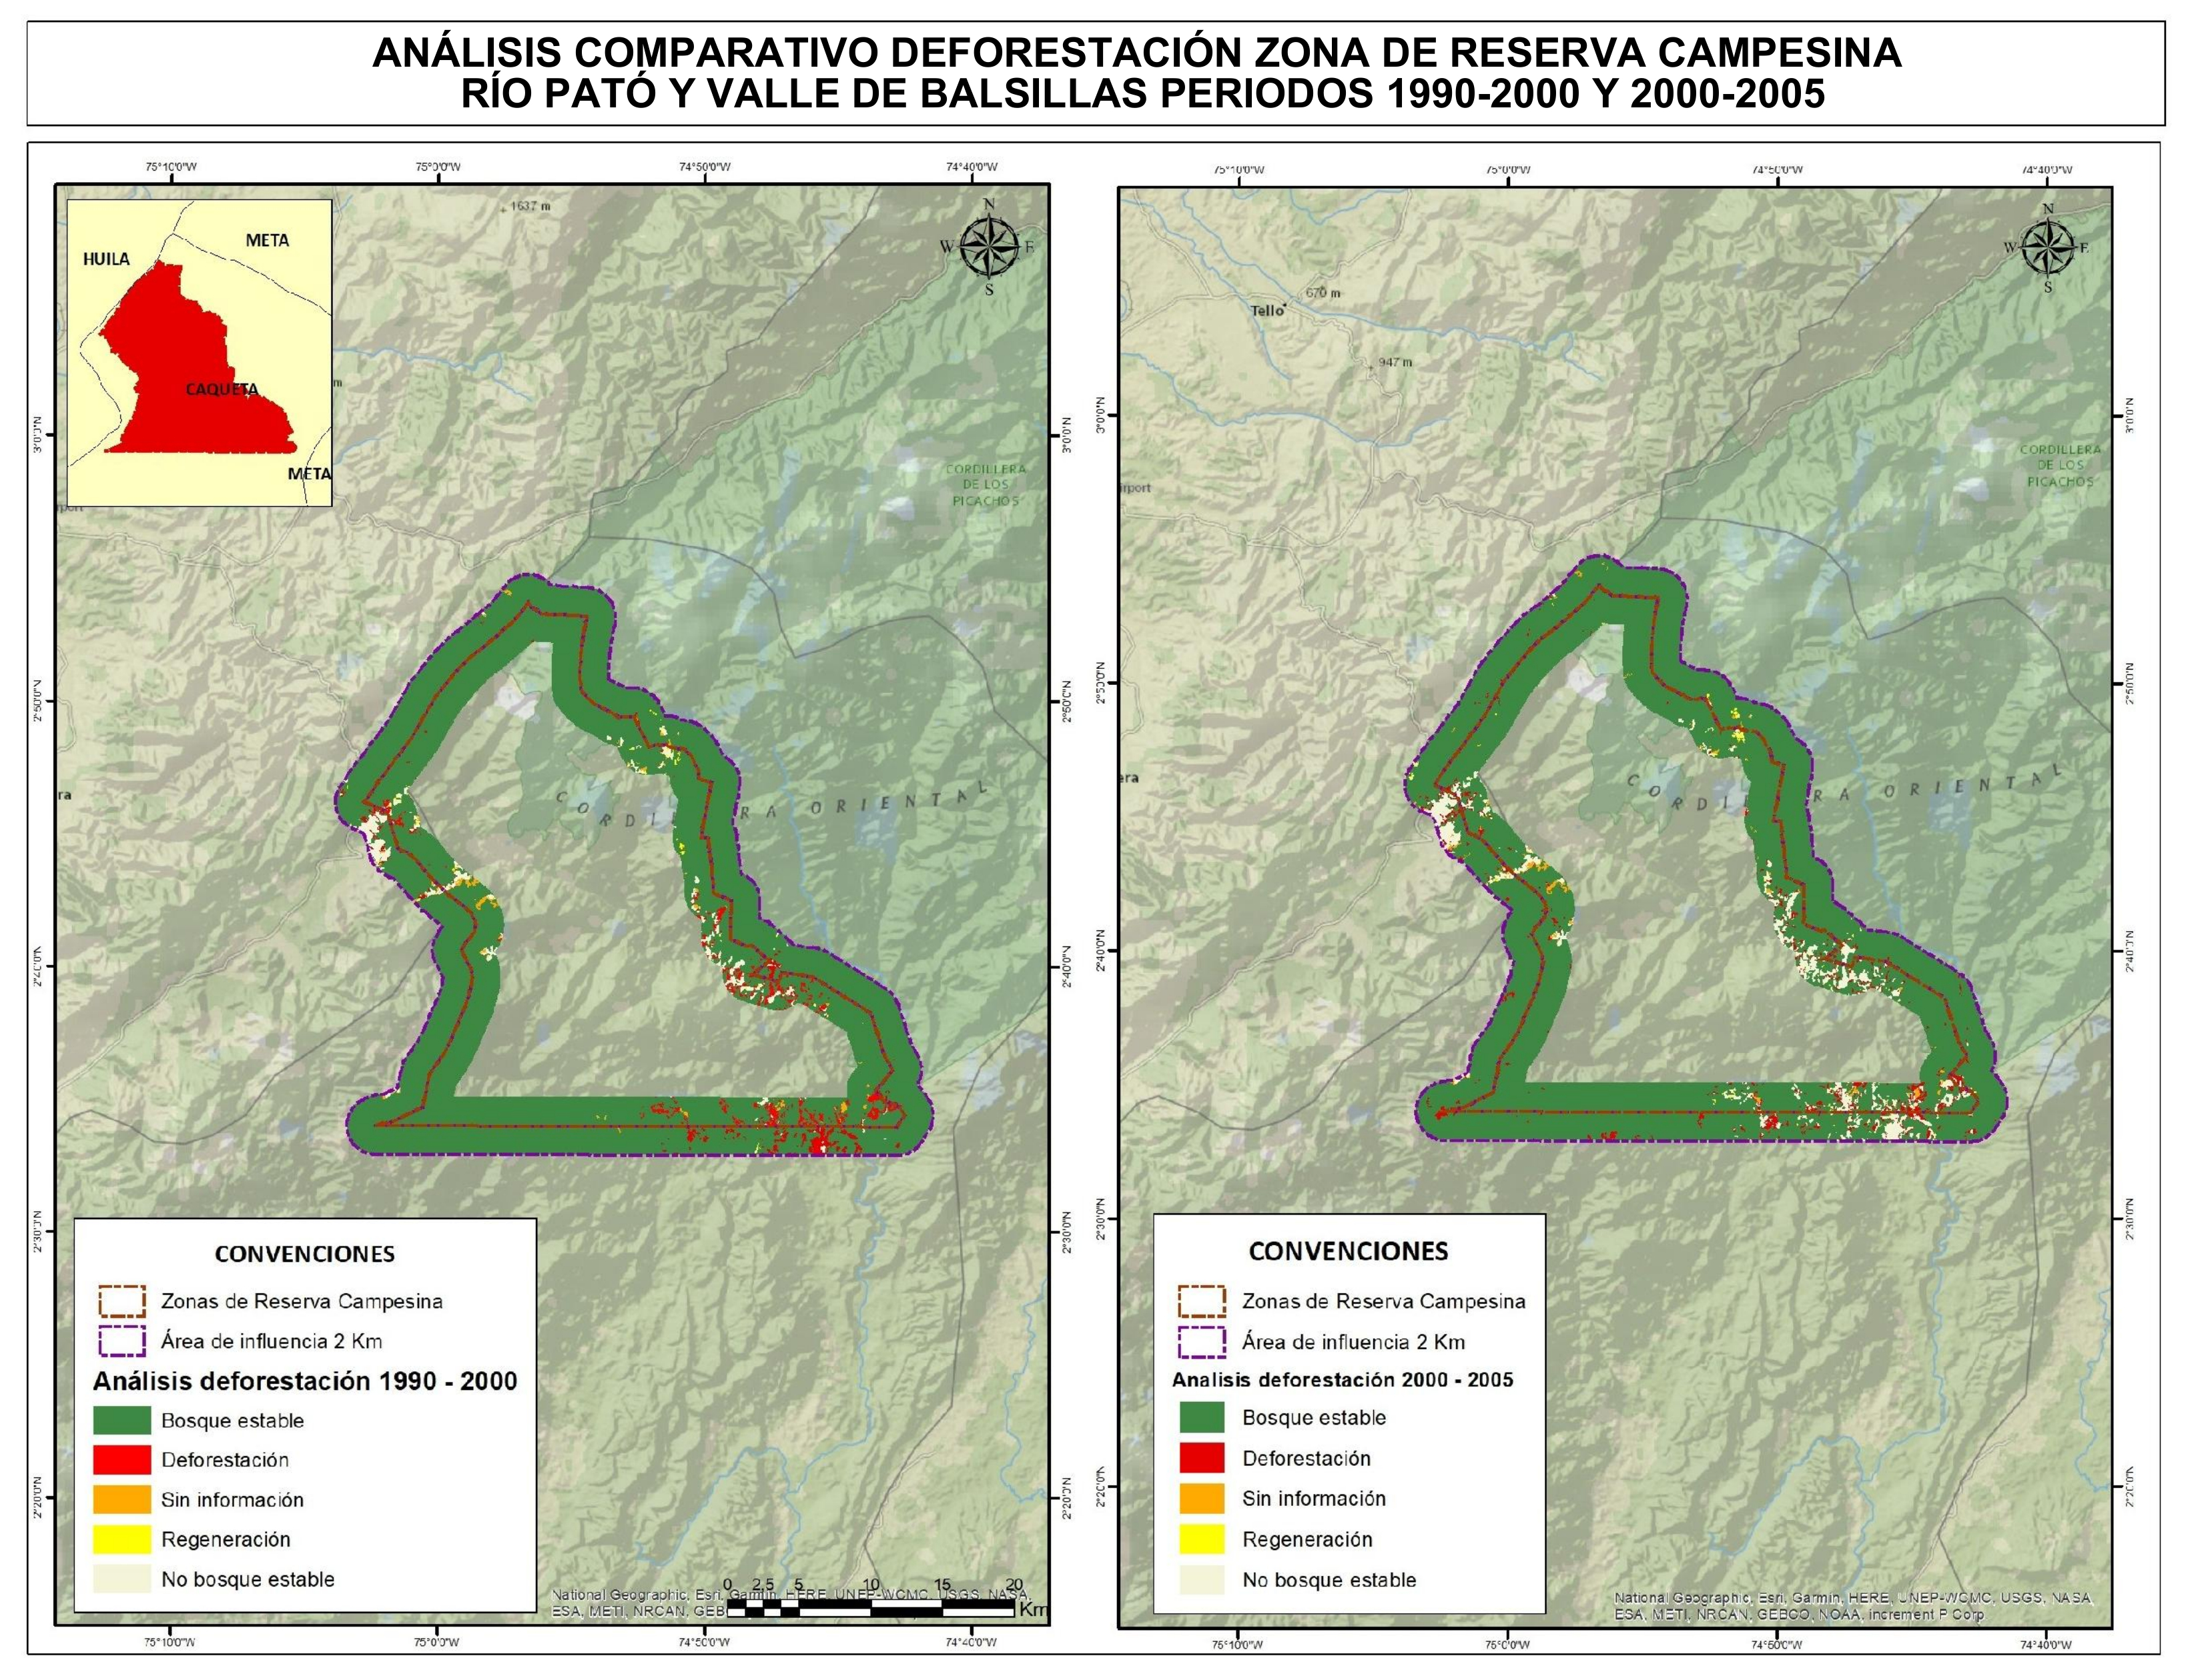
Data: - Pixels of 30 X 30mts with deforestation information - Pixels in a bandwidth of 2 and 5 km around the limit of the PRZ - Panel with information for three periods: 1990-2000 (pre, one observation) 2001-2005 (post, one observation) 2006-2010 (post, one observation)

Slide 17
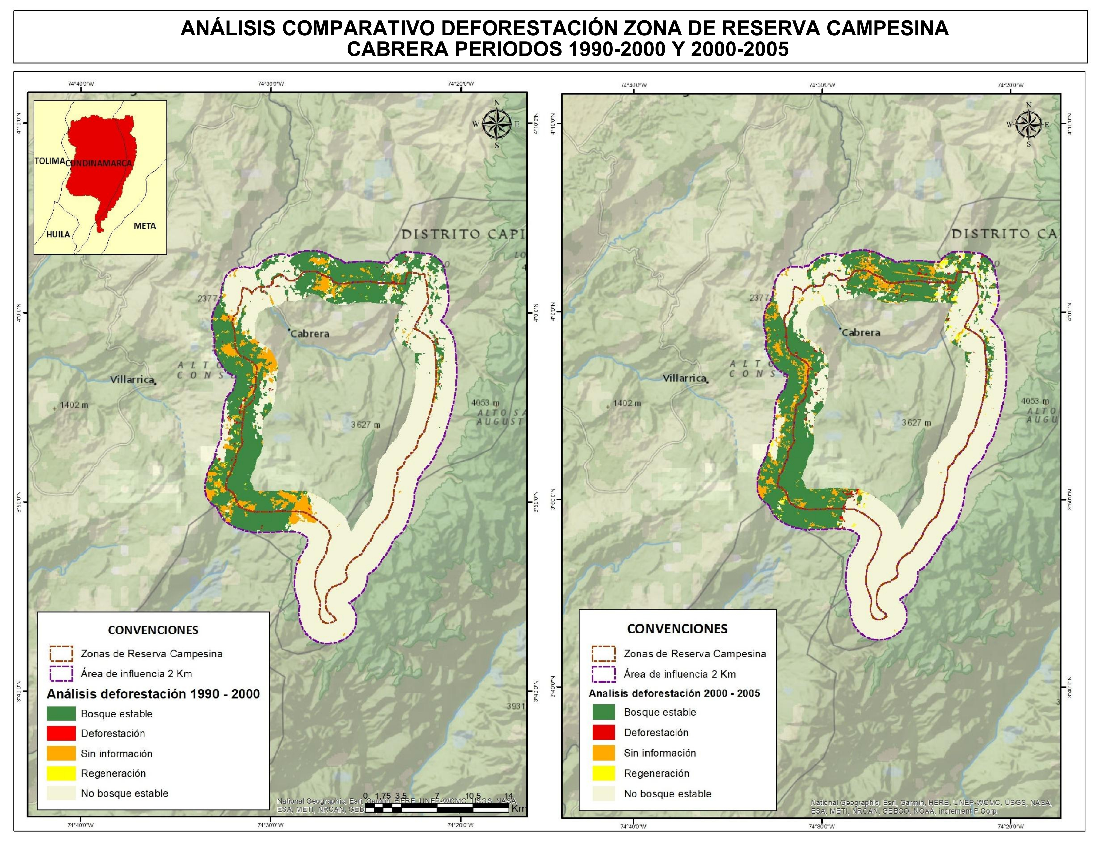

Slide 18
Panel de datos a partir de la interpretación de imágenes satelitales realizadas por el IDEAM con pixeles de resolución de 30 mts^{2.} 1990-2000 (pre) 2001-2005 (post), 2006-2009 2010 en adelante anual
Notes:
This is one PRZ and we have images of pre and post-treatment, we can see the pixels treated and the controls. Colored in red we can see the deforested pixels.

Slide 19
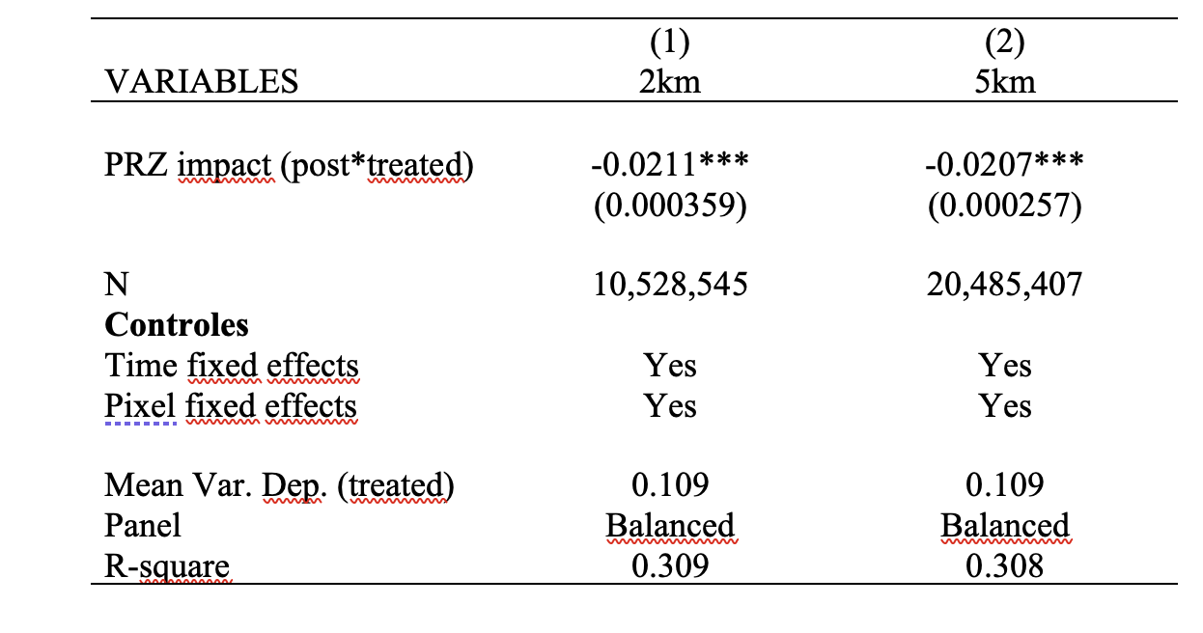
Results
Effect of the PRZ declaration on the probability of deforestation
Note: Ordinary least squares with robust standard errors clustered at the pixel level.
Source: IDEAM deforestation data 1990-2000 (pre), 2000-2005 and 2006-2010 (post). Pixel and time fixed effects included

Slide 20
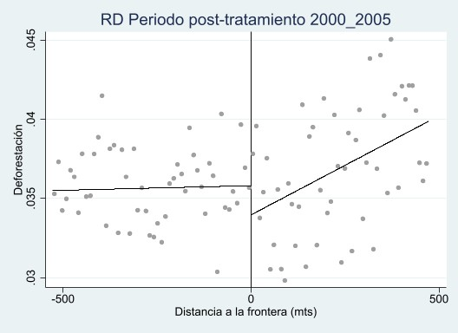
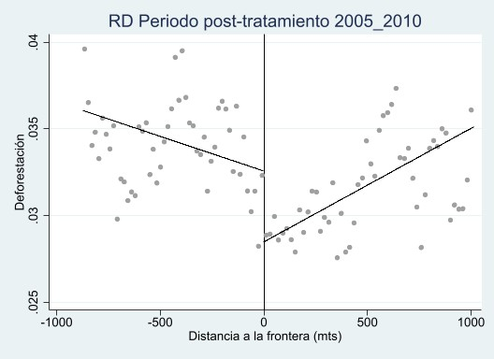
Regression discontinuity spatial design

Slide 21
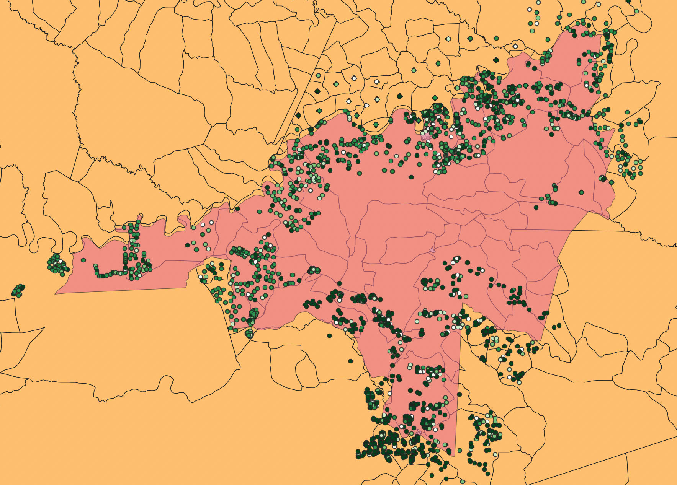
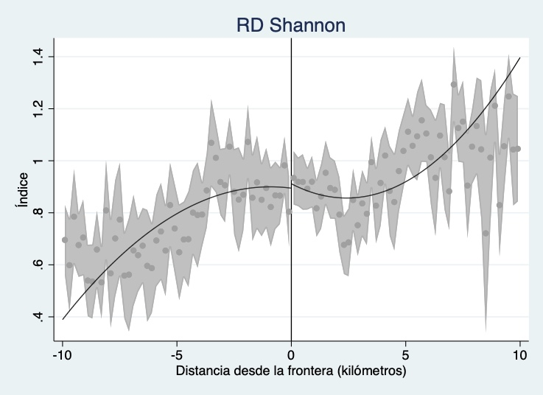
Exploring the mechanisms.
Agricultural National Census (2014)
Communal organization
16% of farmers inside de PRZ belong to a community organization vs 4% of farmers located outside.
Land inequality
Land gini inside de PRZ is 0.65 vs 0.73 outside.
Working on (other sustainability wealth index):
Shannon Index (diversity crops)
Example. PRZ Guaviare.

Slide 22
Conclusions
In the last years and after the peace agreement, the rural communities have demanded the declaration of 39 more PRZ, and the government has refusing them. In contrast, they have been promoting the economic reserve zones, which are places for agribusiness with no environmental commitments. It´s changing.
In Colombia, as in many countries, 70% of the agricultural production comes from small farmers. This model can contribute to more sustainable governance systems and improve food security.
This kind of arrangement can be a good model for places with a threat of deforestation and land grabbing due to agribusiness.

