Slide 1
Exploring Economics of Allocative Fairness Experimental Evidence from India
Rohit Jindal
Behavioral Ecological Economics Conference
July 2023

Slide 2
Fair?
Allocating football tickets (Kahneman 1986)
Auction
Lottery
Queue

Slide 3
Allocative Fairness
Allocation (Rawls 1971; Savage 2010)
Indivisible good in short supply
Focus on selection process
Fairness? (Rescher 2002)
No one gets
Everyone
gets
Some get
Who?
How?

Slide 4
Previously
Lottery (Broom 1990; Stone 2010)
Fair
Price/Market
Efficient
But (Kahneman 1986, Savage 2010)
Price to eliminate excess demand unfair
Lottery unfair

Slide 5
Research Qs?
Alternatives to Lottery/Price?
Survey, behavior?
Developing countries?
Environmental Economics?
Field (framed) experiment

Slide 6
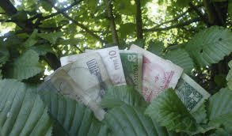
Environmental Context
Ecosystem Services
Benefits from nature: biodiversity, carbon sequestration
Payments for Ecosystem Services (PES)
Contracts to conserve nature
Conservation outcomes important
When demand for contracts >> supply
How to allocate?

Slide 7
Experimental Research in India
Rajasthan
Mainly rural
Agriculture
Environmental conservation

Slide 8
Experiment 1
Subjects randomly divided into 4 groups
In each group ~ 50% selected for leaf collection, based on treatment
Compensation: Rs100 (~$1.5 half-day’s wage), except auctions
If selected, receive payment and collect leaves
Outcome: Number of leaves collected

Slide 9
Allocation Mechanisms
Group deliberation (let people decide): Deliberation
Criteria (social usefulness; number of trees conserved): Criteria
---------------------------------------------------------------------------------------
3. Price (efficiency): Auctions
4. Random (treating people equally): Lottery

Slide 10
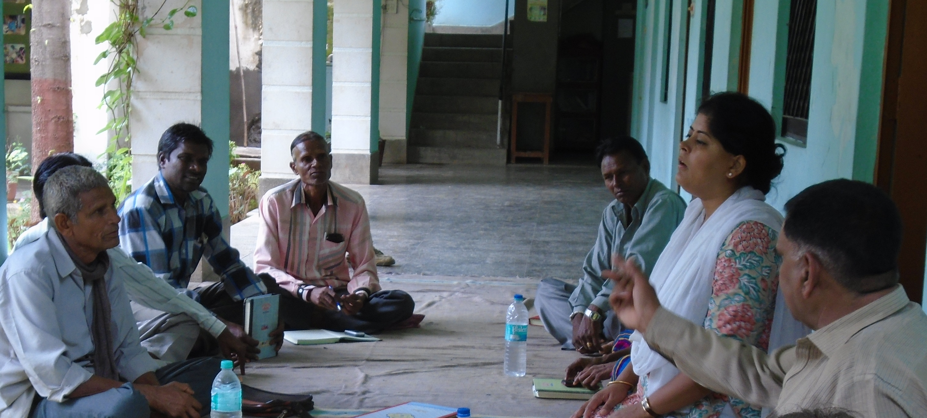
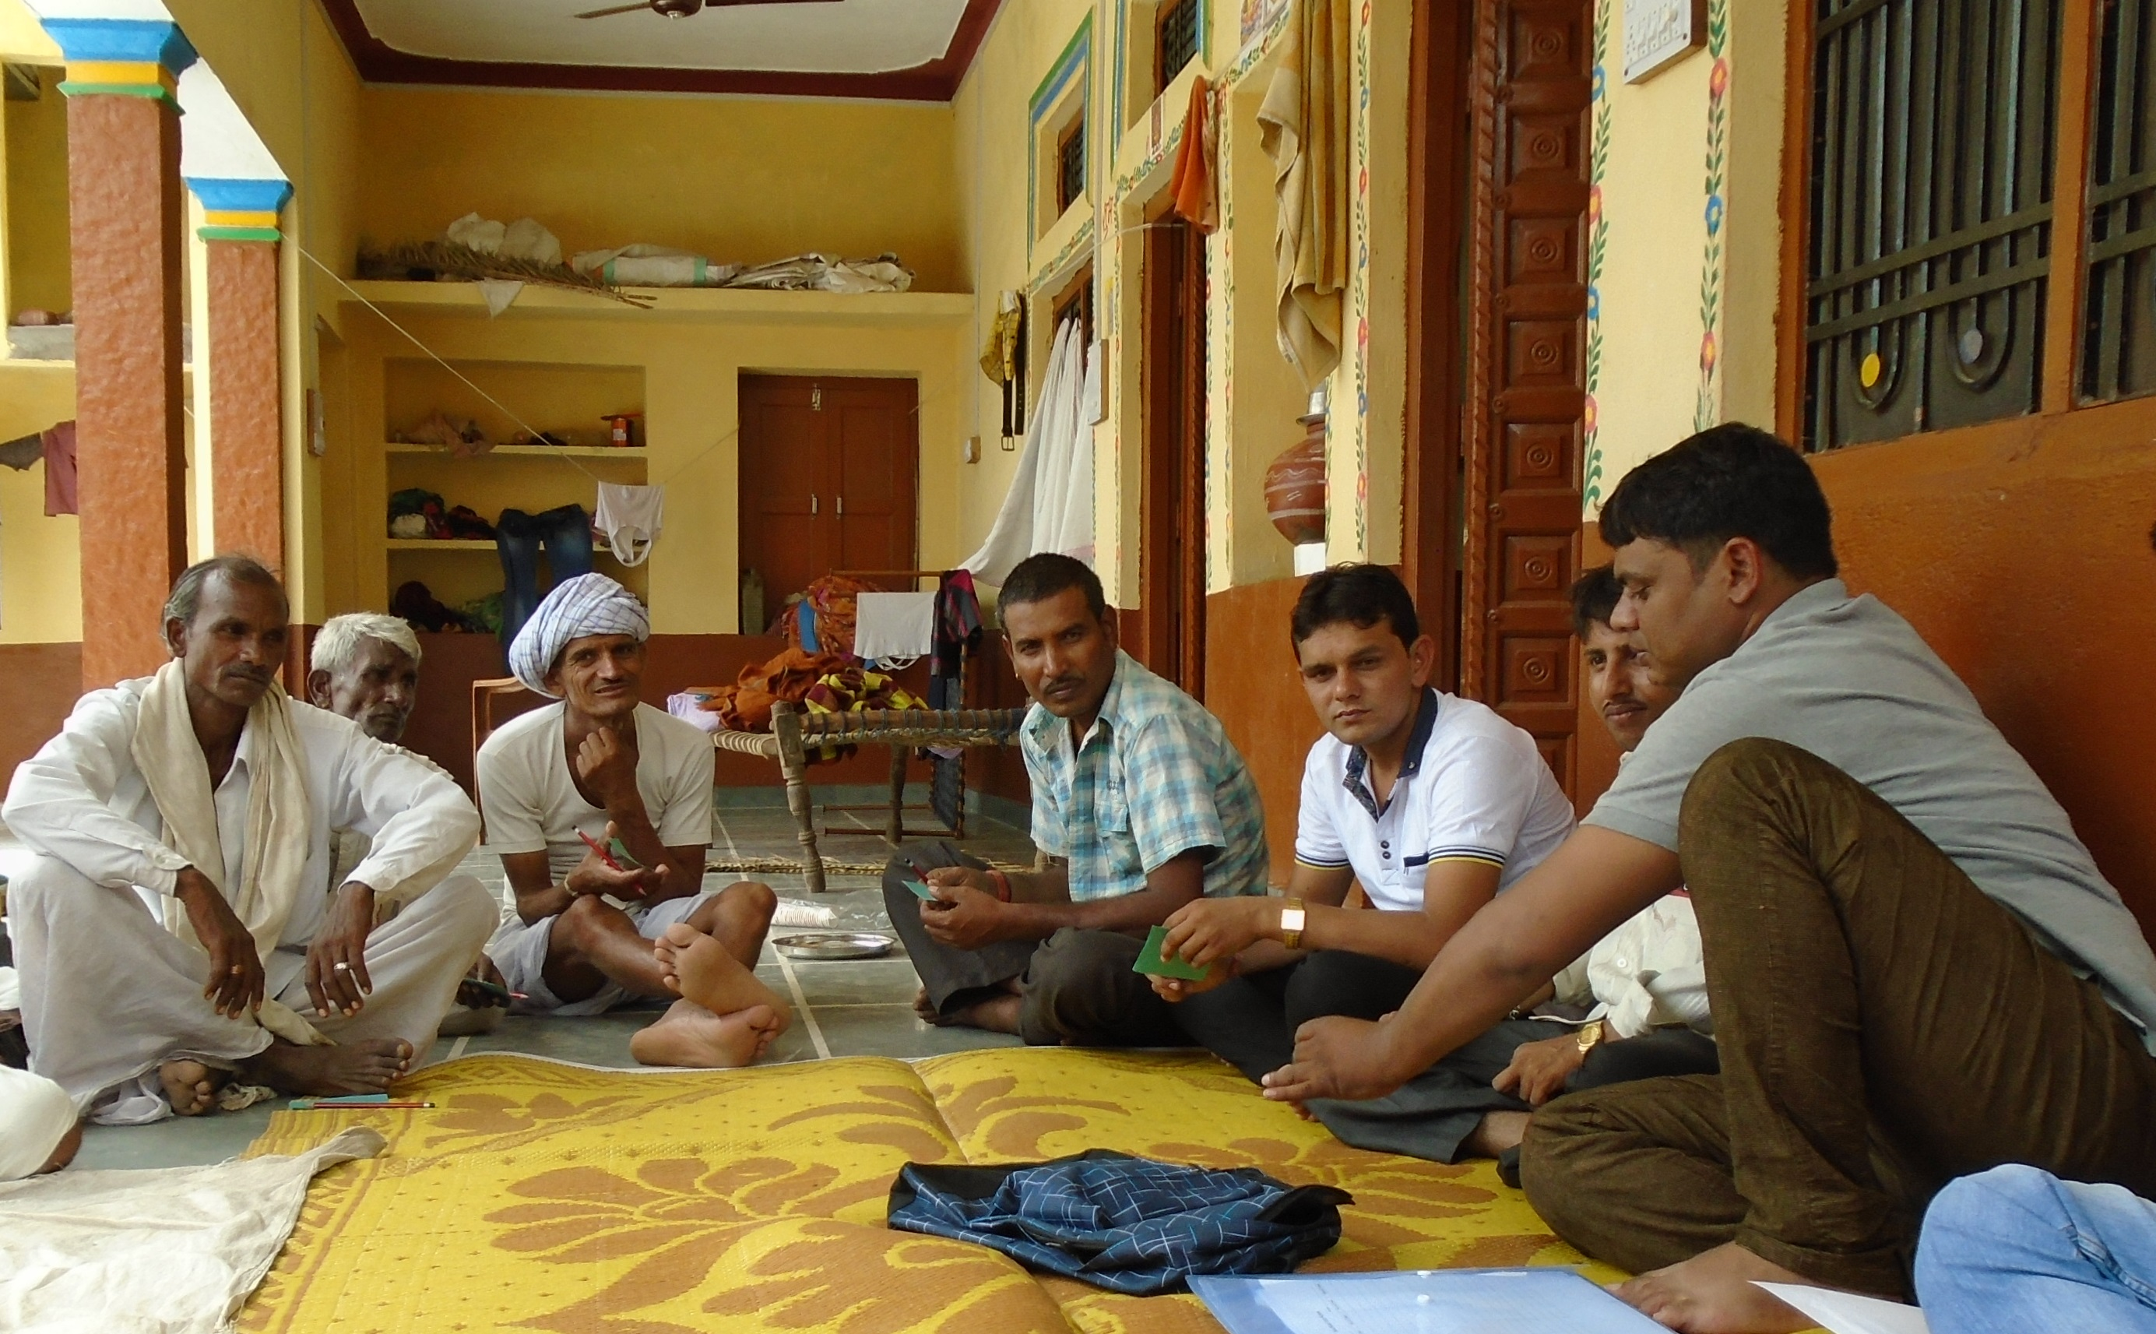
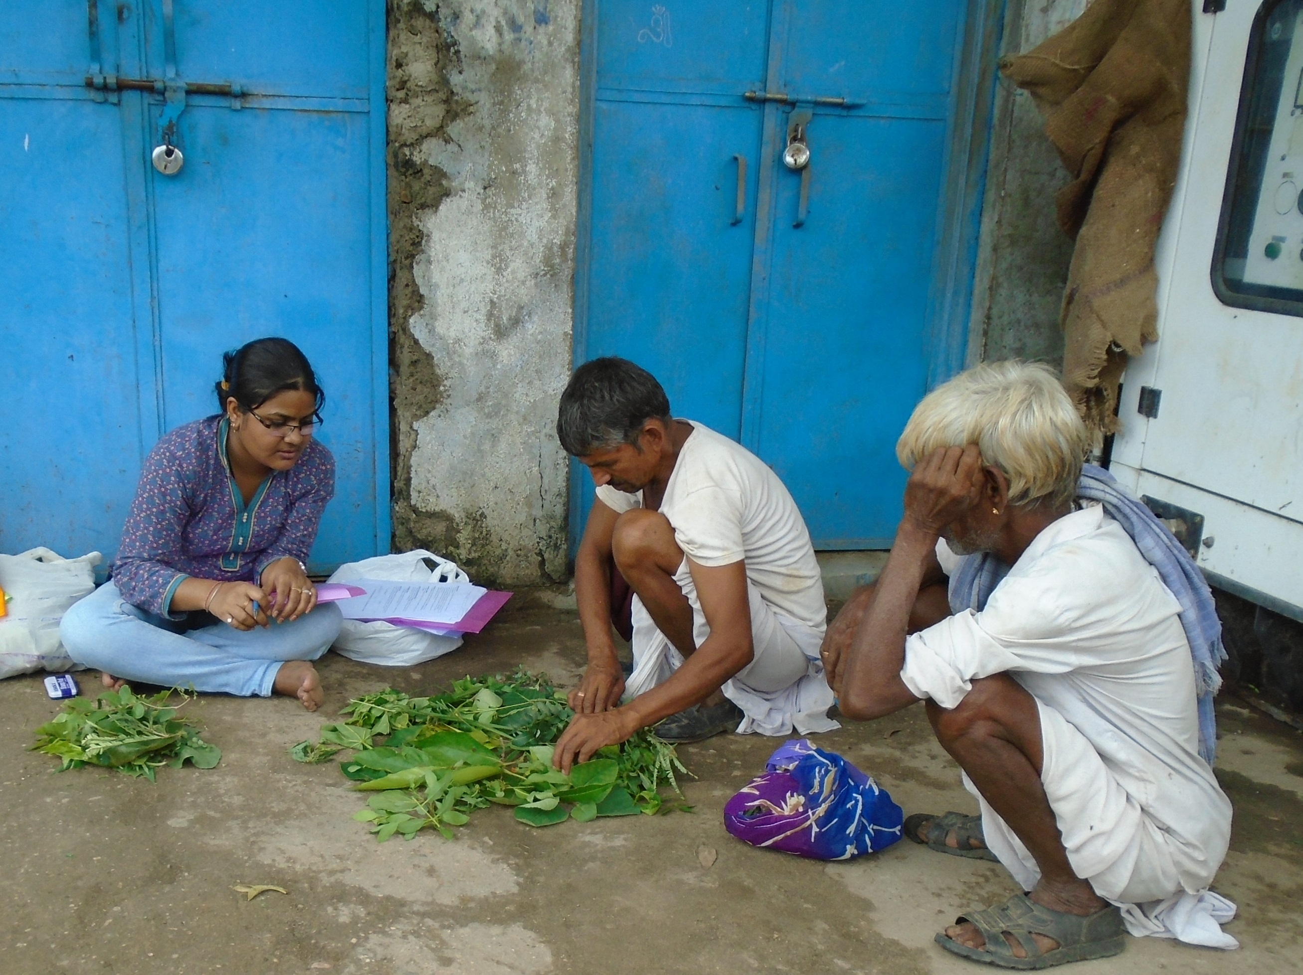

Slide 11
Treatments
Villages Replications | Allocation Mechanisms
 | Deliberation | Criteria | Lottery | Auction
Bambora 1 | 9 | 8 | 10 | 10
Hathida | 9 | 9 | 10 | 9
Rawatpura | 12 | 13 | 15 | 15
Bambora 2 | 9 | 10 | 9 | 8
Kelatalai | 12 | 11 | 10 | 11
Total | 51 | 51 | 54 | 53
Total
37
37
55
36
44
209

Slide 12
Descriptive Statistics
Variable | Mean | SE
Age | 41.5 | 14.64
Sex (Male =1) | 0.46 | 0.49
Education (literate =1) | 0.49 | 0.50
Livelihood (Wage labor =1) | 0.44 | 0.49
Sample size = 209

Slide 13
Leaf Collection Contracts
 | Deliberation* | Criteria* | Lottery* | Auction**
Total participants | 51 | 51 | 54 | 53
Number of contracts | 24 | 23 | 24 | 23
% awarded | 47% | 45% | 44% | 44%
Total
209
94
45%
* Each contract was awarded at Rs100/contract
**Contracted price depended on bids.

Slide 14
Variables | OLS Y = Selected for Contract (1/0) | OLS Y = Number of Leaves Collected | Heckman two-stage
Intercept | 0.44 (0.33) | 36.7** (12.9) | 27.6 (28.87)
Villages (Ref Bambora1) Bambora 2 | -0.08 (0.12) | -2.9 (4.34) | -3.4 (6.86)
Hathida | -0.06 (0.12) | 4.3 (3.9) | 4.06 (5.27)
Kelatalai | 0.03 (0.12) | 4.5 (3.9) | 3.3 (4.37)
Rawatpura | 0.04 (0.11) | 2.1 (3.6) | 2.9 (4.00)
Treatments (Ref Auction) Criteria = 1 | 0.03 (0.09) | 13.3** (3.3) | 12.2** (4.02)
Deliberation = 1 | 0.04 (0.10) | 8.6** (3.4) | 8.6* (4.79)
Lottery = 1 | -0.01 (0.09) | 1.04 (3.4) | -0.5 (3.69)
Age | 0.007 (0.02) | -1.1* (0.62) | -0.8 (0.88)
Age square | -0.00 (0.001) | 0.01* ((0.01) | 0.007 (0.01)
Male = 1 | 0.11 (0.08) | -0.67 (2.67) | 3.2 (5.9)
Literate = 1 | -0.02 (0.09) | -0.65 (2.93) | -2.4 (3.5)
Wage Labor =1 | 0.08 (0.08) | - | 0.21
Obs | 206 | 90 | 206
Prob > F; Prob > Chi sq | 0.09 | 0.01 | 0.03
Lambda (Heckman) | - |  | 0.97 (24.9)
** 5% Significant
* 10% Significant
(Standard errors)

Slide 15
Main Result
Criteria
Deliberation
Auction
Lottery

Slide 16
Implication
Implication
Allocation mechanisms can change behavior
Lottery/Auction significantly lower than Criteria/Deliberation
(Kahneman 1986, Savage 2010)
Fairness?
Experiment 2 (quasi-experiment)

Slide 17
Experiment 2: confirm ordering
Respondents
Hypothetical scenarios
6 Pair-wise comparisons/respondent
 | Deliberation | Criteria | Lottery | Auction
Deliberation
Criteria
Lottery
Auction

Slide 18
Descriptive Statistics
Variable | Mean | SE
Age | 43.9 | 14.26
Sex (Male =1) | 0.67 | 0.47
Education (literate =1) | 0.69 | 0.46
Livelihood (Wage labor =1) | 0.38 | 0.49
Sample size = 135

Slide 19
Fairness Ordering
Borda Counts
Transitive comparisons (94.5% consistent)
Significant variation F_{critical} = 2.62
p-value < 0.0001
Criteria
Deliberation
Auction
Lottery

Slide 20
Experiment 1: Framed Field Expt
Experiment 2: Quasi Experiment
Criteria
Deliberation
Auction
Lottery
Criteria
Deliberation
Auction
Lottery

Slide 21
Allocation Mechanisms
Fairness matters – Previously
Effect on behavior – NEW RESULT

Slide 22
Additional Results

Slide 23
ES Supply Curve through auctions
Village | Winning bid (Rs) | # of contracts
Bambora 1 | 50 | 5
Hathida | 50 | 4
Rawatpura | 100 | 7
Bambora 2 | 50 | 2
Kelatalai | 30 | 5
Total |  | 23

Slide 24
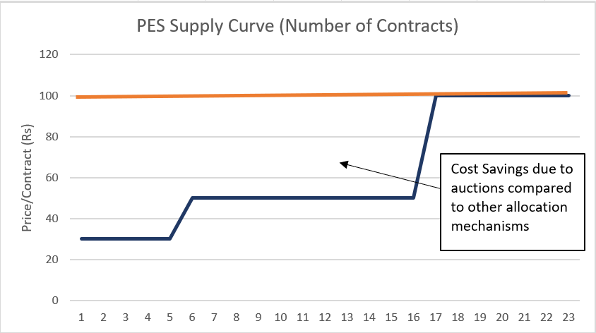
Auctions Efficient Number of Contracts

Slide 25
Auctions NOT Efficient Conservation Outcomes (# of leaves)
Auction
Criteria

Slide 26
Implications
Fairness matters (strong support)
Deliberation/Criteria most fair
Auctions/Lottery least fair (replication of result)
Auctions not necessarily efficient
Effect on behavior (weak support)
Behavior changes: fairness of allocation mechanism

Slide 27
Thanks!
Questions?

