Slide 1
Nudging recycling behaviour through feedback and social norms
Federica Stablum
University of Trento
Behavioural Ecological Economics University of Florence
10-11 July 2023

Slide 2
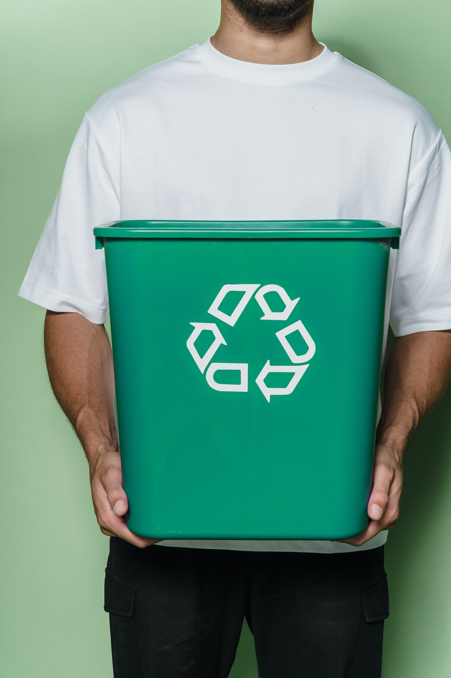
Outline
Introduction
Network and context
Methodology
Needs analysis
First Intervention
Second Intervention
What is next?

Slide 3
Introduction
72% of waste is recycled in Italy – Best country in the EU (Il riciclo in Italia, 2022)
Heterogeneity in regions, areas, and systems
Motivation Opportunity Ability (MOA) influences recycling behaviour (Ölander & Thøgersen, 1995)
M: cost/benefit, attitudes and preferences, values, identity, norms
O: availability and convenience of infrastructure, policies
A: Knowledge and skills, habits, past behaviour, perceived behavioural control
Develop policies + support behaviours (see Cristobal Garcia et al., 2022, for a review)

Slide 4
Introduction (2)
Recycling as pro-environmental behaviour (PEB)
High effort (daily) but quite low impact (compared to other PEBs)
Feedback and norms have been effective in improving/increasing recycling (see De Leon & Fuqua, 1995; Dupré & Meineri, 2016; Schultz, 1999)
Increasing when low adherence + improving when low quality
Crucial that recycling is HIGH quality to support circularity of materials

Slide 5
Network and Context

Slide 6
Methodology
1
NEEDS ANALYSIS
Engage stakeholders and citizenship
Survey to investigate psychological and contextual barriers
FIELD INTERVENTION
Based on nudging principles
Informed by the needs analysis
2

Slide 7
Needs analysis
Survey open to all citizens of Latina (municipality) accessible via Junker
Psychological: information, effort, norms, beliefs, PBC, behaviour
Contextual: frequency, problems, barriers, possible solutions
N = 717 (93% from kerbside WCS)
M_{age} = 52 years; 53% women; 18% retired

Slide 8
Needs analysis: insights
Positive beliefs and attitudes towards environmental issues and separate waste collection
Recycling is positive behaviour and in line with their values
Multiple contextual barriers – lack of Opportunity (from MOA framework)
Collection calendar, communication, home management of containers, surveillance, and feedback on the quality of waste
Implementation of feedback to improve sorting and inform citizens

Slide 9
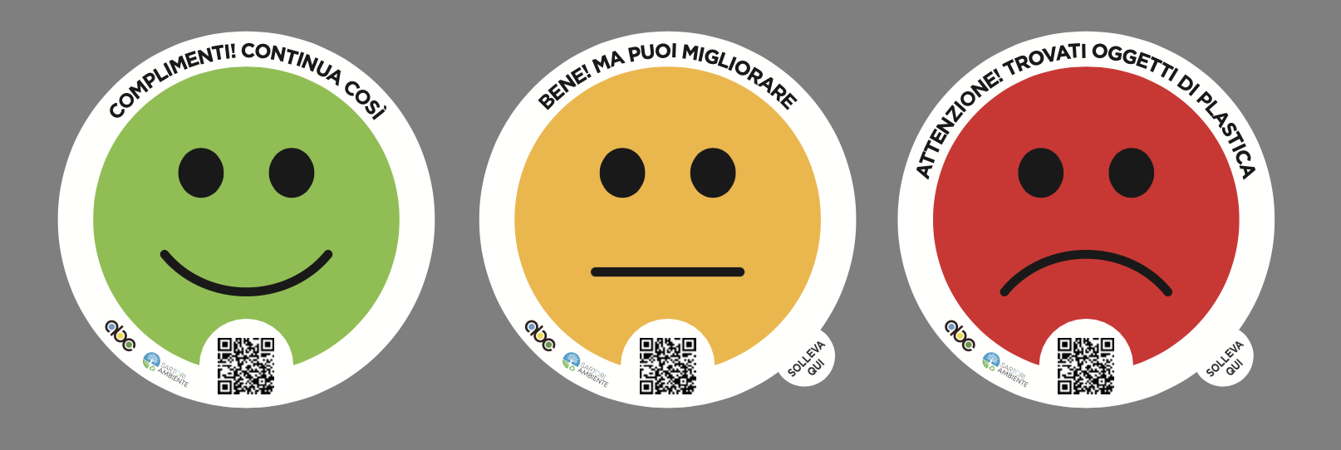
First Intervention
Feedback on quality of plastic (packaging) and food waste
Variable interval reinforcement
~ 250 households in Latina (Lazio)
Homogenous population: flat complex, mostly families, average income
Measures:
# of stickers (+ type)
Waste analysis

Slide 10
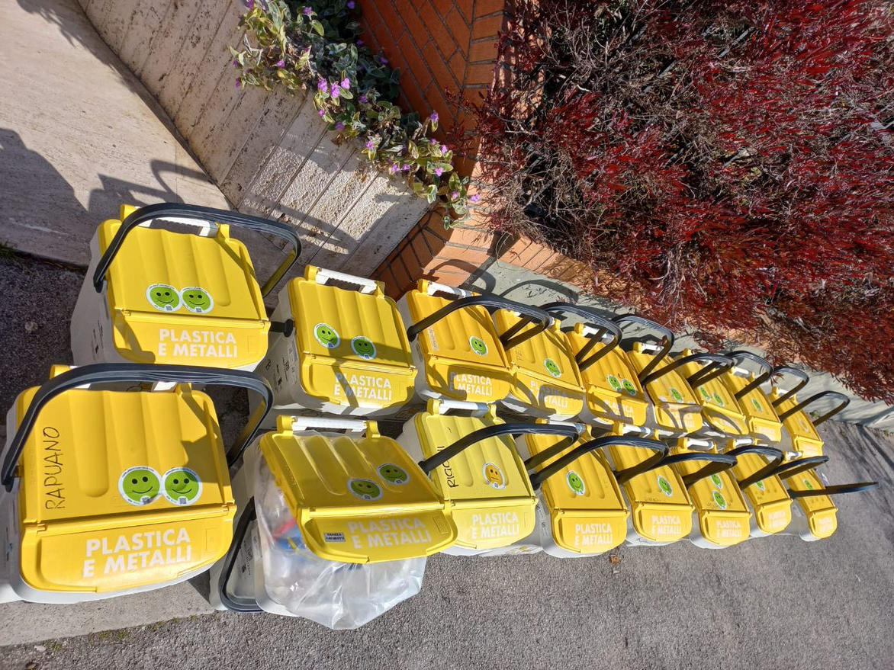
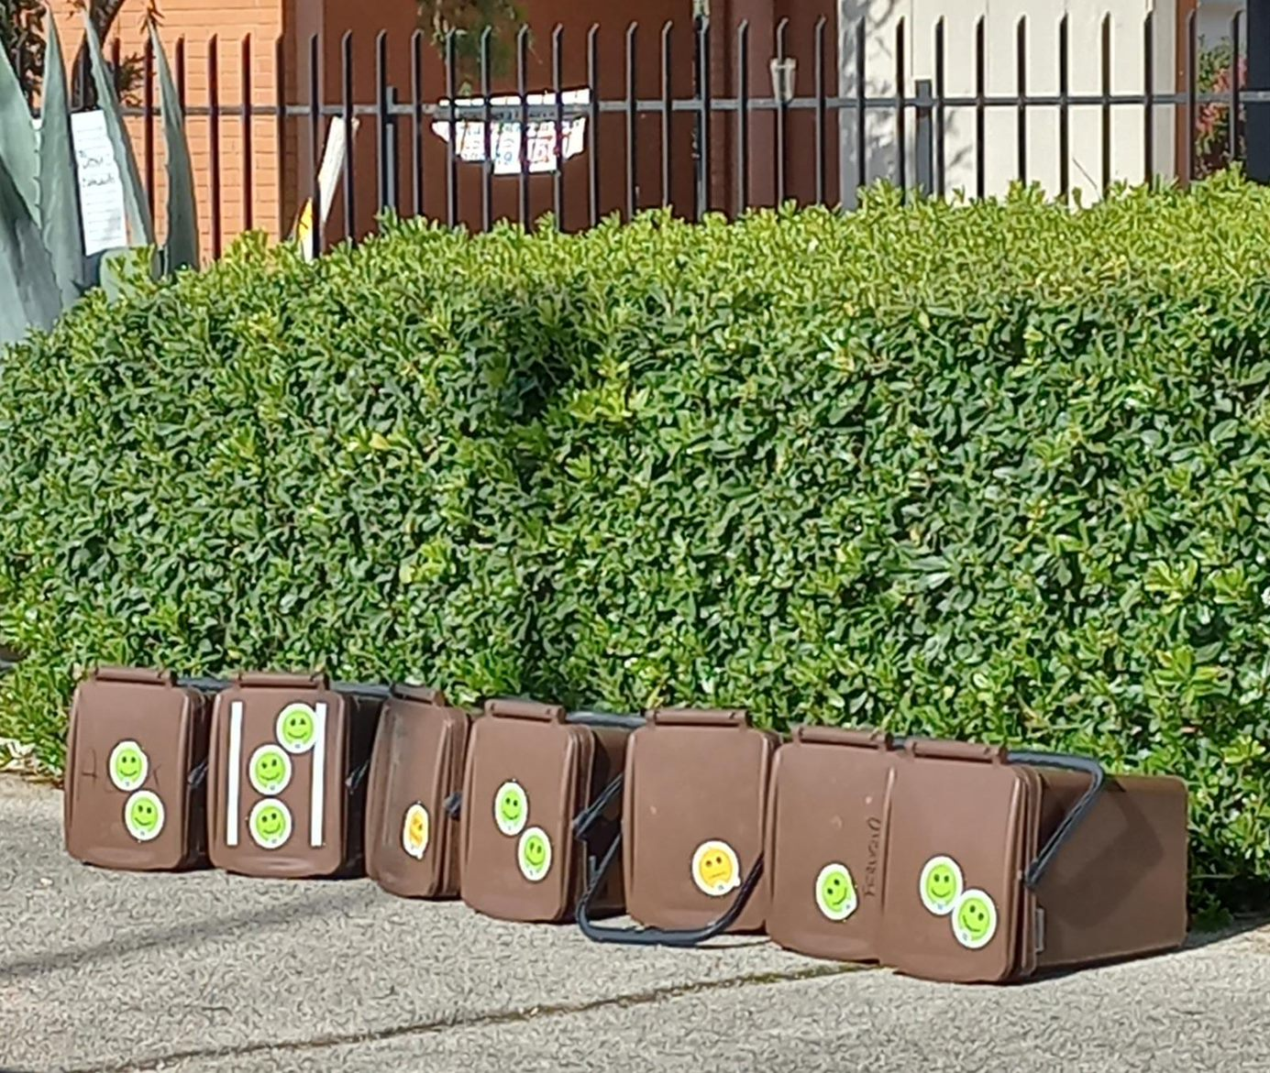

Slide 11
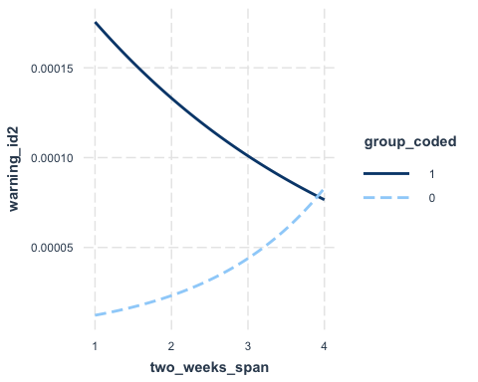
First Intervention: results
Total: 1396 feedback given, 92% green
Negative feedback was significantly higher in EG compared to CG, X² (1, N = 1396) = 10.62, p = .001
Plastic received significantly more negative feedback compared to food waste, X² (1, N = 1396) = 10.33, p = .001
EG appears to worsen while CG improves over the course of the intervention

Slide 12
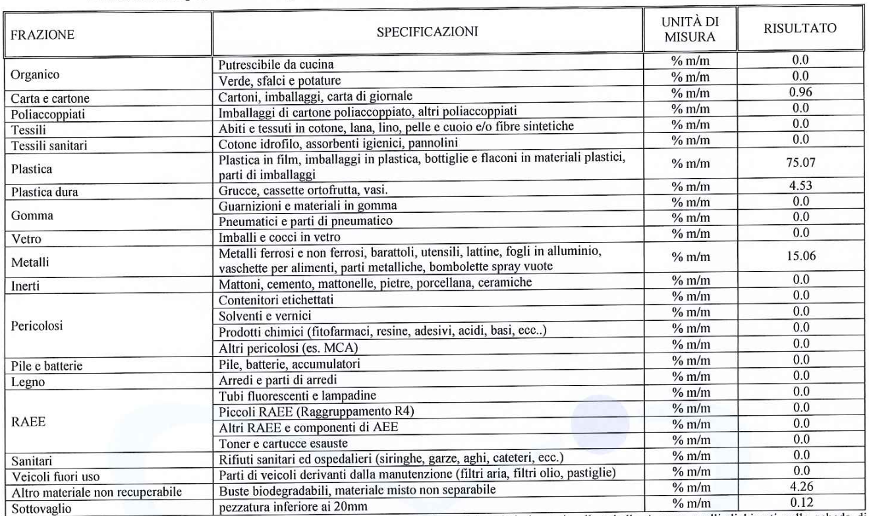
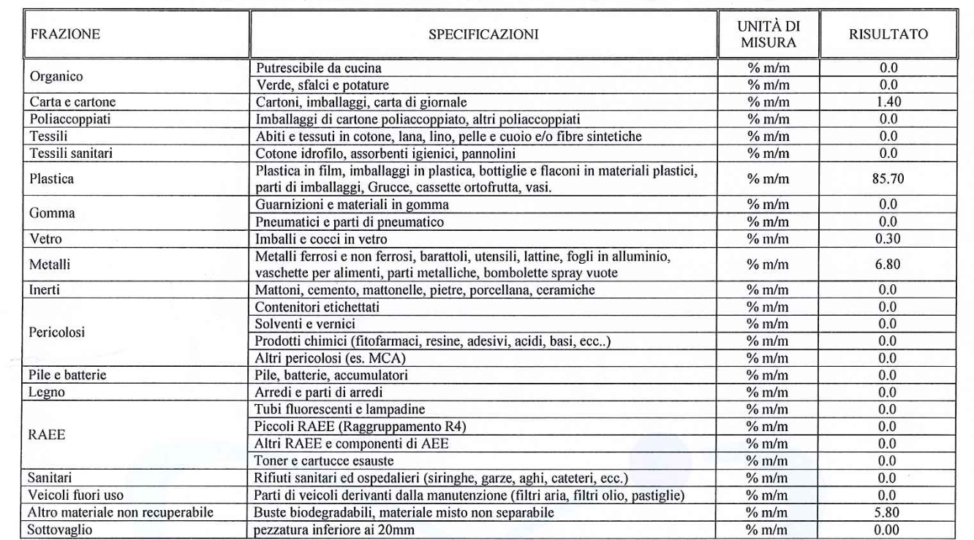
Q5 (CG) before and after intervention PLASTIC waste analysis
From ~ 90 % to 92.5% correctly sorted waste

Slide 13
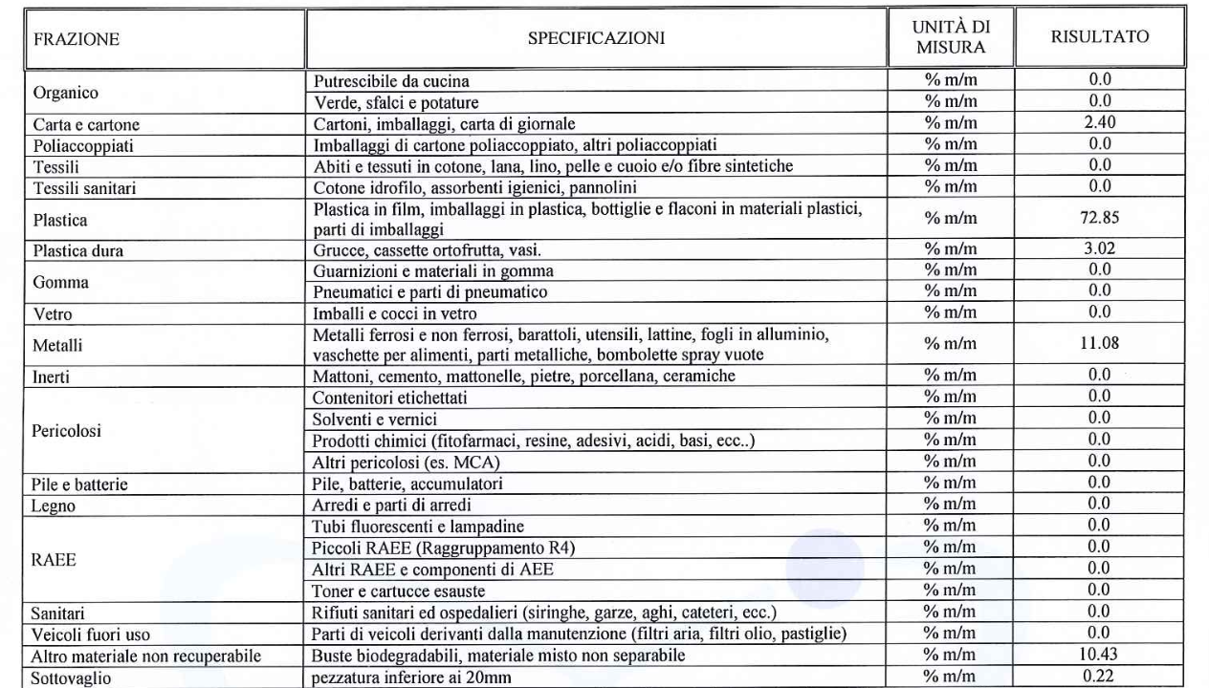
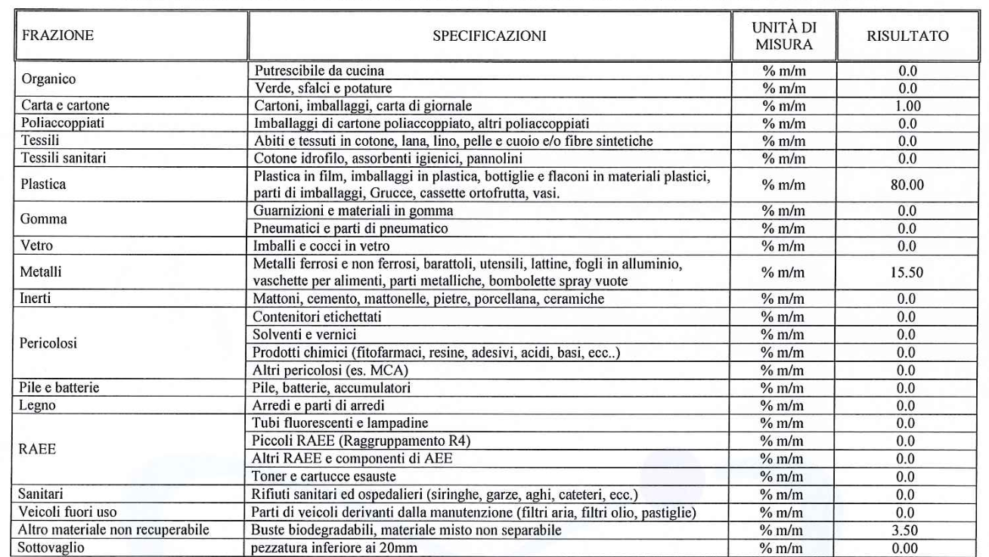
Q4 (EG) before and after intervention PLASTIC waste analysis
From ~ 84 % to 95.5% correctly sorted waste

Slide 14
First Intervention : insights
Improvement in EG after intervention
Many in EG started showing the mistake of exposure without container, maybe because they felt watched or under scrutiny
Performance was already above average in the area
Positive feedback increased exposure but not necessarily positive
… so what now?

Slide 15
Second Intervention
Focus on a worse performing fraction
Feedback on quality AND quantity of mixed waste
Continuous reinforcement
~ 250 households in Latina (Lazio)
Control and Exp Groups swapped from first intervention

Slide 16
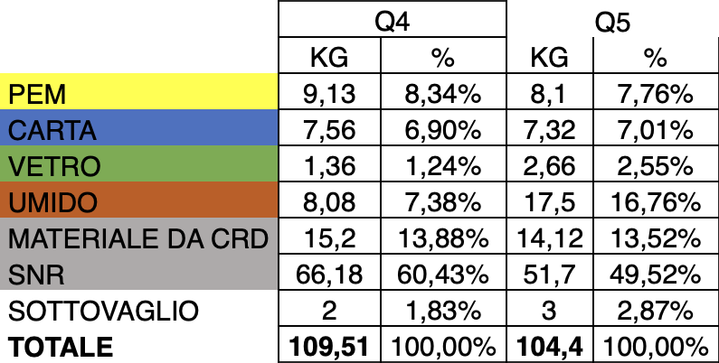
Second Intervention
AIM to improve quality and lower exposure rate
It is more efficient (and sustainable) to only collect full bins

Slide 17
Second Intervention: preliminary results
Still ongoing but seems more promising
454 stickers given of which 51% green, 35% yellow, 14% red
Variety in exposure rates and waste found (textiles, plastic, animal litter)
Many citizens use door-to-door collection at every opportunity they have, taking out bins when they are not full

Slide 18
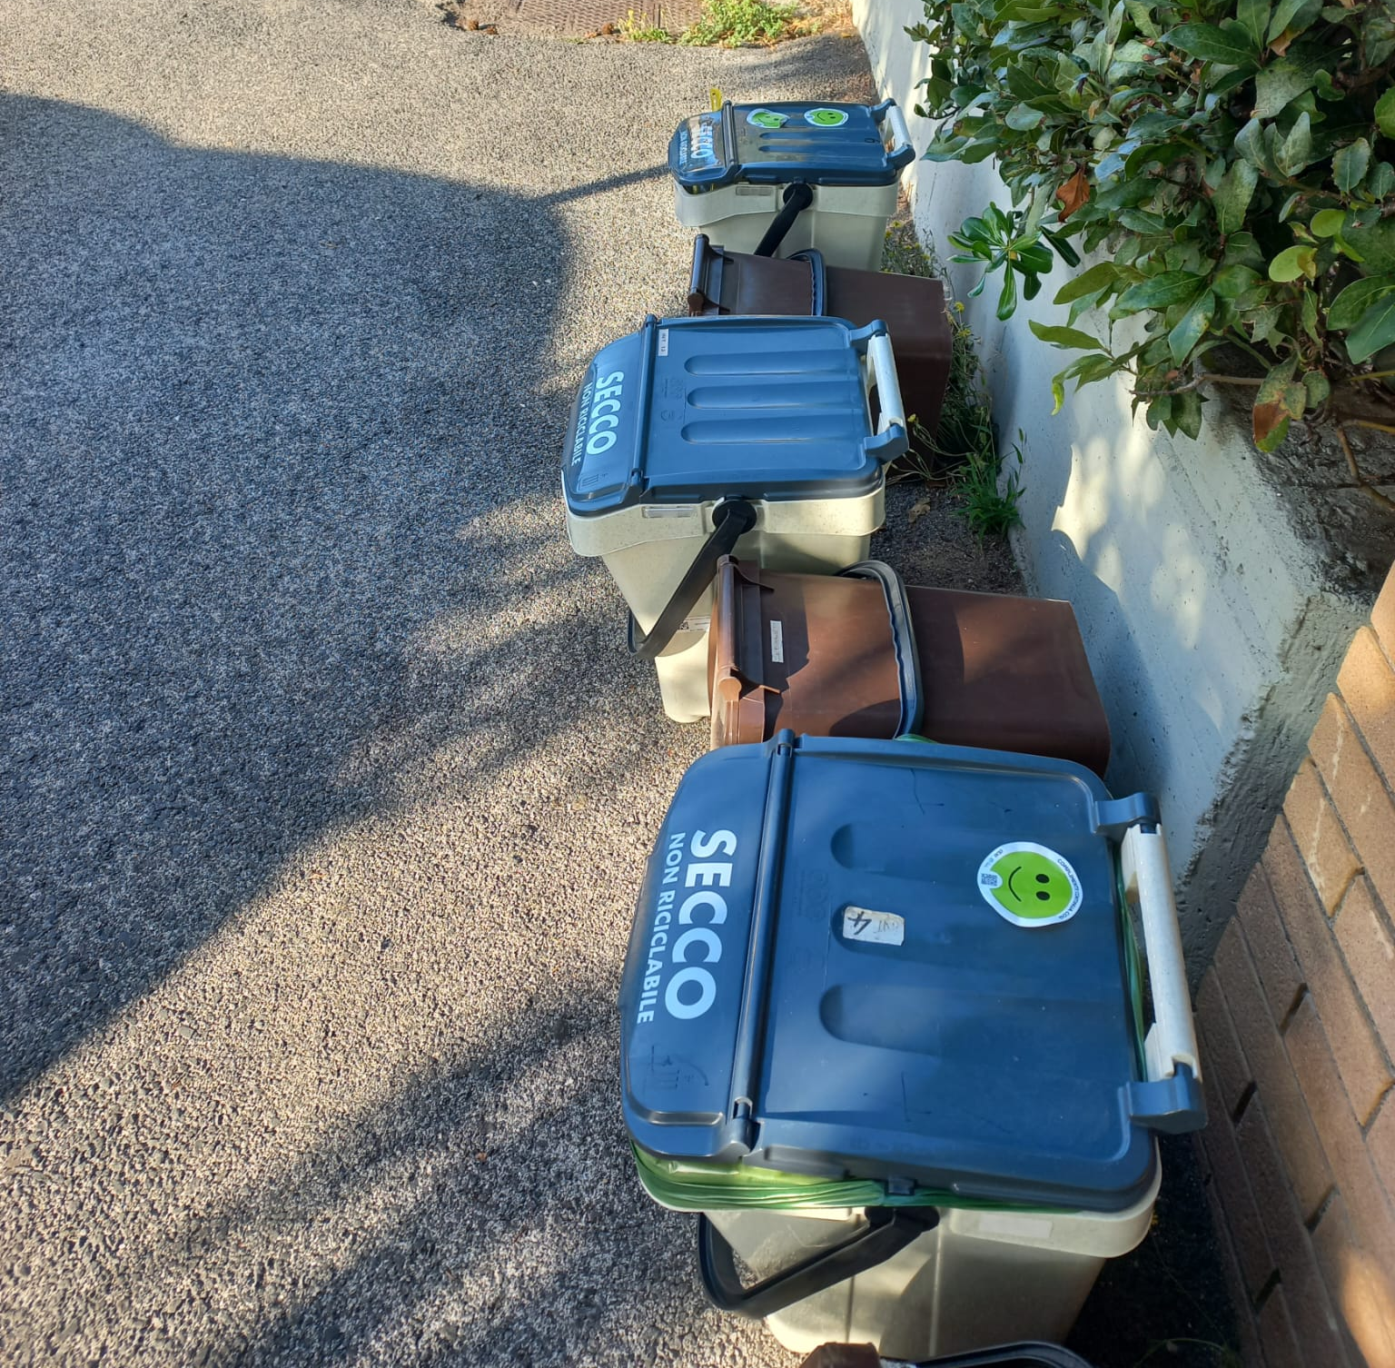
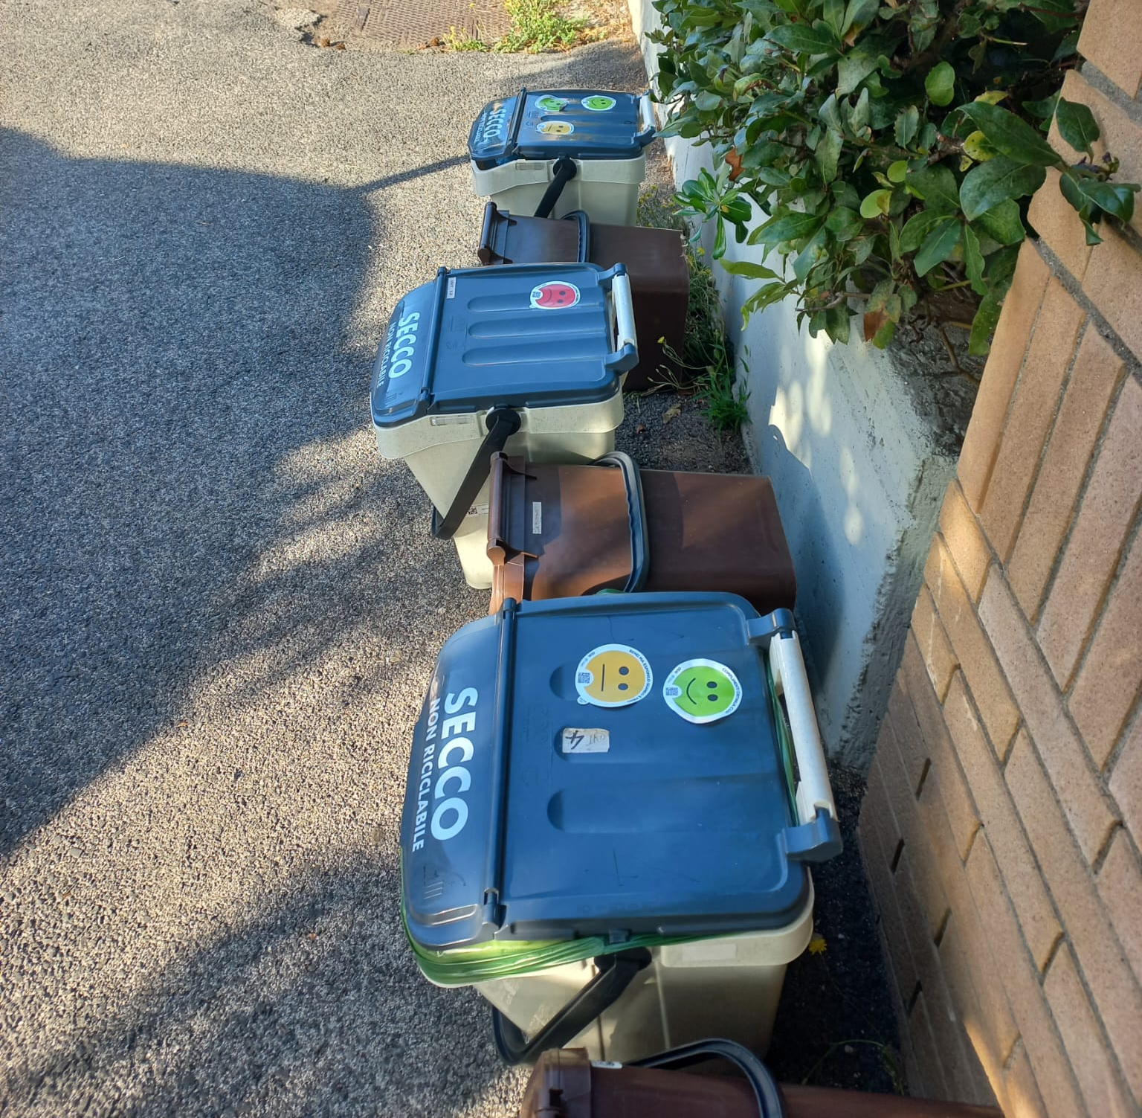

Slide 19
Discussion
Tentative claim that the first intervention had a positive impact
More challenging but more opportunities to be impactful
Important to engage the population that will participate
Chance to provide evidence for companies to improve
Find missed opportunities (e.g. lack of communication) to address

Slide 20
References
De Leon, I. G., & Fuqua, R. W. (1995). The effects of public commitment and group feedback on curbside recycling. Environment and behavior, 27(2), 233-250.
Dupré, M., & Meineri, S. (2016). Increasing recycling through displaying feedback and social comparative feedback. Journal of Environmental Psychology, 48, 101-107.
Fondazione per lo sviluppo sostenibile, Rapporto annuale: Il riciclo in Italia, 2022. https://www.ricicloinitalia.it/wp-content/uploads/2022/12/Il-Riciclo-in-Italia-2022.pdf )
Ölander, F., & Thøgersen, J. (1995). Understanding of consumer behaviour as a prerequisite for environmental protection. Journal of consumer policy, 18, 345-385.
Schultz, P. W. (1999). Changing behavior with normative feedback interventions: A field experiment on curbside recycling. Basic and applied social psychology, 21(1), 25-36.
Cristobal Garcia, J., Pierri, E., Antonopoulos, I., Bruns, H., Foster, G. and Gaudillat, P., Separate collection of municipal waste: citizens’ involvement and behavioural aspects, EUR 31310 EN, Publications Office of the European Union, Luxembourg, 2022, ISBN 978-92-76-59008-8, doi:10.2760/665482, JRC131042.

Slide 21
Thank you for the attention! Any questions?
Reach me at federica.stablum@unitn.it
Behavioural Ecological Economics University of Florence
10-11 July 2023

