Slide 1
Environmental traffic-lighting: The twin effects of ecolabels on between-CATEGORY and WITHIN-PRODUCT SUBSTITUTION for food purchases.
Sebastian Lyons;
New College, University of Oxford.
Notes:
Disclaimer: this is a working paper. It presents a framework to measure the effect of ecolabels on purchase decisions. Experimental data will be collected in the comings months.

Slide 2
Contents
Introduction
Method
Sequential Purchase Model
Simultaneous Purchase Model
Summary
Notes:
Plan for this talk!

Slide 3
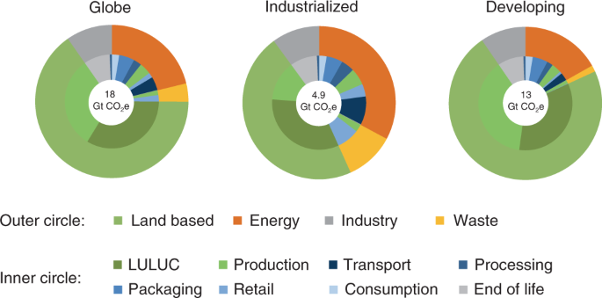
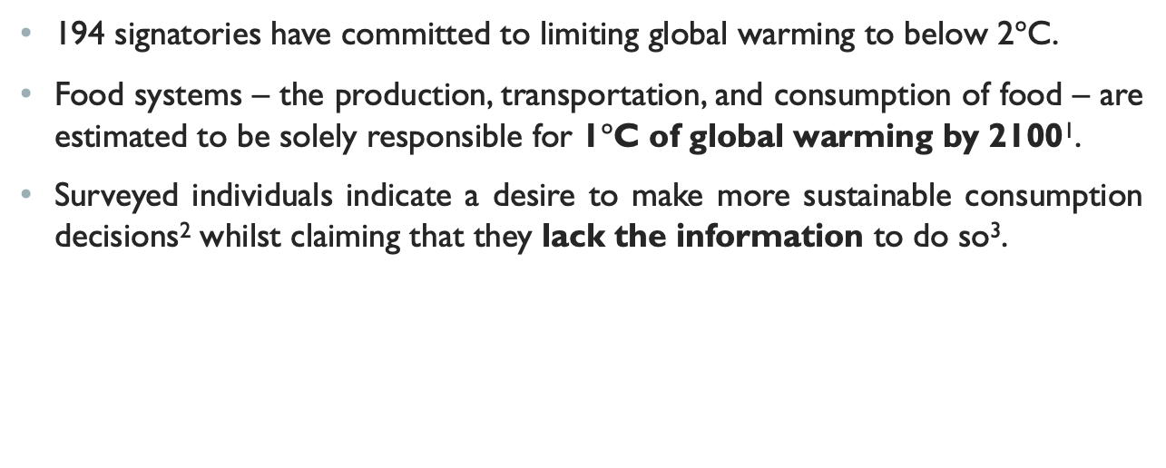
FOOD CONSUMPTION AND THE Environment
194 signatories have committed to limiting global warming to below 2$°$C.
Food systems – the production, transportation, and consumption of food – are estimated to be solely responsible for 1$°$C of global warming by 2100¹.
Surveyed individuals indicate a desire to make more sustainable consumption decisions² whilst claiming that they lack the information to do so³.
1 Ivanovich et al. 2023.
2 Grimmer and Miles 2017.
3 Osman and Thornton 2019.
Notes:
1. Importance of food systems.
2. Food systems take us half way to breaking Paris Agreement.

Slide 4
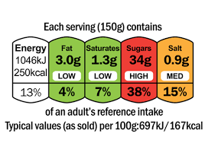
Is this story familiar?
The health costs of nutrition-related diseases such as cancer and cardiovascular disease were high and increasing in many countries at the turn of the century⁴.
In 2006, the UK Food Standards Agency recommended front-of-pack traffic-light labels on food products⁵. The FSA sought to equip consumers with the information necessary to make healthier purchases.
By 2023, there is a broad consensus that these labels have reduced the incidence of nutrition-related diseases by encouraging healthier purchases, although the size of this effect is disputed.
4 Lopez et al. 2006.
5 FSA 2007.
6 Kunz et al. 2020.
Notes:
Voluntary process. Provides colour- and written-based information. Latter, including percentage of daily recommended consumption, is not possible for ecolabels because we are yet (can we ever?) to calculate the daily per capita sustainable EF.

Slide 5
Existing literature
Pre-existing literature (56 studies) on effect of ecolabels on selection, purchase, or consumption exist⁷. 80% of these studies conclude that the ecolabel treatment induces more sustainable outcomes.
But…
41 studies were hypothetical.
39 studies received an unclear or high risk of bias rating.
Majority of studies forced participants to observe the treatment.
7 Potter et al. 2021.
Notes:
Problems with existing approaches. Miscalculate treatment effect. Likely to have upward bias (from 1 and 3).

Slide 6
Contributions of this paper
Truth-telling compatible: participants receive product they select.
Distinguishes within-product substitution from between-group substitution.
Designs a new ecolabel which is a function of both (i) all products and (ii) the individual product.

Slide 7
Contents
Introduction
Method
Sequential Purchase Model
Simultaneous Purchase Model
Summary

Slide 8
Environmental TRAFFIC LIGHTS
Aim: measure the effect of front-of-pack environmental traffic lights on food purchases for ‘composed’ meals.
Traffic lights: each product’s environmental footprint (EF) score is a mean of its percentile rank for 4 key indicators: GHG emissions, water use, biodiversity loss, and eutrophication potential⁸.
A = 1-20, B = 21-40, C = 41-60, D = 61-80, E = 81-100.
8 Clark et al. 2022.
Notes:
'Composed' - unprepared food products that you use to make a meal. Distinct from 'ready meals'
Low score = more sustainable

Slide 9
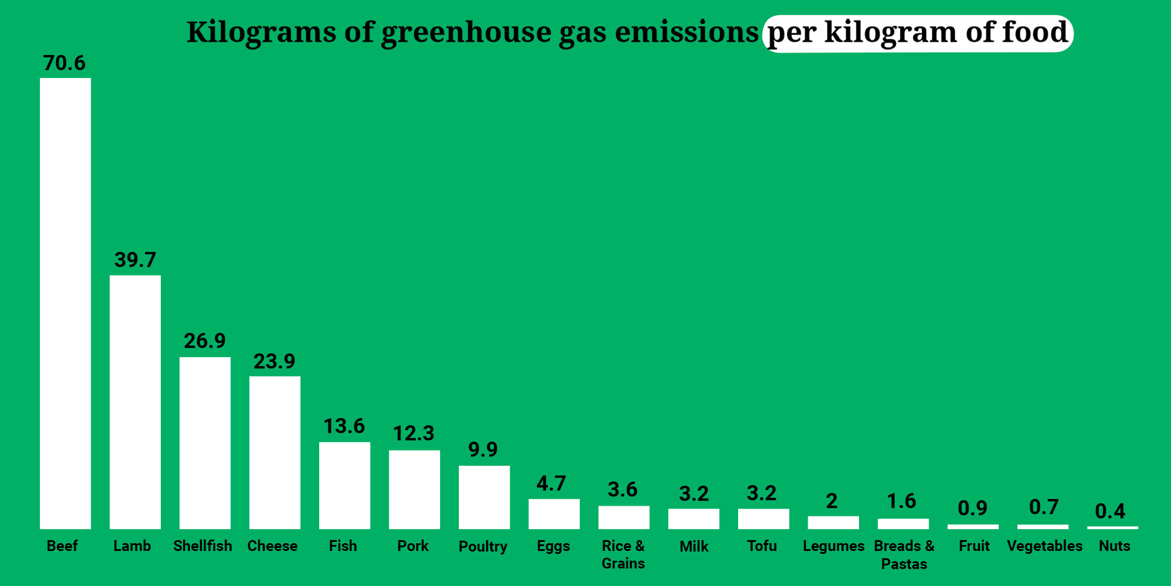
FOOD CATEGORIES
Five categories: (1) beef and lamb, (2) poultry and pork, (3) fish, (4) lacto-ovo, (5) plant-based.
Between-category variation: 5 > 3 > 1 in EF scores⁹.
Within-product variation: different versions of the same product have different EF scores¹⁰.
9 Arrazat et al. 2023.
10 Arrazat et al. 2023.
11 IPCC 2022.
Notes:
Fish is higher in this graph because it only captures kg of GHG emissions without regard to water use, biodiversity loss, or eutrophication potential.

Slide 10
Hard choices
Between-category substitution – replacing meat, dairy, and eggs with plant-based alternatives – would have significant environmental benefits¹².
Evidence that ecolabels causes a shift towards more lacto-ovo and plant-based meals in a statistically significant manner exists¹³.
Taste preferences, cultural norms, or access to appropriate alternatives may make between-category substitution less attractive¹⁴.
Within-product substitution – replacing less sustainable versions of a product with more sustainable versions – has less significant environmental benefits but consumers are likely to prefer this to between-category substitution.
12 Clark et al. 2022.
13 Arrazat et al. 2023.
14 Willet et al. 2019.

Slide 11
bORING STUFF …
Where: Centre for Experimental Social Sciences (CESS), Nuffield College, University of Oxford.
When: October-December 2023.
Who: CESS database of 10,000 regular survey participants. Age range of 18-64.
Powered at 80% for a minimum detectable effect of 0.03. Requires 550 participants per arm (N = 1,100).
Averaged results from three papers measuring the effect of ecolabels on purchase decisions.

Slide 12
Contents
Introduction
Method
Sequential Purchase Model
Simultaneous Purchase Model
Summary

Slide 13
Stage 1a
Each participant selects three items from a range of ~ 30 food products frequently used by UK households to compose a home-cooked meal. Participants will be randomly assigned one of the items they have chosen to take home.
Benefits? (1) Realistic Choice; (2) Truth Telling Compatible.
Hypothesis 1: ecolabels cause between-category substitution – participants move from less sustainable food categories to more sustainable food categories.

Slide 14
Stage 1b
Participants are presented with an above-, below-, and average EF score version for each of the three items they selected. Each participant selects a version of each item, of which they are randomly assigned one to keep.
Challenge: if we keep the ecolabel in its current form, there is not sufficient within-product variation in EF scores. Our solution is to present EF scores as a function of both (i) all products and (ii) the individual product. The former may lack sufficient variation, but the latter does not¹⁵.
Hypothesis 2: ecolabels cause within-product substitution – participants move from less sustainable versions of products to more sustainable versions.
15 Clark et al. 2022.

Slide 15
Contents
Introduction
Method
Sequential Purchase Model
Simultaneous Purchase Model
Summary

Slide 16
Do consumers make decisions like this?
So far, we have proposed that consumers make purchase decisions sequentially: they choose which products they would like before choosing the version of each product to purchase.
This model supposes that consumers will respond to EF scores by choosing a more sustainable meal (stage 1A) before choosing more sustainable components with which to make that meal (stage 1B).
What would happen if consumers made purchase decisions simultaneously?

Slide 17
Stage 2
Participants are presented with 90 products – 3 EF score versions of the 30 food products from stage 1A. Each participant selects 3 products, of which they are randomly assigned 1 to keep.
Benefits? (1) Realistic choice; (2) truth-telling compatible.
Participants can now engage in between-category and within-product substitution simultaneously. The former has a more significant environmental impact but consumers are likely to view the latter as more favourable.
Hypothesis 3: if consumers make category and product decisions simultaneously, then taste preferences, cultural norms, or access to appropriate alternatives will reduce the amount of between-category substitution that ecolabels induce.

Slide 18
Contents
Introduction
Method
Sequential Purchase Model
Simultaneous Purchase Model
Summary

Slide 19
KEY POINTS
Food systems have a major impact on our environment. Consumers claim that they want to make more sustainable decisions but cannot because they lack the information to do so. Front-of-pack ecolabels provide this information.
Ecolabels try to induce two responses in consumers: (1) between-category substitution and (2) within-product substitution. The former would have the biggest effect on environmental outcomes but is less favourable.
The method consumers use to make purchase decisions matters. If consumers make decisions simultaneously, then ecolabels may not improve environmental outcomes by as much as predicted in sequential decision-making models.

Slide 20
Challenges
Which model of shopping is more realistic?
Sequential vs simultaneous decision-making.
How well does our experimental design replicate real supermarkets?
Realistic product options, truth-telling incentives.
Are ‘composed’ meals representative of shopping patterns?
Composed meals vs ready meals.
Are there unintended financial and/or nutritional consequences to ecolabels?
Measure control vs treatment group.

Slide 21
THANK YOU!
Data collection and analysis is scheduled for Autumn 2023. Research design is likely to be updated over the coming months. Plan to publish paper in 2024.
Do you have any queries or suggestions?
E: Sebastian.lyons@new.ox.ac.uk;
L: www.linkedin.com/in/Sebastian-lyons.
Sebastian Lyons;
New College, University of Oxford.

Slide 22
pOWER ANALYSIS
Experiment measures difference in means between the control and treatment group.
Type I error rate: 5%.
Power: 80%.
Mean under H0: 0.5.
Standard Deviation: 0.2.
MDE: 0.03.

Slide 23
Reference List
Arrazat et al. 2023. ‘Traffic-light front-of-pack environmental labelling across food categories triggers more environmentally friendly food choices: a randomized controlled trial in virtual reality supermarket’ in International Journal Behavioural Nutrition and Physical Activity 20(7).
Clark et al. 2022. ‘Estimating the environmental impacts of 57,000 food products’ in PNAS 119(33).
Gadema et al. 2011. ‘The use and usefulness of carbon labelling food: A policy perspective from a survey of UK supermarket shoppers’ in Food Policy 36.
Grimmer, M and Miles, M. 2017. ‘With the best of intentions: a large sample test of the intention-behaviour gap in pro-environmental consumer behaviour’ in International Journal of Consumer Studies 41(1).
Ivanovich et al. 2023. ‘Future warming from global food consumption’ in Nature Climate Change 13.
Kunz et al. 2020. ‘Traffic Light Labels on Taste Expectations and Purchase Intentions’ in Foods 9(2).
Lopez et al. 2006. ‘Global and regional burden of disease and risk factors, 2001: systematic analysis of population health data’ in The Lancet 367.
Osman, M and Thornton, K. 2019. ‘Traffic light labelling of meals to promote sustainable consumption and healthy eating’ in Appetite 138.
Potter et al. 2021. ‘The Effects of Environmental Sustainability Labels on Selections, Purchase, and Consumption of Food and Drink Products: A Systematic Review’ in Environment and Behaviour 53(8).
Potter et al. 2023. ‘Effects of environmental impact and nutrition labelling on food purchasing: An experimental online supermarket study’ in Appetite 180.
Sacks et al. 2009. ‘Impact of front-of-pack ‘traffic-light’ nutrition labelling on consumer food purchases in the UK in Health Promotion International 24(44).
Whitton et al. 2011. ‘National Diet and Nutrition Survey: UK food consumption and nutrient intakes from the first year of the rolling programme and comparisons with previous surveys’ in British Journal of Nutrition 106.
Willet et al. 2019. ‘Food in the Anthropocene: The EAT-Lancet Commission on healthy diets from sustainable food systems’ in Lancet 393.
.
.
.

