Slide 1
Assessing Water-Energy-Food Nexus Industries Socioeconomic and Environmental Impacts Using Input-Output Analysis
Andre Luis de Souza Coelho
MSc. Sustainable Development Practice
Ph.D. Student Urban Leadership & Entrepreneurship (CAUSES/UDC)
source: https://www.water-energy-food.org/
Notes:
Good Afternoon
I want to start saying thanks the organization and all of you here.
I am Andre Coelho from Rio de Janeiro, Brazil. I live in the Washington DC metropolitan area, where I am doing my Ph.D. in Urban Leadership and Entrepreneurship, with a concentration in Urban Sustainability and Resilience, at the University of the District of Columbia.
My advisor is Dr. Sabine O'Hara, whom some of you may know from the Ecological Economics scholar community.
By the way, I am not an economist. I am and sustainability scientist joining the ecological economics field looking at the interdisciplinarity of sustainable development.
Today I will present my recent work on using input-output analysis to support the implementation of sustainable technologies and public policy using a case study of the water-food-energy nexus industries in the DC metropolitan area.

Slide 2
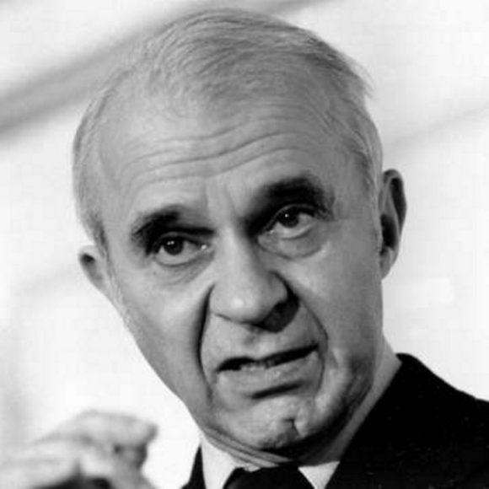
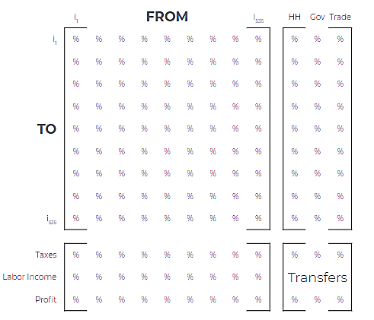
Before the age of computers, Leontief started mapping the flow of goods and services between different economic sectors, which proved to be crucial in learning more about how economies interconnect through global supply chains. Today, his models are still vital to our understanding of the economy.
source: https://www.ubs.com/microsites/nobel-perspectives/en/laureates/wassily-leontief.html - https://implan.com/
Notes:
The input-output analysis, or just I-O analysis, is a methodology created by Nobel laureate Professor Wassily Leontief in the 40s. The fundamental purpose of the I-O model is to analyze the interdependence of different sectors of the economy.
This structural analysis provides a comprehensive and articulate base combining the power of robust quantitative analyses grounded in economic and social observation.

Slide 3
US Environmentally-Extended Input-Output (USEEIO) is a family of models designed to bridge the gap between traditional economic calculations, sustainability, and environmental decision-making. It provides a robust resource for estimating the potential impacts—environmental and economic—associated with the production or consumption of goods and services.
source: https://www.epa.gov/land-research/us-environmentally-extended-input-output-useeio-models
Notes:
Governments, businesses, and academic institutions widely use this method to analyze economic changes in, for example, output, employment, and GDP, which makes the I-O a well-known trusted method.
Recently, with the fundamental need to better account for the environmental impacts of economic decisions, the Environmentally-Extended-Input-Output analysis was created to assess the ecological effects of economic activities related to the use of resources and the release of pollutants.
Plus, the cost and complexity of a Life Cycle Assessment analysis is high, which lead most business to do not have an assessment of its impacts if it is not a requirement. There are some studies comparing the outcomes of EEIO and LCA showing similar results.
In all our analyses, we used 2019 data (with 2021 dollar value) on the IMPLAN modeling system, considered a market leader model for this application in the United States.

Slide 4
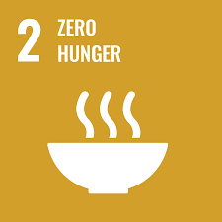
source: https://sdgs.un.org/goals
Notes:
A new development model is necessary to shift our predatory relationship with the natural environment. Sustainable development has become one of the main approaches to create a balanced and integrated relationship between socioeconomic progress aligned to environmental protection, limiting the impacts on the planet.
The water-energy-food nexus, or WEF nexus, is an approach created to take advantage of synergies and reduce trade-offs between its elements once their production, process, and distribution are highly interconnected. WEF nexus plays a central role in implementing sustainable development goals (SDG) due to the intersection of water management, food availability, and energy production.

Slide 5
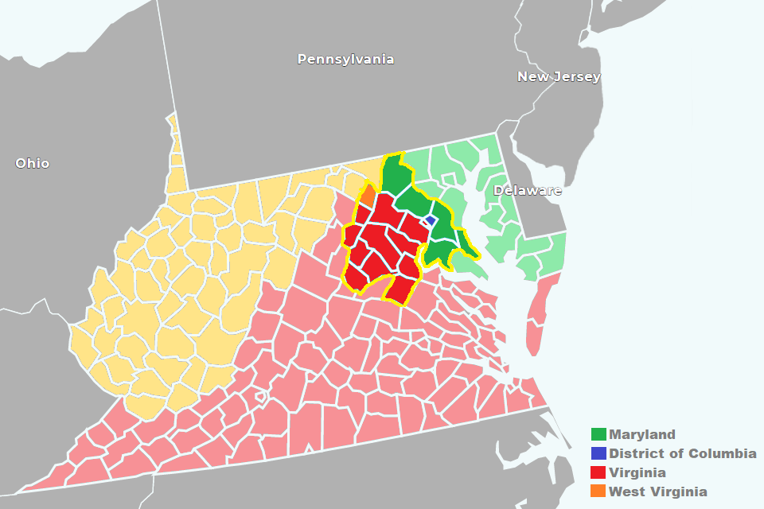
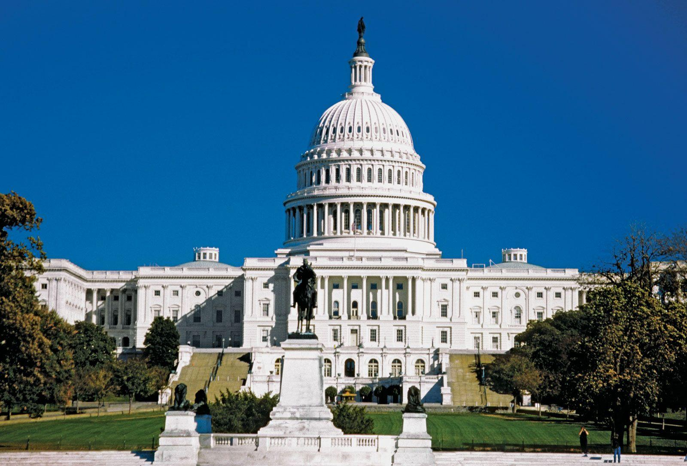
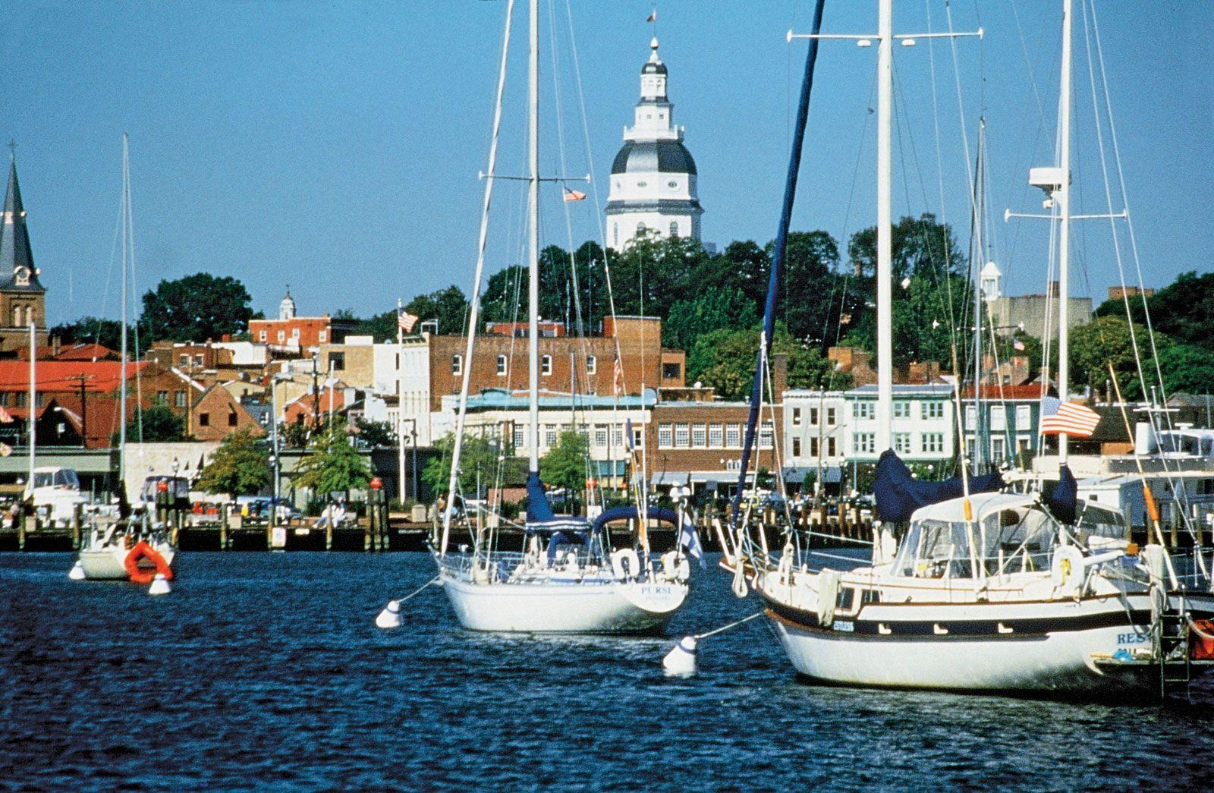
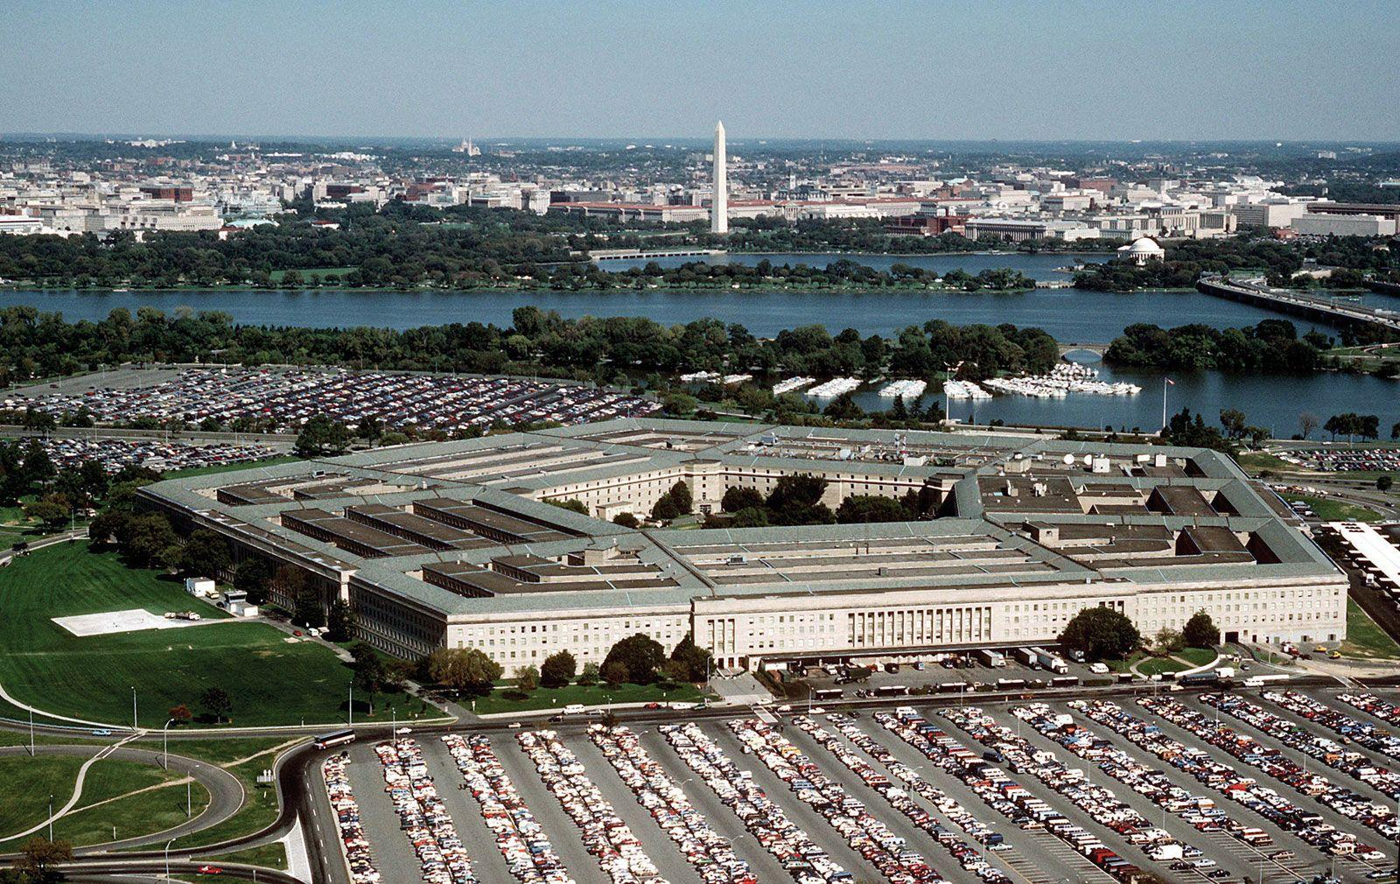
Average age - 37.9 years
Female - 51%
White - 43%
Black - 24%
Hispanic/Latinx - 17%
Asian -11%
Per capita income - US$ 55,165.00
People below the poverty line - 8.7%
source: https://www.britannica.com/ - https://www.census.gov
Notes:
The Washington DC Metropolitan area is located in the East-Cost of the United States and comprises 25 counties divided between the states of Maryland, Virginia, and West Virginia, and the District of Columbia, the US national capital. The region has over 6 million inhabitants occupying around 17,000 square km of land.

Slide 6
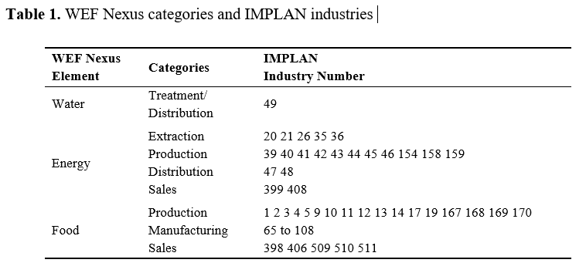
1-19 Agriculture
20-38 Mining, Minerals, and Oil
39-49 Utilities
50-62 Construction
63-391 Manufacturing
392-413 Wholesale and Retail
414-421 Transport Related
422-525 Services
526-534 Government Enterprises
535-538 Commodity-Only Sectors
539-546 captures payroll and employment for different types of government
https://support.implan.com/hc/en-us/articles/115009674428-IMPLAN-Industries-NAICS-Correspondences
Notes:
We divided the WEF nexus industry into seven categories, one for the water element, four for the energy element, and three food categories, corresponding with 87 of the 546 IMPLAN industries (table 1), based on the North American Industry Classification System (NAICS) codes.

Slide 7
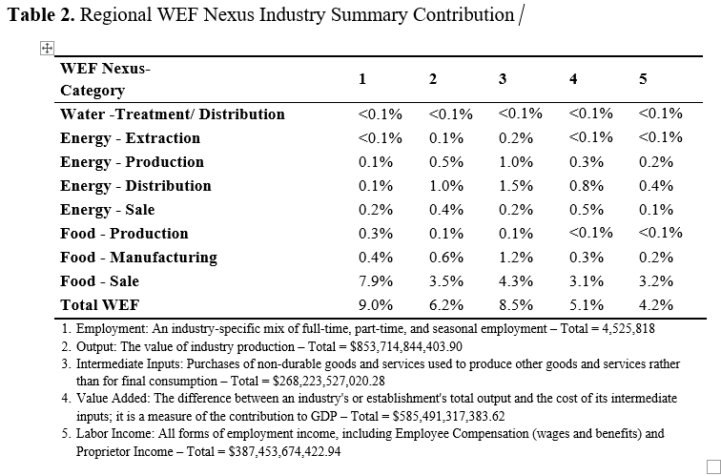
Notes:
As a result, we see the WEF Nexus industries substantially contributing to the regional economy. For example, 9% of the employment and 5% of GDP come from these industries. The food sale industry is highly relevant to the local economy and drives the total contribution. Consequently, whatever impacts these business experiences, such as the COVID pandemic, creates several socioeconomic consequences.
We tend to look at sustainability at the macro level most of the time. Many indicator are only available in a country level, but a lot of the decision related to sustainability are made in local or regional level. This method permits us to aggregate and disaggregate the data in different geographical and industrial groups. Using these information, you can model and compare the results of public policies between two cities for example.

Slide 8
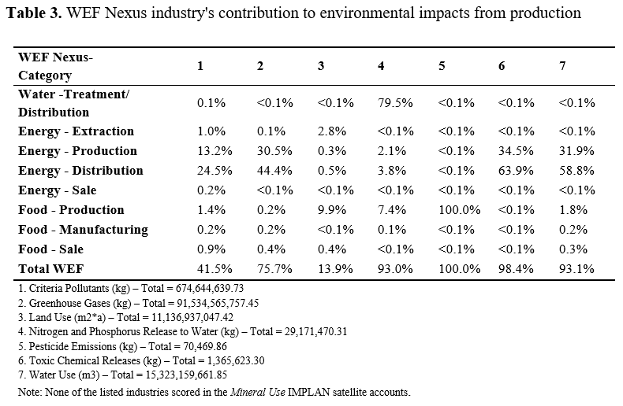
Notes:
Once we extend our analysis to the environmental impacts, the 4% to 9% economic contribution becomes more than 90% in four of the seven environmental accounts. For example, among all the WEF Nexus industries, energy has little contributions to direct local socioeconomic, but accounts for 75% of greenhouse gases emissions, 98% of toxic chemical releases, and 93% of water use.
It is important to mention that these results do not account for the upstream or downstream impacts. In other words, the emissions of each specific industry operation are independently accounted disregarding the emission generated to produce its inputs or the emissions associated with the consumption of the products by households. So, these values are underestimated, which is a limitation of the model.
Again, this framework focus on create a fast and cost-effective way for the stakeholders to analyze projects based on reliable data to be able to question proposals made using only economic indicator.

Slide 9
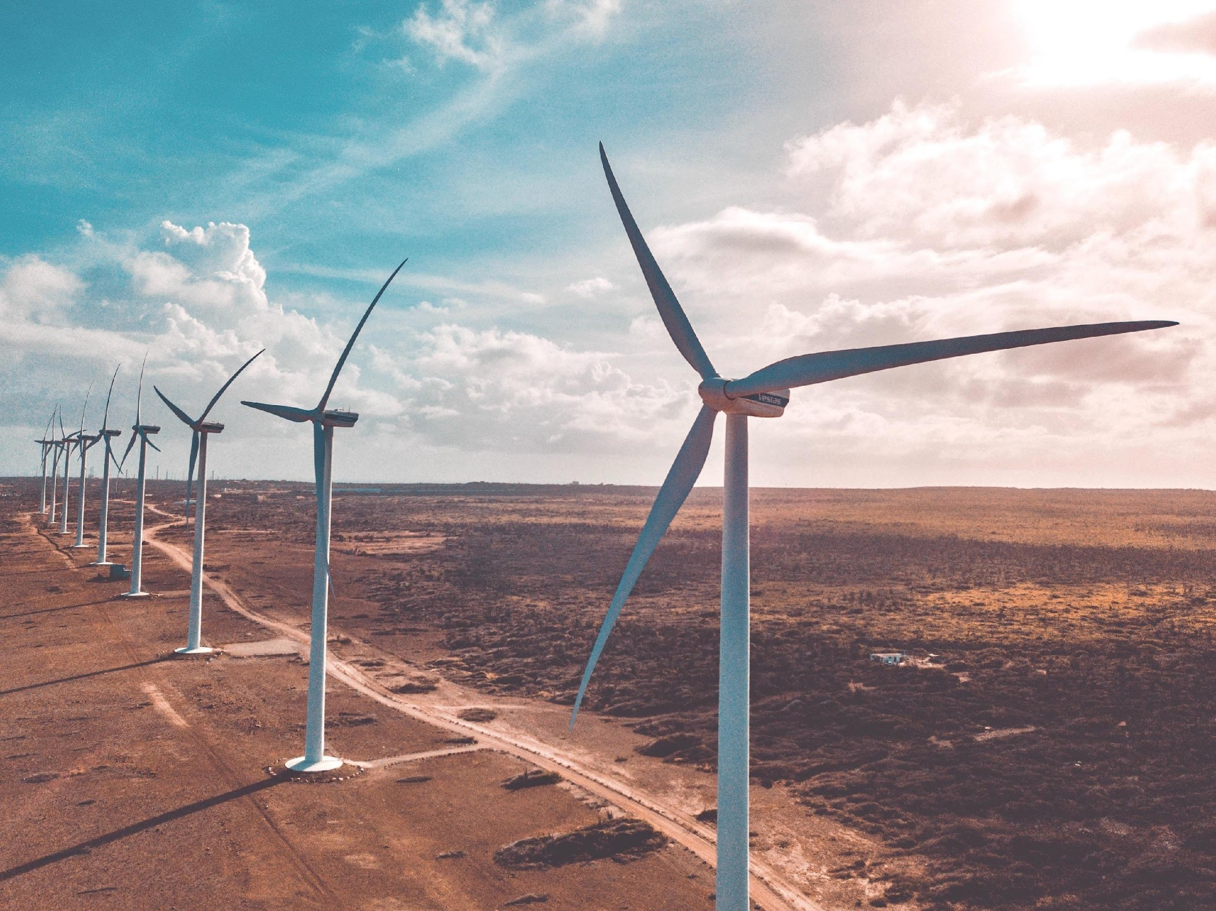
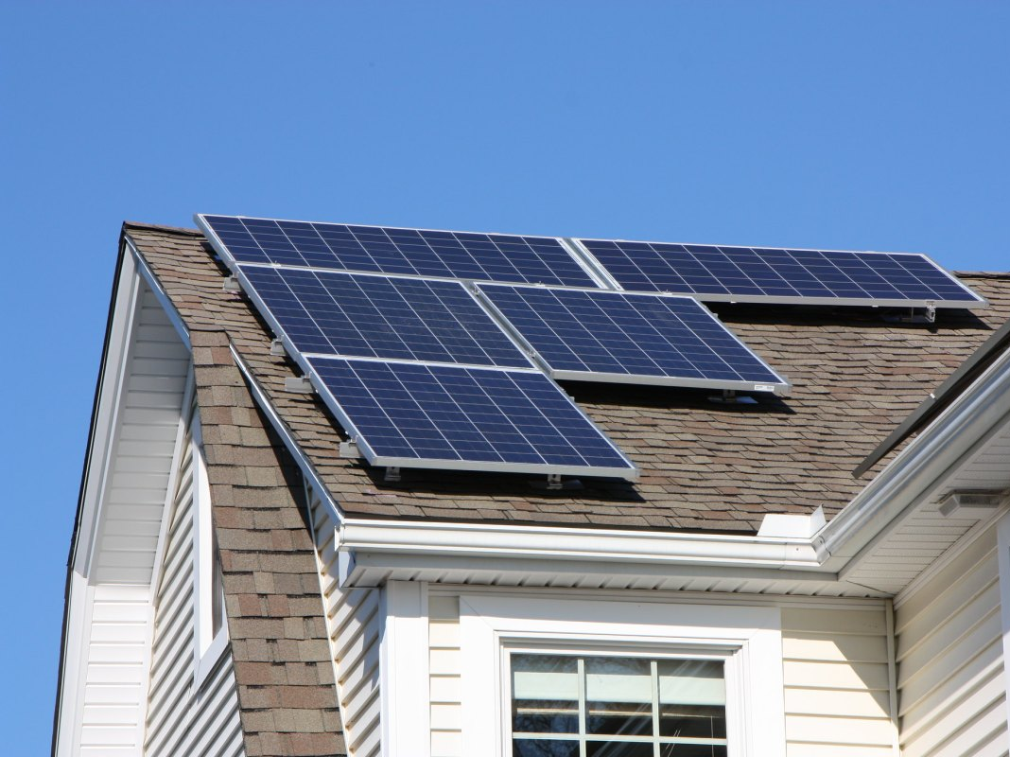
Notes:
Identifying the most significant contributors to the regional environmental footprint is the first step toward solutions to reduce these indicators.
Our results uncover some of the impacts of a critical group of industries that can help decision-makers to, for example, support the clean energy transition from fossil fuels to renewable energy to reduce the WEF nexus's contribution to environmental impacts.

Slide 10
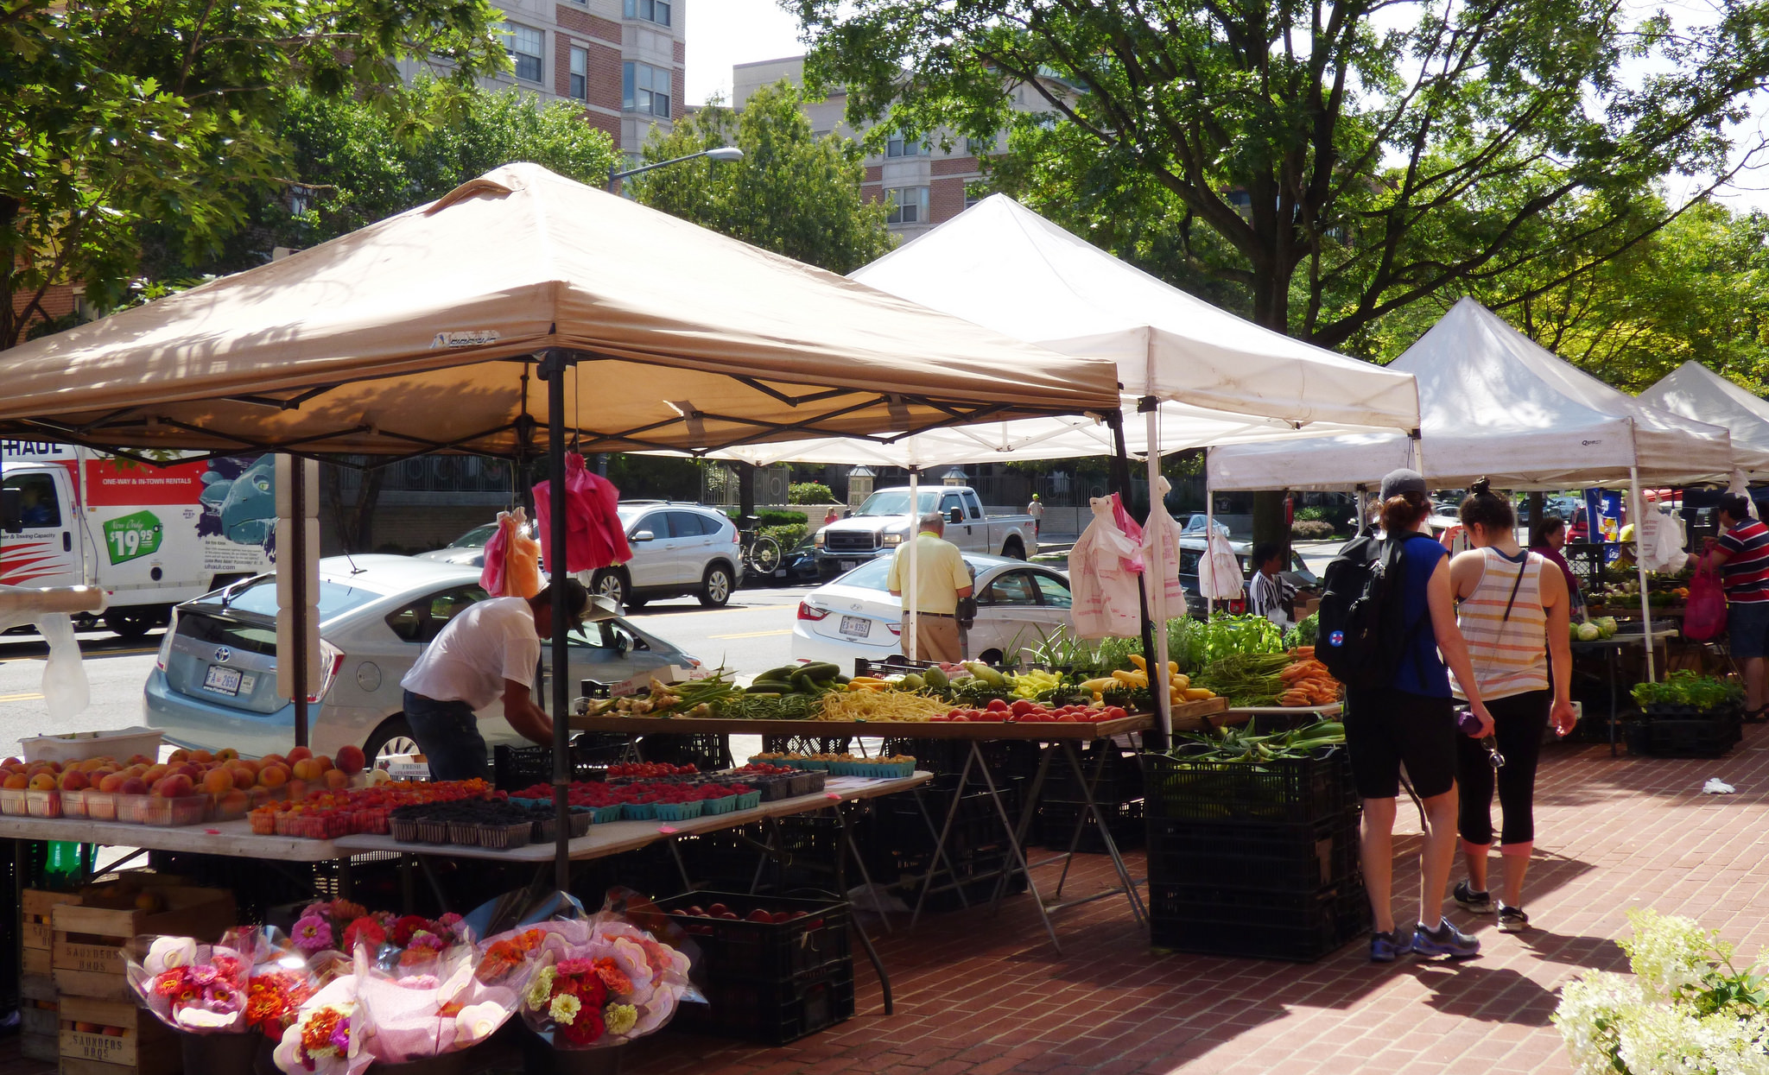
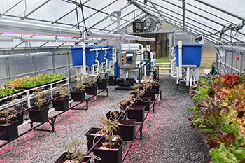
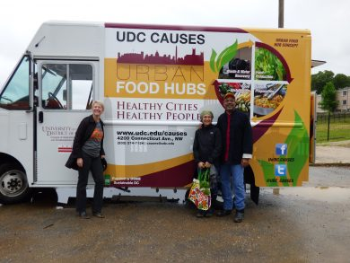
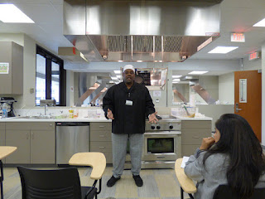
https://www.udc.edu/causes/urban-food-hubs/
Notes:
But also support regional investments such as the development of the food industry, aligned to local food production, and small food and drink places, schools for professional education, that help the community thrive creating positive socioeconomic results with lower environmental impacts and supporting a long-term transition.
The food Hubs Model, for example, proposes a diversification on the food industry based on local development and create a market for health and nutritious food on low-income neighborhood.

Slide 11
source: https://museudoamanha.org.br/pt-br/do-maua-ve-se-o-rio
Notes:
Finally, Establishing urban sustainability is crucial for the future of our society. Metropolitan areas such as the DC Metro will multiply and grow together with the global population increase.
Further studies are necessary, and the I-O model expands the possibilities for replication of this framework because this method is already used worldwide, facilitating access to the data and training.
The proposed framework provides accountability for the three foundation elements of sustainable development, helping stakeholders understand and make decisions when planning long-term goals on the local WEF nexus development.
Now I can get some questions, and I appreciate any comments to help me stretch this work to the next level.

Slide 12
Thank You! andre.desouzacoelho@udc.edu
Andre Luis de Souza Coelho
MSc. Sustainable Development Practice
Ph.D. Student Urban Leadership & Entrepreneurship (CAUSES/UDC)
Notes:
Thank You!

