Slide 1
Behavioral ecological economics: review and research priorities
Stefan Drews
University of Málaga (Spain)
Workshop on ‘Behavioural ecological economics’ (University of Florence, July 10-11, 2023)

Slide 2
Outline
Introduction
Background: ecological economics and behavioral science
Frequent themes and important behavioral contributions in the flagship journal Ecological Economics and beyond (*)
Behavioral environmental versus ecological economics
Considerations for future research & conclusions

Slide 3
Introduction
Behavioral science in government units, UN, OECD, journals, etc.
Scopus database: “behavior*” in the journal of Ecological Economics → ~600 hits (even more when including indexed keywords or other search terms)
“Behavioral ecological economics” in Google Scholar → 1 hit (108 words!)
Setting boundaries and identifying priorities may help to establish more coherent research field and to differentiate from “behavioral environmental economics”

Slide 4
A very brief clarification of ecological economics
Continuous debate about the identity of ecological economics
For example: “New Resource Economists“, “New Environmental Pragmatists”, “Social Ecological Economists“ (Spash, 2013)
“While disagreements are a prerequisite for scientific progress, they can metastasize into rending schisms affecting the field’s vitality and influence” (Farley and Kish, 2021)
Core ideas of modern ecological economics (Røpke, 2005)
Human dependence on well-functioning ecosystems that provide the basic life support for societies
Limits have to be taken seriously (post-growth, etc.)
Equity and (re)distribution
Systems thinking
Basic ignorance: uncertainty and complexity
Transdisciplinarity and pluralism
Economy is embedded in a broader social and cultural system and co-evolving with nature

Slide 5
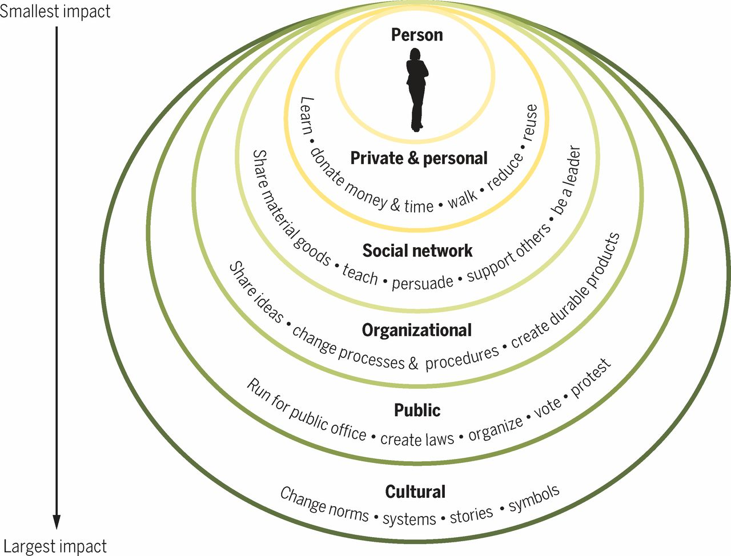
How can behavioral science best inform public policy?
Many behavioral scientists focus on policy interventions at the level of the individual (= “i-frame”), often neglecting the larger systemic context in which individuals operate (an “s-frame”).
Corporate opponents of systemic change (e.g. regulation) have long sought to highlight individual responsibility (“responsibilization”) for societal problems, aligning with the emphasis on i-frame solutions promoted by some behavioral scientists. The latter unintentionally serves the interests of opponents of systemic change.
The impact of i-frame interventions that solely target individual behavior has been disappointing and can undermine support for systemic reforms → Call for system-oriented behavioral public policy
Amel et al., 2017*
Chater and Loewenstein, 2022*

Slide 6
Evolution of behavioral articles in Ecological Economics
Year 2000 as main starting point
Alternative behavioral models: “Many authors in ‘ecological economics’ have expressed a discomfort with the neoclassical behavioural model, and some have even pointed out that it is partly responsible for setting the wrong agenda for environmental policy-making (Costanza, 1991). But although ecological economics is prospering as a field of integrated research, it has generated few new insights about the link between behaviour, environment and policy.” (van den Bergh et al., 2000)
A behavioral approach to understanding overconsumption (Brown and Cameron, 2000)
Special issue: “The human actor in ecological-economic models” (Janssen and Jager, 2000)
Search of the term “behavior*” in abstracts :
Great diversity of topics!

Slide 7
Reviewing reviews and conceptual/theoretical papers
General papers (n=13)
Behavioral models
Behavior and link to ecological economics and environmental policy
Nudges/behavioral interventions (n=6)
Miscellaneous topics/questions (n=14)
Evolutionary psychology
Rebound
Social-tipping points
Specific behavioral factors (e.g. social desirability)
Information overload
Motivation crowding in Payments for Ecosystem Services (PES)
Etc.
(Primary studies: dominant focus on distinct types of consumption)

Slide 8
Heterogeneity in alternatives to homo economicus
Homo sustinens (Siebenhuner, 2000)
Homo reciprocans (Gintis, 2000)
Homo psychologicus (Jager et al., 2000)
Homo efficens
(Levine et al., 2015)
Homo economicus
Homo faber
(Ferraro and Reid, 2013)
Homo politicus
(Faber et al., 2002)
Homo ecologicus
(Becker, 2006)

Slide 9
Nudges
Various reviews indicate positive effects of nudges:
“The toolbox containing green nudges does have some promising innovative instruments public policy might use in order to promote pro-environmental behavior” (Schubert, 2017)
Summary of 44 international studies shows effectiveness of four different types of nudges, “yet effect sizes vary immensely” (Andor and Fels, 2018)
Social norms: “these interventions are effective at inducing significant changes in behavior” (Farrow et al., 2017)
Framing: “Loss framing is more effective than gain framing, providing support for the loss aversion hypothesis” (Homar and Cvelbar, 2021)
Interventions addressing other-regarding preferences “can be effective in increasing different PEB types” (Heinz and Koessler, 2021)
Meta-analysis of 52 studies on electricity use finds on average 1.9–3.9% reduction (Buckley, 2021)

Slide 10
Nudges: skepticism (1/2)
1. Recent second-order meta-analysis finds effect sizes of 2-12%, with high-quality evidence pointing to 2% (Bergquist et al., 2023*; see also Drews and van den Bergh, 2022*)
Favorable meta-analysis of nudging in various (non-climate) domains (Mertens et al., 2022), but critical responses:
“No evidence for nudging after adjusting for publication bias” (Maier et al., 2022)
“No reason to expect large and consistent effects of nudge interventions” (Szaszi et al., 2022)
2. Context-dependence of results and nearly complete absence of research in regions where majority of world population lives (Drews and van den Bergh, forthcoming*)
3. Scalability problems, distraction from more effective solutions (Chater and Loewenstein, 2022*)
4. Editorial: Ecological economics – The next 30 years (Farley and Kish, 2021)
“NCE and our STEM (Science, Technology, Engineering and Math)-obsessed society focus on technological change and simple behavioral nudges to solve our problems (…), but there are no purely technical solutions to social dilemmas. Achieving the goals of EE will require cooperation at unprecedented scales.” [emphasis added]

Slide 11
Nudges: skepticism (2/2)
…
5. Survey of ~800 climate-policy researchers: little enthusiasm among ecological economists
= “(e.g. education or ecolabels)”
Drews et al., submitted*

Slide 12
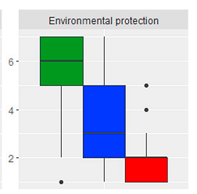
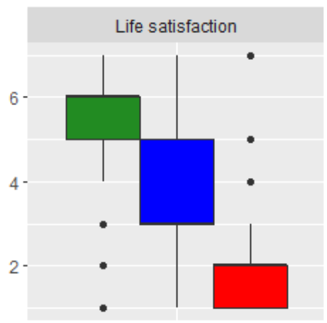
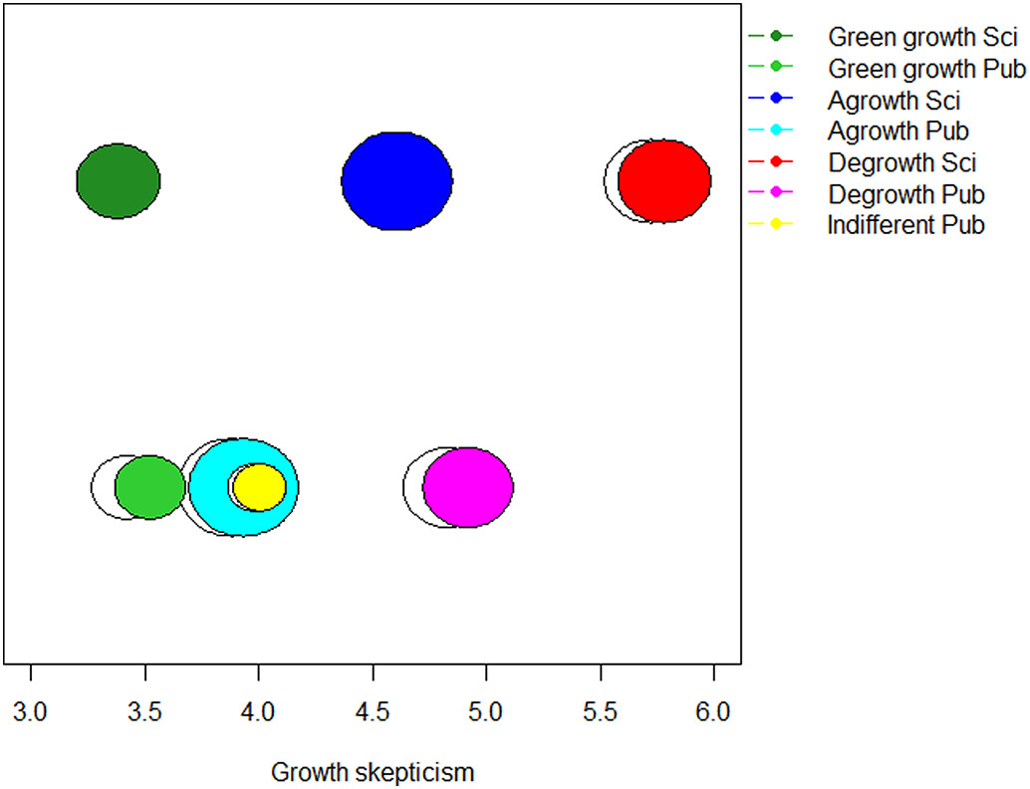
Post-growth opinions/behaviors
Seeing the problem and support for s-frame solutions (Chater and Loewenstein, 2022*):
Opinion clusters in academic and public debates (Drews et al., 2019)
Example questions:
1= strongly disagree to 7= strongly agree

Slide 13
...Post-growth opinions/behaviors and related concepts
Study for Canada with similar findings (Tomaselli et al., 2019):
The Assured (41.1%), Ambivalent (36.3%), The Concerned (22.6% → higher likelihood of voting post-growth politics)
Communicating “degrowth” might backfire (Drews and Antal, 2016) or not (Drews and Reese, 2018*)
Sufficiency:
“in sustainable consumption is manifested in individual consumption moderation and behavioral change (microeconomics), supported by a transition in the socio-economic environment towards a more just intra- and intergenerational distribution of affluence (macroeconomics).” (Jungell-Michelsson and Heikurrinen, 2022)
What level of personal monthly income is considered to be enough (sufficiency level) and to what degree do individuals evaluate their personal monthly income as being enough (sufficiency evaluation)? (Castro and Bleys, 2023)

Slide 14
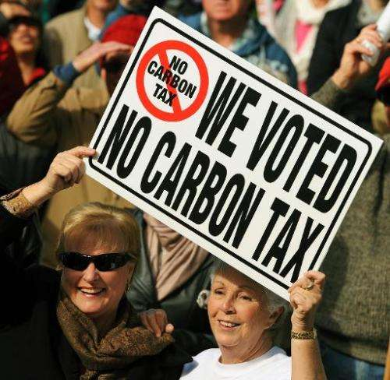
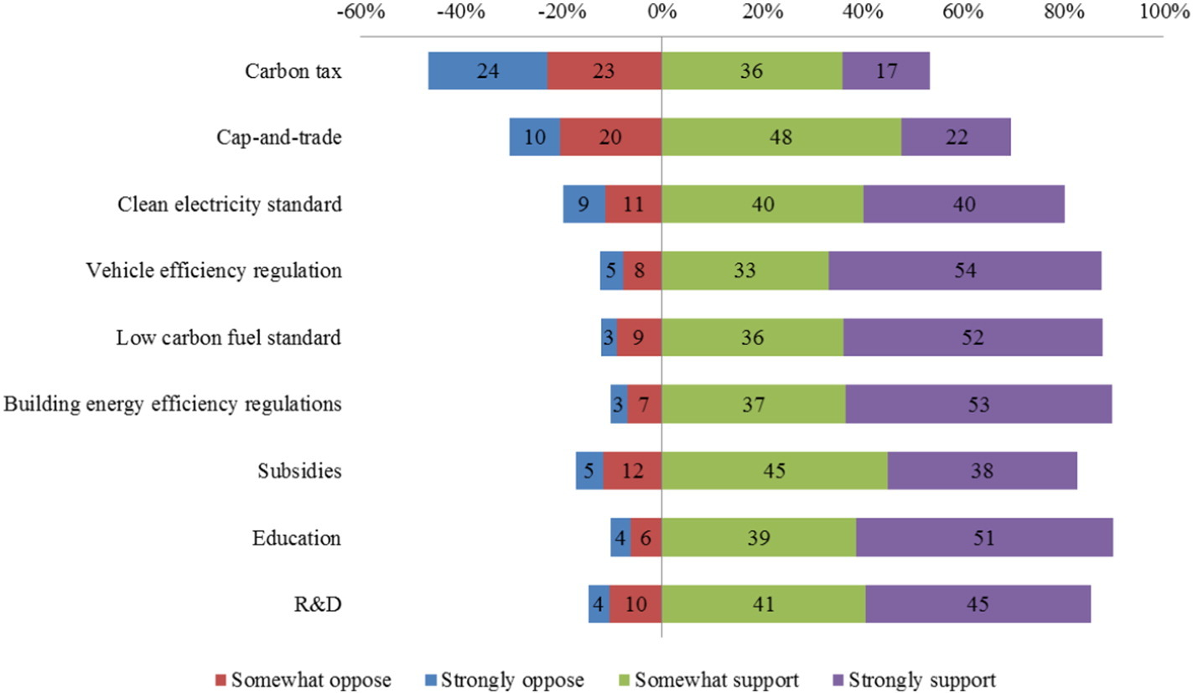
Public support for climate/environmental policies
Questions:
How much public support/acceptance?
What (behavioral) factors explain it?
Information/knowledge, ideology, fairness, policy design, etc.
Focus of ecological economics?
More dynamic understanding needed (Kallbekken, 2023*)
Most studies on taxes
Few studies focus on restrictive policies, such as decreasing oil extraction (Sælen and Aasen, 2023)
(see also results from survey of climate-policy researchers on next slide!)
Rhodes and
Axsen, 2017

Slide 15
Ecological economists‘ policy preferences
Drews et al., submitted*

Slide 16
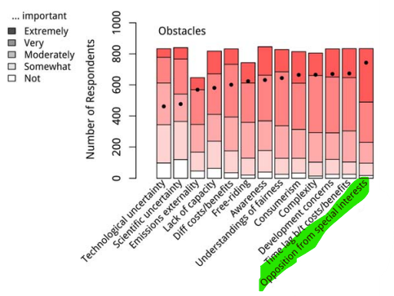
(More) political behavior (research needed)
1. Individual and contextual factors affecting green party voting (Schumacher, 2014)
2. Discussion of the roots of the ‘far right insurgency’ (Muradian and Pascual, 2020):
“we favour building bridges with academic traditions and disciplines with which ecological economics has had relatively weak connections, such as social and political psychology.”
3. Survey: 917 IPCC/UNFCCC experts
“Please indicate—in your opinion —how important the following obstacles (responses) are to keeping global average temperature increase below 2°C.”
Kornek et al., 2020*

Slide 17
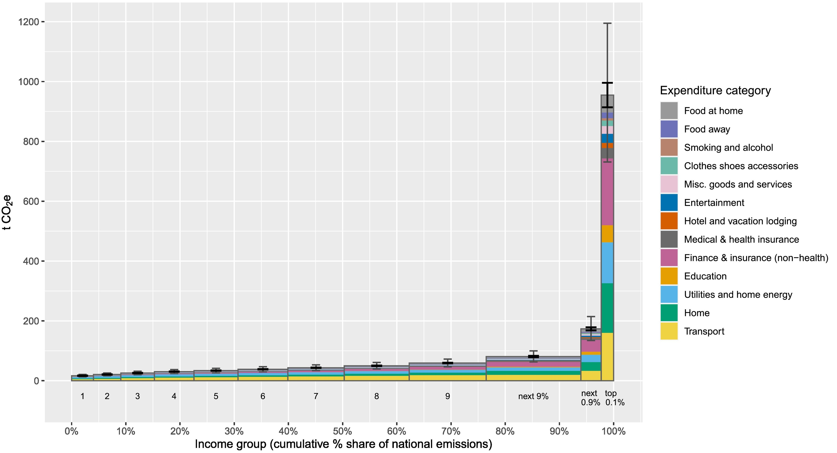
Economic/carbon inequality
Much work on link between economic inequality and environment at macro-level, but little work on behavior (Galvin and Sunikka-Blank, 2018)
“If climate policy does not account for such extreme emissions disparities, it will limit effectiveness, erode public support, and disproportionately harm economic and socially marginalized groups.” (Starr et al., 2023)
Estimate of emissions for Roman Abramovich: 31,000 tons of CO2e (Barros and Wilk, 2021*)

Slide 18
Informational and cultural environment
(Non-) green advertising as barriers for transition
Ecological economists tend to be skeptical about “consumer sovereignty” (Norton et al., 1998)
Cognitive heuristics (e.g. “footprint illusion”) can create psychological barriers for sustainable consumption, which can serve as a justification for regulating not just conventional but also green advertising (Castro and Drews, 2023)
“Understanding and reversing industry exploitation“, “improving the information environment for public debate, and countering active attempts to corrupt it” → key s-frame research topics (Chater and Loewenstein, 2022*)
Culture of “fast pace of life” reduces pro-environmental behavior (Hoffmann et al., 2022) → working-time reduction as one potential systemic solution?

Slide 19
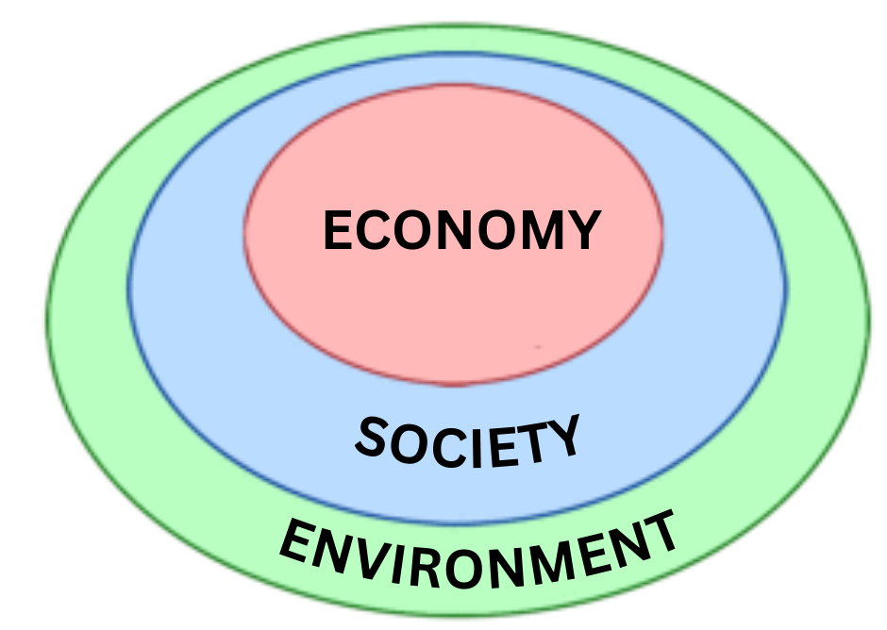
Natural environment
Clear connection to work on PES, less clear for PEB
Progressive separation from nature as a reason for lacking environmental awareness, notably of complex, distant side-effects (Luzzati et al., 2022)
Positive link between spatial, temporal and social contexts of childhood nature experiences, and adulthood environmental preferences (Jensen and Olsen, 2019)
“Is there some combination of fear and hope sufficient to dissolve our culture-wide conspiracy of denial or must we rely on some “staggering ecological disaster” to wake a world of sleep-walkers?” (Rees, 2020)
Mixed evidence in literature: “The size of the temperature-opinion effect—if present—is likely to be small” (Howe et al., 2020*)
Adopting ecocentrism and ecological ethics (Washington and Maloney, 2020)

Slide 20
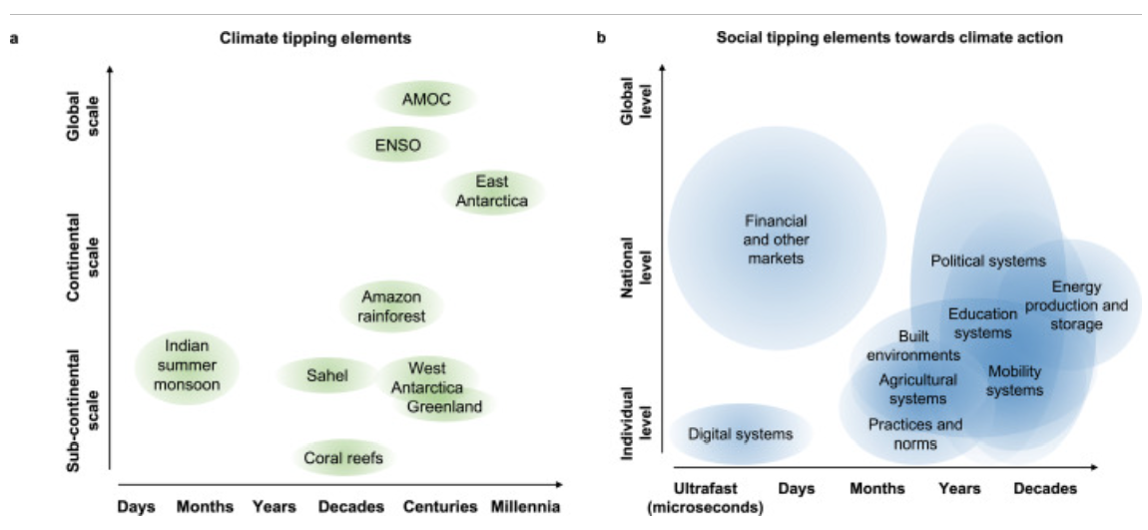
Social tipping points
Interest in the concept given that rapid shifts are necessary for sustainability transition
Social system = network of social agents embedded within social-ecological environment; under certain critical conditions, a small change in the system or its environment can lead to qualitative change
Differences: social vs. climate tipping processes (e.g. agency, temporal and spatial scales, complexity)
Winkelmann et al., 2022

Slide 21
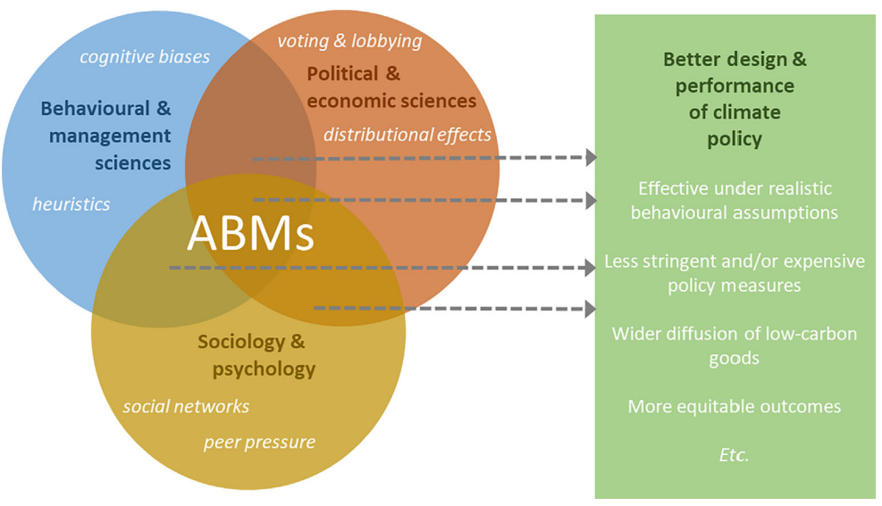
Behavioral insights in formal social-ecological models
Framework for inclusion of theories on human decision-making in formal/mathematical natural resource management models (Schlüter et al., 2017)
Support the identification and operationalization of alternative behavioural theories (bounded rationality, etc.) so that modellers can make informed choices on which theory is relevant for a given context and research question
Further example: agent-based modelling of climate policy
Savin et al., 2022*

Slide 22
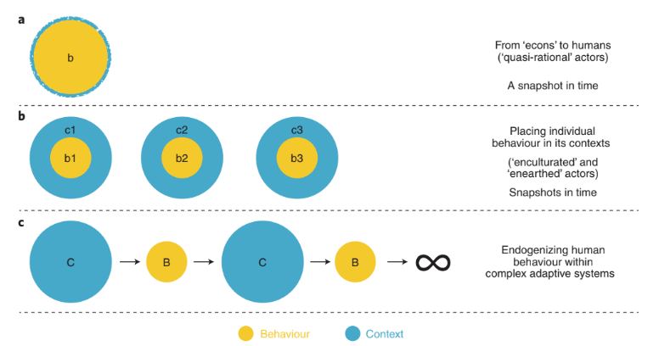
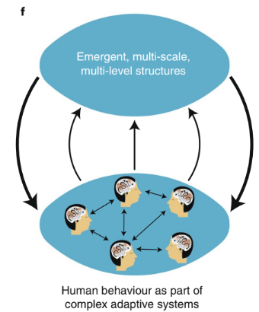
Towards human behavior in complex adaptive systems
Schill et al., 2019*

Slide 23
Behavioral environmental vs. ecological economics?
Various reviews on behavioral environmental economics:
Context-dependent preferences (e.g. due to endowment effect) in non-market valuation; social preferences and crowding-out of intrinsic motivation (Shogren et al., 2010*)
Nudges/non-monetary interventions
Concept, political/academic interest, effects (Croson and Treich, 2014*)
Long-run, policy interaction, and spillover effects (Kesternich et al., 2017*)
Considerable overlap with research published in Ecological Economics
Relatively less consideration of ‘systemic’ issues (i.e. broader socio-cultural context)

Slide 24
Some considerations for future research
Leverage points (LP) = point of intervention in a system of interest to alter its behaviour, trajectories, and outcomes (Dorninger et al., 2020) → deep LP = post-growth worldview
Limits: behavioral responses to inequality, income and wealth taxes/caps, etc.
Nudge, boost, or rather sludge (audits) and budge?
Learn from other fields, such as discussion about impact-orientation in environmenal psychology (Nielsen et al., 2021a*), borrow/extend constructs (e.g. systems thinking)
Focus on specific individuals beyond average consumer (Nielsen, 2021b*):
High-income consumers, people in non-consumer roles (e.g. investors; organizational decision-maker; community leader)
Political behaviors (with potential to connect to “institutional ecological economics”)
Consider “heterogeneity revolution” (Bryan et al., 2021*), and how people change more ‘durable’ contexts (Schill et al., 2019*)
What about group-level analysis or other approaches beyond individual level?

Slide 25
Conclusions
A growing amount of behavioral research in the journal of Ecological Economics, but some (or perhaps most) of it is difficult to distinguish from behavioral environmental economics and other related fields
Behavioral ecological economics may prioritize research that:
focuses on understanding the dynamic interplay between individual behavior and diverse contextual or systemic factors
contributes systemic solutions to the social-ecological crisis
This requires research collaborations!

Slide 26
Thank you!

Slide 27
References (1/3)
Amel, E., Manning, C., Scott, B., & Koger, S. (2017). Beyond the roots of human inaction: Fostering collective effort toward ecosystem conservation. Science, 356(6335), 275-279.
Andor, M.A., Fels, K.M., 2018. Behavioral Economics and Energy Conservation – A Systematic Review of Non-price Interventions and Their Causal Effects. Ecol. Econ. 148, 178–210. https://doi.org/10.1016/j.ecolecon.2018.01.018
Barros, B., & Wilk, R. (2021). The outsized carbon footprints of the super-rich. Sustainability: Science, Practice and Policy, 17(1), 316-322.
Becker, C. (2006). The human actor in ecological economics: Philosophical approach and research perspectives. Ecological economics, 60(1), 17-23.
Bergquist, M., Thiel, M., Goldberg, M. H., & van der Linden, S. (2023). Field interventions for climate change mitigation behaviors: A second-order meta-analysis. Proceedings of the National Academy of Sciences, 120(13), e2214851120.
Brown, P. M., & Cameron, L. D. (2000). What can be done to reduce overconsumption?. Ecological Economics, 32(1), 27-41.
Bryan, C. J., Tipton, E., & Yeager, D. S. (2021). Behavioural science is unlikely to change the world without a heterogeneity revolution. Nature human behaviour, 5(8), 980-989.
Buckley, P. (2020). Prices, information and nudges for residential electricity conservation: A meta-analysis. Ecological Economics, 172, 106635.
Castro, D., & Bleys, B. (2023). Do people think they have enough? A subjective income sufficiency assessment. Ecological economics, 205, 107718.
Castro, J., & Drews, S. (2023). Heuristics processing of green advertising: Review and policy implications. Ecological Economics, 206, 107760.
Chater, N., & Loewenstein, G. (2022). The i-frame and the s-frame: How focusing on individual-level solutions has led behavioral public policy astray. Behavioral and Brain Sciences, 1-60.
Croson, R., Treich, N., 2014. Behavioral Environmental Economics: Promises and Challenges. Environ. Resour. Econ. 58, 335–351. https://doi.org/10.1007/s10640-014-9783-y
Dorninger, C., Abson, D. J., Apetrei, C. I., Derwort, P., Ives, C. D., Klaniecki, K., ... & von Wehrden, H. (2020). Leverage points for sustainability transformation: a review on interventions in food and energy systems. Ecological Economics, 171, 106570.
Drews, S., 2023. Behavioral ecological economics, in: Haddad, B.M., Solomon, B.D. (Eds.), Dictionary of Ecological Economics. Edward Elgar Publishing, pp. 26–26. https://doi.org/10.4337/9781788974912.B.4
Drews, S., & Antal, M. (2016). Degrowth: A “missile word” that backfires?. Ecological Economics, 126, 182-187.
Drews, S., & Reese, G. (2018). “Degrowth” vs. other types of growth: labeling affects emotions but not attitudes. Environmental Communication, 12(6), 763-772.
Drews, S., Savin, I., van den Bergh, J.C.J.M., 2019. Opinion Clusters in Academic and Public Debates on Growth-vs-Environment. Ecol. Econ. 157, 141–155. https://doi.org/10.1016/j.ecolecon.2018.11.012
Drews, S., & Van Den Bergh, J. C. (2023). A critical assessment of the effectiveness of low-carbon nudges. In Behavioural Economics and the Environment (pp. 268-284). Routledge.
Drews, S., & Van Den Bergh, J. C. (forthcoming). Behavioral interventions for climate mitigation in developing countries: overview and prospects. Environment and Development.
Faber, M., Petersen, T., & Schiller, J. (2002). Homo oeconomicus and homo politicus in Ecological Economics. Ecological economics, 40(3), 323-333.
Farley, J., & Kish, K. (2021). Ecological economics: The next 30 years. Ecological Economics, 190, 107211.

Slide 28
References (2/3)
Ferraro, E., & Reid, L. (2013). On sustainability and materiality. Homo faber, a new approach. Ecological Economics, 96, 125-131.
Galvin, R., & Sunikka-Blank, M. (2018). Economic inequality and household energy consumption in high-income countries: a challenge for social science based energy research. Ecological economics, 153, 78-88.
Gintis, H. (2000). Beyond Homo economicus: evidence from experimental economics. Ecological economics, 35(3), 311-322.
Homar, A. R., & Cvelbar, L. K. (2021). The effects of framing on environmental decisions: A systematic literature review. Ecological Economics, 183, 106950.
Howe, P. D., Marlon, J. R., Mildenberger, M., & Shield, B. S. (2019). How will climate change shape climate opinion?. Environmental Research Letters, 14(11), 113001.
Hoffmann, C., Hoppe, J. A., & Ziemann, N. (2022). Faster, harder, greener? Empirical evidence on the role of the individual Pace of Life for productivity and pro-environmental behavior. Ecological Economics, 191, 107212.
Jager, W., Janssen, M. A., De Vries, H. J. M., De Greef, J., & Vlek, C. A. J. (2000). Behaviour in commons dilemmas: Homo economicus and Homo psychologicus in an ecological-economic model. Ecological economics, 35(3), 357-379.
Janssen, M. A., & Jager, W. (2000). The human actor in ecological-economic models: Preface. Ecological Economics, 35(3), 307-310.
Jensen, A. K., & Olsen, S. B. (2019). Childhood nature experiences and adulthood environmental preferences. Ecological economics, 156, 48-56.
Jungell-Michelsson, J., & Heikkurinen, P. (2022). Sufficiency: A systematic literature review. Ecological Economics, 195, 107380.
Kallbekken, S. (2023). Research on public support for climate policy instruments must broaden its scope. Nature Climate Change, 13(3), 206-208.
Kesternich, M., Reif, C., Rübbelke, D., 2017. Recent Trends in Behavioral Environmental Economics. Environ. Resour. Econ. 67, 403–411. https://doi.org/10.1007/s10640-017-0162-3
Kish, K., Farley, J., 2021. A Research Agenda for the Future of Ecological Economics by Emerging Scholars. Sustainability 13, 1557. https://doi.org/10.3390/su13031557
Kornek, U., Flachsland, C., Kardish, C., Levi, S., & Edenhofer, O. (2020). What is important for achieving 2 C? UNFCCC and IPCC expert perceptions on obstacles and response options for climate change mitigation. Environmental Research Letters, 15(2), 024005.
Levine, J., Chan, K. M., & Satterfield, T. (2015). From rational actor to efficient complexity manager: Exorcising the ghost of Homo economicus with a unified synthesis of cognition research. Ecological Economics, 114, 22-32.
Lezak, S. B., & Thibodeau, P. H. (2016). Systems thinking and environmental concern. Journal of Environmental Psychology, 46, 143-153.
Luzzati, T., Tucci, I., & Guarnieri, P. (2022). Information overload and environmental degradation: Learning from HA Simon and W. Wenders. Ecological Economics, 202, 107593.
Mertens, S., Herberz, M., Hahnel, U. J., & Brosch, T. (2022). The effectiveness of nudging: A meta-analysis of choice architecture interventions across behavioral domains. Proceedings of the National Academy of Sciences, 119(1), e2107346118.
Muradian, R., & Pascual, U. (2020). Ecological economics in the age of fear. Ecological Economics, 169, 106498.
Nielsen, K. S., Cologna, V., Lange, F., Brick, C., & Stern, P. C. (2021a). The case for impact-focused environmental psychology. Journal of Environmental Psychology, 74.
Nielsen, K. S., Nicholas, K. A., Creutzig, F., Dietz, T., & Stern, P. C. (2021b). The role of high-socioeconomic-status people in locking in or rapidly reducing energy-driven greenhouse gas emissions. Nature Energy, 6(11), 1011-1016.

Slide 29
References (3/3)
Norton, B., Costanza, R., & Bishop, R. C. (1998). The evolution of preferences: why sovereign 'preferences may not lead to sustainable policies and what to do about it. Ecological economics, 24(2-3), 193-211.
Rees, W. E. (2020). Ecological economics for humanity’s plague phase. Ecological Economics, 169, 106519.
Rhodes, E., Axsen, J., Jaccard, M., 2017. Exploring Citizen Support for Different Types of Climate Policy. Ecol. Econ. 137, 56–69. https://doi.org/10.1016/j.ecolecon.2017.02.027
Røpke, I. (2005). Trends in the development of ecological economics from the late 1980s to the early 2000s. Ecological economics, 55(2), 262-290.
Sælen, H. G., & Aasen, M. (2023). Exploring public opposition and support across different climate policies: Poles apart?. Ecological Economics, 209, 107838.
Savin, I., Creutzig, F., Filatova, T., Foramitti, J., Konc, T., Niamir, L., ... & van den Bergh, J. (2023). Agent‐based modeling to integrate elements from different disciplines for ambitious climate policy. Wiley Interdisciplinary Reviews: Climate Change, 14(2), e811.
Schubert, C. (2017). Green nudges: Do they work? Are they ethical?. Ecological economics, 132, 329-342.
Shogren, J. F., Parkhurst, G. M., & Banerjee, P. (2010). Two cheers and a qualm for behavioral environmental economics. Environmental and Resource Economics, 46, 235-247.
Spash, C. L. (2013). The shallow or the deep ecological economics movement?. Ecological Economics, 93, 351-362.
Schlüter, M., Baeza, A., Dressler, G., Frank, K., Groeneveld, J., Jager, W., Janssen, M.A., McAllister, R.R.J., Müller, B., Orach, K., Schwarz, N., Wijermans, N., 2017. A framework for mapping and comparing behavioural theories in models of social-ecological systems. Ecol. Econ. 131, 21–35. https://doi.org/10.1016/j.ecolecon.2016.08.008
Schumacher, I. (2014). An empirical study of the determinants of green party voting. Ecological Economics, 105, 306-318.
Siebenhüner, B. (2000). Homo sustinens—towards a new conception of humans for the science of sustainability. Ecological economics, 32(1), 15-25.
Starr, J., Nicolson, C., Ash, M., Markowitz, E. M., & Moran, D. (2023). Assessing US consumers' carbon footprints reveals outsized impact of the top 1%. Ecological Economics, 205, 107698.
Stoddard, I., Anderson, K., Capstick, S., Carton, W., Depledge, J., Facer, K., ... & Williams, M. (2021). Three decades of climate mitigation: why haven't we bent the global emissions curve?. Annual Review of Environment and Resources, 46, 653-689.
Szaszi, B., Higney, A., Charlton, A., Gelman, A., Ziano, I., Aczel, B., ... & Tipton, E. (2022). No reason to expect large and consistent effects of nudge interventions. Proceedings of the National Academy of Sciences, 119(31), e2200732119.
Tomaselli, M. F., Sheppard, S. R., Kozak, R., & Gifford, R. (2019). What do Canadians think about economic growth, prosperity and the environment?. Ecological Economics, 161, 41-49.
Van den Bergh, J. C., Ferrer-i-Carbonell, A., & Munda, G. (2000). Alternative models of individual behaviour and implications for environmental policy. Ecological Economics, 32(1), 43-61.
Washington, H., & Maloney, M. (2020). The need for ecological ethics in a new ecological economics. Ecological Economics, 169, 106478.
Winkelmann, R., Donges, J. F., Smith, E. K., Milkoreit, M., Eder, C., Heitzig, J., ... & Lenton, T. M. (2022). Social tipping processes towards climate action: a conceptual framework. Ecological Economics, 192, 107242.

