Slide 1
A field experiment to promote water saving in the metropolitan area of Milan
Stefano Clò (University of Florence),
Tommaso Reggiani (Cardiff University - UK)
Sabrina Ruberto (University of Naples L’Orientale)

Slide 2
Introduction: Research Question & Motivation
Do we know how much water we consume daily?
Systematic underestimation and biased perception
lack of environmental awareness on our water footprint
Why?
Lack of frequent and clear information on water consumption.
consumption recorded through analogue meters, usually installed outside private homes
Analogue meters report cumulated (stock) consumption at household level
water billing usually based on estimated data (self-reported communications or door-to-door reading)
Water billing reports households’ aggregated consumption over a period (108 cubic meter over a semester)

Slide 3
Introduction: Research Question & Motivation
Online information campaign on water consumption
Cheap to implement and effective in stimulating sustainable behaviours (Ferraro and Miranda, 2013; Ferraro and Price, 2013; Price et al., 2014)
Launched in partnership with CAP Group, which manages the integrated water services in Milan
Randomized installation of 15k smart meters which allow for a remote and frequent data collection
Involved about 1,000 households in the metropolitan area of Milan
Main goal of the research
Assess to which extent informative feedbacks on water consumption improve environmental awareness and nudge a water saving behaviour.

Slide 4
the information campaign
online social information program over a five-month period: From September 2021 to January 2022.
treated units received on a monthly basis a short report via e-mail (water consumption diary), with info on:
Your Monthly Consumption Diary - August 2021
Dear Customer, here is your water consumption diary.
On August 2021, your households’ daily water consumption amounted to 259 liters per person.
Over the same month, the average daily water consumption in your neighbourhood was 227 liters per person.
Average daily consumption
Group Average daily consumption
Ranking position (on a 1000 scale)
Consumption class size (households belonging to the 1st 2nd 3rd tertile)
Low User
Medium User
High User
graphical representation
You are here

Slide 5
Contributions to existing literature
Geographical context
Previous research
water conservation experiments mainly developed in the US (Ferraro and Price, 2013; Brent et al., 2015; Hahn et al., 2016; Schultz et al.,2019; Brent et al., 2020),
various applications in other parts of the world
Australia (Sarac et al., 2003; Fielding et al., 2013 )
Central and South America (Datta et al., 2015; Miranda et al., 2020; Torres and Carlsson, 2018)
South Africa (Smith and Visser, 2013),
Asia (Sudarshan, 2017; Agarwal et al., 2017; Goette, et al. 2019).
Europe (Ansink et al., 2021 in the United Kingdom and Kažukauskas et al., 2021 in Sweden).
Our research: First application in Italy.
verify external validity of previous results to a diverse socio-economic context with emerging water scarcity issue:
climate crisis’ related droughts phenomena
Demand side: unsustainable consumption behaviour
very high levels of per-capita water consumption (Italian average per capita consumption of 236 litres per day vs European average of 144 litres per day)
low awareness due to widespread technological backwardness in data collection and communication

Slide 6
Contributions to existing literature
Type of communicated information
Previous research
total amount of households’ aggregated water consumption (Ferraro and Price, 2013; Brent at al., 2015; Schultz et al., 2019)
daily average of households’ aggregated water consumption (Bhanot, 2017; Jessoe et al., 2021).
Our research
Daily average of per capita water consumption
Information is more familiar and understandable
family consumption of 108 cubic meters over a semester
family consumption of 600 litres per day
per capita consumption of 200 litres per day
same amount of consumption, but daily per capita information easily associated with our daily experience

Slide 7
Contributions to existing literature
Information notification tool
Previous research
printed leaflets in the form of door hangers (Nolan et. Al 2008; Goette et al., 2019)
printed letters or postcards (Ferraro and Price, 2013; Hahn et al., 2016; Landon et al., 2018; Schultz et al., 2019; Torres and Carlsson, 2018; Carlsson et al., 2021; Fielding et al., 2013; Miranda et al., 2020).
combination of printed letters and emails or website (Dolan & Metcalfe 2013; Brent at al. 2015; Bhanot, 2017; Jessoe et al., 2021; Schultz et al. 2016; Daminato et al., 2021)
printed copies more effective than digital versions delivered via email.
campaign not significant in case of email notification.
Our research
information campaign notified exclusively via e-mail.
First to provide evidence on the effect of an information campaign based uniquely on e-mail online notifications
Observe compliance rate and combine a ITT analysis with a LATE analysis

Slide 8
RQ1- Did the experiment promote water conservation?
difference-in-difference (DID) estimator:
$y_{it}=α+β_{1}T_{i}+β_{2}{Post}_{t}+ β_{3}T_{i}∗{Post}_{t}+θ_{i}+u_{t}+ε_{it}$ (1)
$y_{it}$ indicates the water consumption of user i in the month t;
$T_{i}$: identifies the treated group (=1 if the user has been treated)
${Post}_{t}$identifies the treatment period (=1 from 2021/09 to 2022/01=0 from 2021/05 to 2022/08);
$β_{3}$ coefficient of the interaction term captures the ATE
${θ_{i} u}_{t}:$unit and time fixed effects

Slide 9
 | (1)
Post | -66.254***
 | (4.887)
Post*Treated | -22.408***
 | (8.526)
Constant | 262.328***
 | (2.619)
No. Obs. | 38,945
R-squared | 0.062
On average, the campaign promoted a daily water saving of 22 liters/pc (-10%) compared to the control group

Slide 10
RQ2- DYNAMIC Analysis: does the impact of the campaign vary over time?
End of the Information Campaign
Pre-parallel trend assumption is confirmed
effect not constant over time, it increases with the n° of reports (from 11 liters/day to 29 liters/day).
repeated e-mails increase awareness (reject expectation of a strong initial effect diluted over time).
After the end of the campaign, T&C converge
Before: lack of information and awareness
During: information improves awareness and water saving
After: water saving declines in spite of the information
Information campaign increases awareness but not sufficient to build intrinsic motivation and to change behavior structurally

Slide 11
RQ3 HETEROGENOUS ANALYSIS: does the impact vary across consumption classes?
Split-sample analysis: Users classified in tertiles according to their pre-treatment level of consumption
Significant effect for the high consumption category only: additional saving of 58 liters/day pc (-29%).
Result consistent with convex saving costs
 | (1) | (2) | (3)
 | Low Users | Medium Users | High Users
Post | 3.709 | -2.602 | -107.508***
 | (2.735) | (3.357) | (11.542)
Post*Treated | -6.333 | -4.898 | -58.371***
 | (3.895) | (6.829) | (22.078)
Constant | 120.037*** | 190.084*** | 425.711***
 | (1.356) | (1.614) | (6.504)
No. Obs. | 12,794 | 13,058 | 13,093
R-squared | 0.013 | 0.038 | 0.154

Slide 12
RQ4- HETEROGENOUS ANALYSIS - does the impact vary with the feedback sent?
Verify if different feedbacks cause at the margin differential effects on water saving.
RDD: focus on users around the two categories’ cut-offs
Similar consumption level but different feedbacks (low vs medium; medium vs high)
“Low User” feedback associated to an increase in consumption (compared to the “medium user”)

Slide 13
RQ4- HETEROGENOUS ANALYSIS - does the impact vary with the feedback sent?
Verify if different feedbacks cause differential effects on water saving.
RDD: focus on users around the two categories’ cut-offs
Similar consumption level but different feedbacks (low vs medium; medium vs high)
“Low User” feedback associated to an increase in consumption (compared to the “medium user”)
“High User” feedback associated to a reduction in consumption (compared to the “medium user”)

Slide 14
RQ5- HETEROGENEOUS ANALYSIS – Does the impact depend on compliance?
So Far: Intention To Treat (ITT) Analysis
all the treated subjects included regardless of compliance status
unbiased ATT estimate
in case of substantial non-adherence, potential untrue estimation of the magnitude of the treatment effect
non-complying (de facto untreated) units analyzed as if they were treated
Online campaign allows to observe the email open rate
46% of the treated group opened less than 3 (of 5) emails
N° of opened emails | Number of Users | percentage | cumulative percentage
None (Zero compliance) | 193 | 19% | 19%
One | 150 | 15% | 34%
Two | 128 | 12% | 46%
Three | 149 | 14% | 60%
Four | 120 | 12% | 72%
Five (full compliance) | 274 | 28% | 100%
Total | 1,014 | 100%

Slide 15
Triple Difference in differences
We differentiate treated units according to the degree of compliance
Non compliers not different compared to different group
Average effect driven by the adherent units who actually received the treatment
Biased estimates in case of self-selection.
POST | -66.258***
 | (4.887)
POST x TREAT | -16.295
 | (14.746)
POST x TREAT x COMPLY | -25.508***
 | (9.687)
Constant | 262.330***
 | (2.619)
Observations | 38,945
R-squared | 0.062

Slide 16
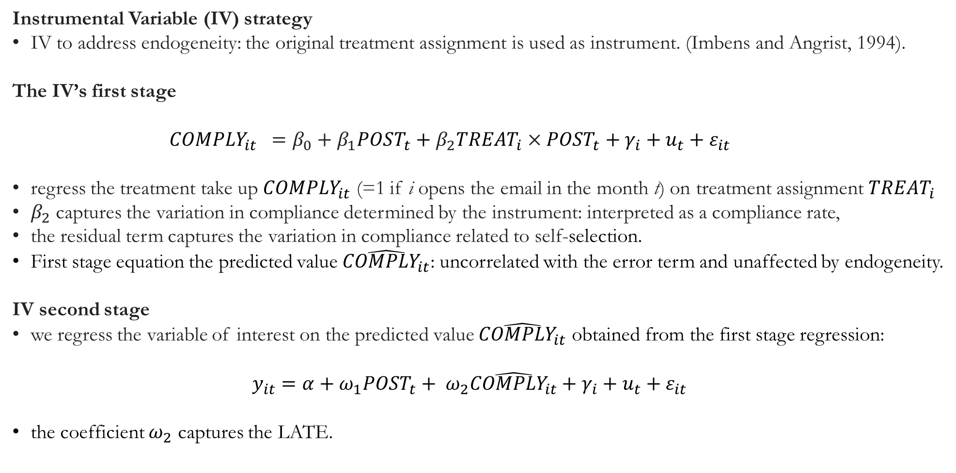
Local Average Treatment Effect
Instrumental Variable (IV) strategy
IV to address endogeneity: the original treatment assignment is used as instrument. (Imbens and Angrist, 1994).
The IV’s first stage
$$COMPLY_{it} =β_{0}+β_{1}POST_{t}+β_{2}TREAT_{i}×POST_{t}+γ_{i}+u_{t}+ε_{it}$$
regress the treatment take up $COMPLY_{it}$ (=1 if i opens the email in the month t) on treatment assignment $TREAT_{i}$
$β_{2}$ captures the variation in compliance determined by the instrument: interpreted as a compliance rate,
the residual term captures the variation in compliance related to self-selection.
First stage equation the predicted value $\hat{COMPLY_{it}}$: uncorrelated with the error term and unaffected by endogeneity.
IV second stage
we regress the variable of interest on the predicted value $\hat{COMPLY_{it}}$ obtained from the first stage regression:
$$y_{it}=α+ω_{1}{POST}_{t}+ ω_{2}\hat{COMPLY_{it}}+γ_{i}+u_{t}+ε_{it}$$
the coefficient $ω_{2}$ captures the LATE.

Slide 17
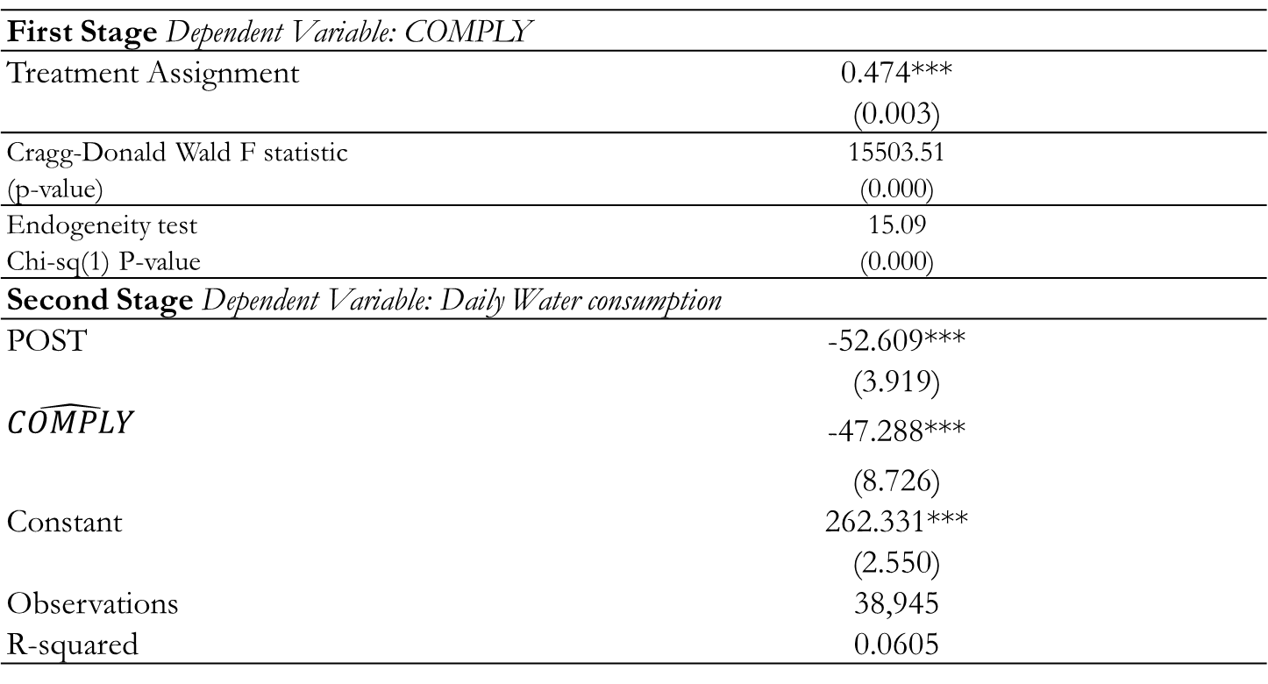
IV’s first stage
Estimate a 47% compliance rate
endogeneity test rejects the null hypothesis that the compliance variable is exogenous: need for an IV approach.
Weak identification test rejects the null hypothesis that our instrument is weak.
IV second stage
Estimate a significant LATE: average per capita water saving of 47 liters/day compared to the control group
First Stage Dependent Variable: COMPLY
Treatment Assignment | 0.474***
 | (0.003)
Cragg-Donald Wald F statistic | 15503.51
(p-value) | (0.000)
Endogeneity test | 15.09
Chi-sq(1) P-value | (0.000)
Second Stage Dependent Variable: Daily Water consumption
POST | -52.609***
 | (3.919)
$$\hat{COMPLY}$$ | -47.288***
 | (8.726)
Constant | 262.331***
 | (2.550)
Observations | 38,945
R-squared | 0.0605

Slide 18
Conclusions
Campaign promoted an average daily reduction of 22 liters/pc (-10%).
Dynamic effect not constant over time, but increases with the number of emails sent. Repeated e-mails increase awareness
Water saving is not permanent, but expires after the end of the experiment
Providing information not sufficient to build intrinsic motivation and to drive structural behavioral change
The impact of the treatment is heterogeneous between the categories of consumers
Different feedbacks affect consumption choices at the margin
Average results driven by complying units with significant LATE effect

Slide 19
Thank you for your attention
Suggestions, questions and comments are welcomed!
Stefano.clo@unifi.it

