Slide 1
What Drives Energy Curtailment? Using COVID-19 as a Natural Experiment to Disentangle the Relative Importance of Attention and Income Shocks
Andreas Löschel Michael Price
Laura Razzolini Madeline Werthschulte
Behavioural Ecological Economics Workshop
July 10, 2023

Slide 2
Motivation
Changes in lifestyles and routines can generate meaningful reductions in carbon emissions (IPCC, 2022).
We look into curtailment actions intended to reduce electricity consumption taken by households during the pandemic
- Conservation actions can reduce emissions from the building sector by 10-40 % (Creutzig et al., 2022)
- Particularly in Germany: Residential consumers account for 25% of total electricity demand (BDEW, 2020) and 54% are tenants (Destatis, 2022)

Slide 3
Motivation
Good news: Such behavior (household routines) is mutable (e.g., by simple behavioral interventions (e.g., Allcott, 2011)
What are the motives underlying curtailment behaviors?

Slide 4
In this study we explore
Three potential motives for energy curtailment actions
Income Reductions
Shifts in attention/salience
Shifts in environmental responsibility
….Using the COVID-19 pandemic as a ‘natural experiment’
…Using surveys conducted in Germany before and during the pandemic (+ data from the SOEP)
Notes:
COVID was a shock that impacted both employment/earning and amount of time spent at home.

Slide 5
Literature & Hypotheses
Income Reductions
The Pandemic affected employment status and income
Electricity consumption and income are positively correlated (Schulte & Heindl, 2017)
Curtailment actions could be taken to reduce expenses

Slide 6
Literature & Hypotheses
Shifts in attention/salience
The Stay-at-home orders limited the set of available actions
Models of attention/salience: the ‘budget’ of attention is split among different choice options (Bordalo et al, 2013; Gabaix, 2019)
Curtailment actions could be taken because of fewer other actions available

Slide 7
Literature & Hypotheses
Shifts in environmental responsibility
Value-Belief-Norm Models: Env. Responsibility is correlated with curtailment actions (Stern, 2000; Jakovcevic & Steg, 2012)
Finite Pool of Worry: Health concerns crowd out environmental concerns (Weber, 2015)
Fewer (more) curtailment actions could be taken because of less (more) environmental concern

Slide 8
Study Design
Two surveys conducted in Germany with representative samples
Quota-based recruitment: participants selected on the basis of gender, age, federal state
Wave 1 - N = 711 (face-to-face) & Wave 2 - N=802 (online)
Timing: Wave 1 – Dec 2017-Jan 2018; Wave 2 – May 2020 (during the pandemic)
Curtailment actions elicited:
QE6. Do you follow any routine in your energy conservation actions?
Choose all that apply
I do not follow any routine.
I check lights in each room before leaving the house.
I switch lights off before leaving rooms.
I unplug electronic appliances after using them.
Other routines (please specify) _______________

Slide 9
Survey questions – both waves
Questions about Personal environmental responsibility
“I am willing to do something about the environment only if others do the same.” (Likert scale 1-4)
“I am willing to make compromises in my current lifestyle for the benefit of the environment.” (Likert scale 1-4)
“I am willing to pay a higher price for electricity if it is generated from renewable energy sources.” (Likert scale 1-5)
Basic demographics and socio-economics characteristics
Gender, age, number children, employment status, education, monthly income

Slide 10
Survey questions – COVID wave
Have you experienced the following? (to proxy income reductions)
‘Being laid-off’ (yes-no)
‘Your employer or You shutting down the business’ (yes-no)
Which of the following measures have you been following? (to proxy increased time spent at home)
‘staying-at-home except to do basic shopping’ (yes-no)
‘avoiding face-to-face contact with friends and family’ (yes-no)
Broader controls:
Trust in government in handling the pandemic
Self- reported altruism + giving to charity of choice in a Dictator Game
Notes:
Aim of study: understand what drives curtailment behavior. We use COVID shock that impacted both employment/earnings and amount of time spent at home.
Dictator Game: select one out of three charities (Doctors Without Borders, Feed the Children, and Amnesty International)
Then allocate 10 euros between self and the chosen charity

Slide 11
 | 1 - Before COVID-19 | 2 - During COVID-19 | 3 - Difference
No. actions (1-4) | 1.055 | 1.747 | 0.692***
 | (0.800) | (1.016) | (0.048)
Switch off lights (=1) | 0.684 | 0.774 | 0.091***
 | (0.465) | (0.418) | (0.023)
Check each room (=1) | 0.147 | 0.424 | 0.276***
 | (0.355) | (0.494) | (0.023)
Unplug appliances (=1) | 0.214 | 0.392 | 0.178***
 | (0.410) | (0.488) | (0.024)
Contribute only conditionally (1-4) | 1.775 | 2.098 | 0.323***
 | (0.740) | (0.961) | (0.045)
Willing to make compromises (1-4) | 3.330 | 3.125 | -0.205***
 | (0.617) | (0.784) | (0.037)
Willing to pay for green energy (1-5) | 2.635 | 2.574 | -0.061
 | (1.311) | (1.321) | (0.069)
Female (=1) | 0.530 | 0.515 | -0.015
 | (0.499) | (0.500) | (0.026)
Age (count) | 48.696 | 48.354 | -0.342
 | (18.483) | (16.272) | (0.893)
No. children (0-5) | 0.416 | 1.023 | 0.606***
 | (0.749) | (1.183) | (0.052)
Education (1-7) | 3.971 | 4.586 | 0.615***
 | (1.215) | (1.041) | (0.059)
Employed (=1) | 0.553 | 0.556 | 0.003
 | (0.498) | (0.497) | (0.026)
Income (1-10) | 6.841 | 6.648 | -0.193
 | (2.704) | (3.123) | (0.168)
Trust (1-5) |  | 3.674
 |  | (1.308)
Sharing in DG (0-1) |  | 0.487
 |  | (0.318)
Self-reported altruism (0-10) |  | 5.018
 |  | (3.044)
Lost job (=1) |  | 0.131
 |  | (0.338)
Stay at home (=1) |  | 0.710
 |  | (0.454)
Avoid contact friends/family (=1) |  | 0.671
 |  | (0.470)
N | 528 | 739 | 1267
Notes:
Analysis in two steps: 1) compare # curtailment actions in each wave to see if there are changes. We use demographic characteristics to control for differences in the two groups of subjects. 2) use COVID shock to identify mechanisms that lead to changes in curtailment routines. Specifically, we ask if income shocks or behavioral changes due to COVID led to changes in curtailment. Again we control for demographics and for altruism.
Finally, we explore the role of environmental responsibility as a driver of curtailment behavior.\\
Data from Table show that # of curtailment actions are higher in the 2nd wave. For ex. Unplug Appliances: difference is 0.178 ….. 83% more likely to unplug appliances and 13% more likely to turn off lights during the COVID wave than earlier.
In 2nd wave we record lower [personal environmental responsibility.
13% lost job, 71% stay home and 67% avoid contacts with friends and family. Similar statistics for Germany as a whole.

Slide 12
 | 1 - Before COVID-19 | 2 - During COVID-19 | 3 - Difference
No. actions (1-4) | 1.055 | 1.747 | 0.692***
 | (0.800) | (1.016) | (0.048)
Switch off lights (=1) | 0.684 | 0.774 | 0.091***
 | (0.465) | (0.418) | (0.023)
Check each room (=1) | 0.147 | 0.424 | 0.276***
 | (0.355) | (0.494) | (0.023)
Unplug appliances (=1) | 0.214 | 0.392 | 0.178***
 | (0.410) | (0.488) | (0.024)
Contribute only conditionally (1-4) | 1.775 | 2.098 | 0.323***
 | (0.740) | (0.961) | (0.045)
Willing to make compromises (1-4) | 3.330 | 3.125 | -0.205***
 | (0.617) | (0.784) | (0.037)
Willing to pay for green energy (1-5) | 2.635 | 2.574 | -0.061
 | (1.311) | (1.321) | (0.069)
Female (=1) | 0.530 | 0.515 | -0.015
 | (0.499) | (0.500) | (0.026)
Age (count) | 48.696 | 48.354 | -0.342
 | (18.483) | (16.272) | (0.893)
No. children (0-5) | 0.416 | 1.023 | 0.606***
 | (0.749) | (1.183) | (0.052)
Education (1-7) | 3.971 | 4.586 | 0.615***
 | (1.215) | (1.041) | (0.059)
Employed (=1) | 0.553 | 0.556 | 0.003
 | (0.498) | (0.497) | (0.026)
Income (1-10) | 6.841 | 6.648 | -0.193
 | (2.704) | (3.123) | (0.168)
Trust (1-5) |  | 3.674
 |  | (1.308)
Sharing in DG (0-1) |  | 0.487
 |  | (0.318)
Self-reported altruism (0-10) |  | 5.018
 |  | (3.044)
Lost job (=1) |  | 0.131
 |  | (0.338)
Stay at home (=1) |  | 0.710
 |  | (0.454)
Avoid contact friends/family (=1) |  | 0.671
 |  | (0.470)
N | 528 | 739 | 1267
13%
83%
Notes:
Data from Table show that # of curtailment actions are higher in the 2nd wave. For ex. Unplug Appliances: difference is 0.178 ….. 83% more likely to unplug appliances and 13% more likely to turn off lights during the COVID wave than earlier.
In 2nd wave we record lower personal environmental responsibility.
13% lost job, 71% stay home and 67% avoid contacts with friends and family. Similar statistics for Germany as a whole.

Slide 13
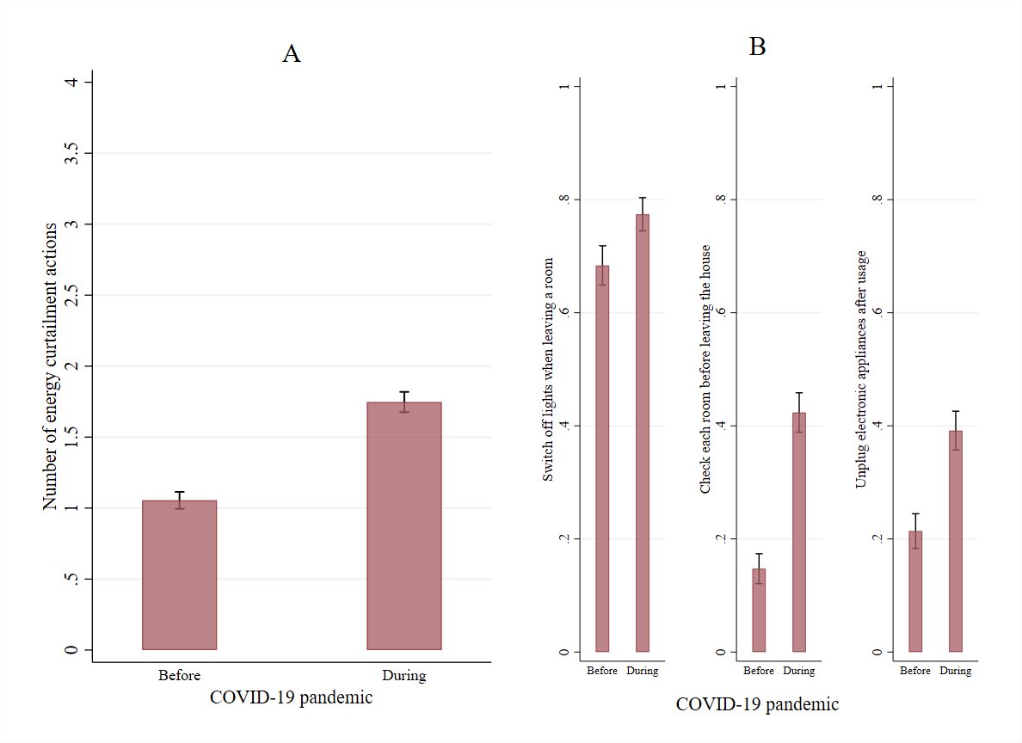
Differences across waves: Raw Data
9%
67%
28%
18%
Notes:
Fig. A compares curtailment behavior across waves, on average 67% more actions in 2nd wave than 1st
Fig. B looks at likelihood of each action in the two waves; in 2nd wave likelihood increases by 9%, 28% and 18% respectively
Evidence of newly developed routines

Slide 14
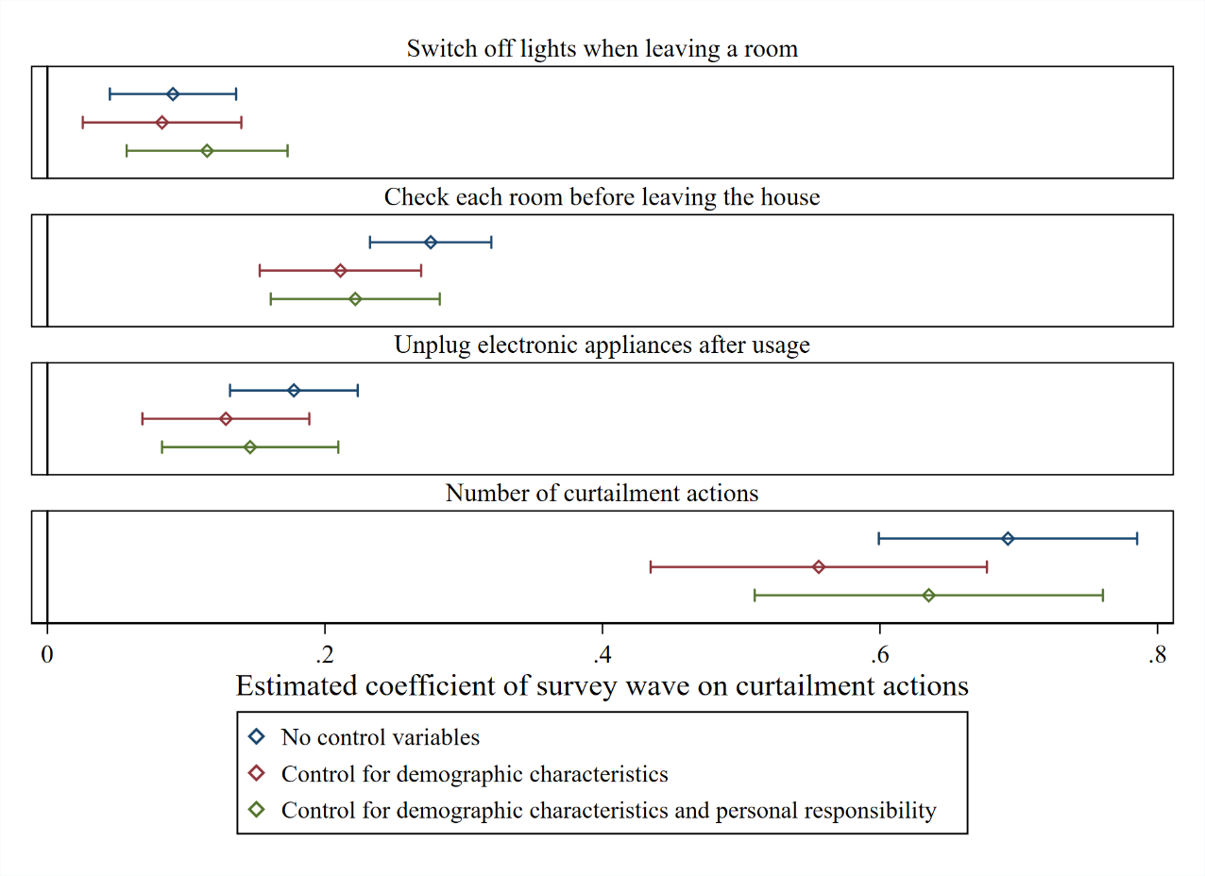
Differences across waves: Estimated Coefficients
Significant correlation between personal environmental responsibility and curtailment actions
Notes:
To control for demographic effects and imbalances across waves, we estimate linear regression models on the total # of reported actions and a series of linear probability models on the likelihood of reporting each action. model (1) controls for the wave, (2) for demographics, (3) for personal environmental responsibility
Fig. show estimate coefficients and bars report the 95% confidence intervals

Slide 15
Exploring Drivers
We observe a significant increase in curtailment actions during the pandemic. What drives this increase?
We explore the impact of:
Having lost the job as a proxy for income reduction (within the COVID wave)
Staying at home and avoiding contact with others and friends as a proxy for attention shifts (within the COVID wave)
Increase in personal environmental responsibility (between waves)
Notes:
We use COVID as exogenous shock. We restrict analysis to 2nd wave and compare behavior of those individuals whose income and staying at home were impacted by the pandemic to the behavior of those initials not affected by the pandemic.
Two channels for the change in behavior: 1) reduced income or 2) increased attention
We proxy shock to income with being laid off or losing job
We proxy increased attention to energy curtailment with adherence with the stay-at-home mandates and reduced contact with friends and family (staying home implies fewer options available)

Slide 16
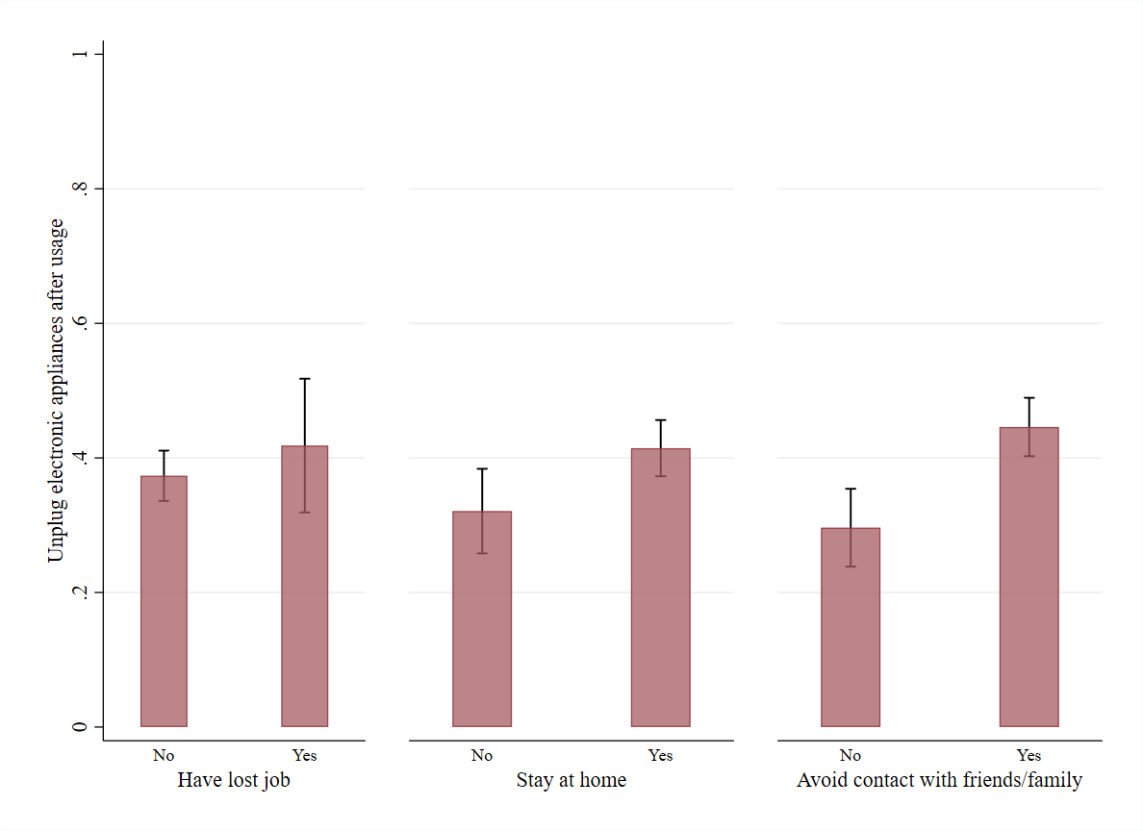
Income Reduction versus Attentions Shifts: Raw data
Notes:
Difference in likelihood of Unplugging appliance is significant only for those who reported spending more time at home, thus increasing attention to energy curtailment.
No difference in likelihood of unplugging between those who lost job and those who did not

Slide 17
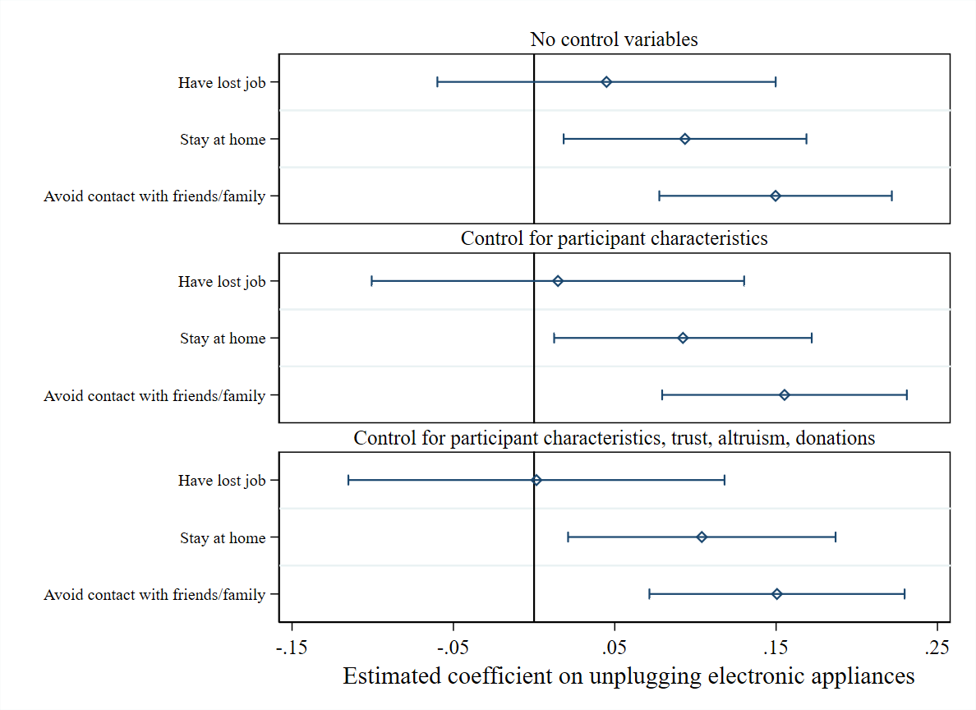
Income Reduction versus Attentions Shifts: Estimated Coefficients
Notes:
Results from series of regressions (a linear probability model) with multiple controls, including trust and altruism + giving in dictator game.
Across all specifications, the estimated coefficient on our proxy for income shocks – reporting a change in employment and job loss – is positive but statistically insignificant. Respondents who reported losing a job during the pandemic are approximately 0.1 to 4.5 percentage points more likely to state that they regularly unplug appliances than counterparts whose employment status was unaffected by the pandemic. For perspective, such effects are significantly smaller than the approximate 13.6 percentage point difference in the estimated propensity to report unplugging appliances across female and male respondents.
The effect on curtailment behavior of our proxies for increased attention – staying at home and avoiding face-to-face contact with friends and family – is positive and statistically significant. Respondents who report increased time spent in the home due to compliance with stay-at-home restrictions are approximately 9.2 to 10.4 percentage points more likely to unplug appliances when not in use than counterparts reporting no such change. Respondents who report increased time spent in the home due to avoiding contacts with others are approximately 15 to 15.5 percentage points more likely to unplug appliances when not in use than counterparts reporting no such change.

Slide 18
More on Exploring Drivers
We explore next whether the observed increase in curtailment behavior in the COVID wave reflects changes in pro-sociality or concerns for the environment and personal environmental responsibility.
About pro-sociality, we combine data from our survey with data from the German Socio Economic Panel (SOEP). We match the timing of the waves with the SOEP data collection and use questions about the environment and about donations made.
From SOEP data, the fraction of respondents reporting that they have made or plan to make a future donation is higher in the 2018 waves of the SOEP than that observed in the 2020 wave. However, the estimated amount donated is greater in the wave conducted during the pandemic than that observed in the wave conducted before the pandemic. Similar results hold for our two waves.

Slide 19
More on Exploring Drivers
About personal environmental responsibility, SOEP data confirm that concerns about the environment have decreased from the 2017/2018 surveys to the survey wave conducted during the pandemic.
SOEP finds a negative association between COVID-19 incidence and concerns for the impact of climate change – a trend that is particularly pronounced in the last quarter of 2020.
These results from the SOEP are consistent with a “finite pool of worry” (Weber, 2006, 2015) among survey respondents. Increasing case numbers and associated concern about the pandemic crowd out environmental concerns.
It seems unlikely that observed increases in curtailment activity in the second wave of the survey are driven by changes in concern for the environment or overall pro-sociality.

Slide 20
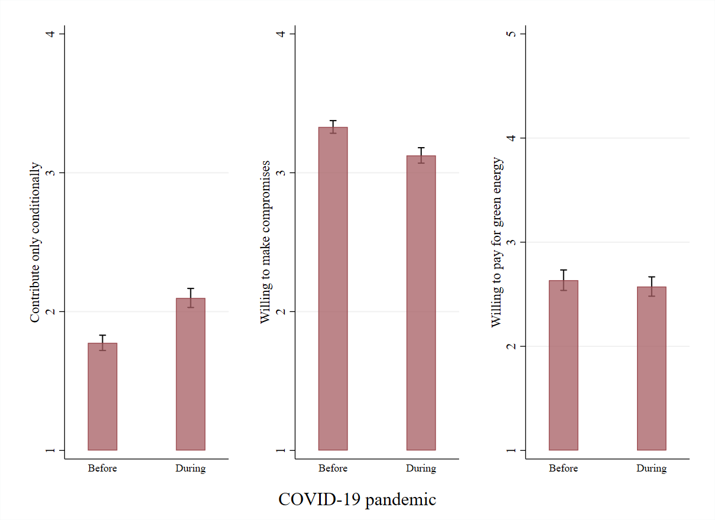
Personal Environmental Responsibility across waves
Notes:
In our waves, respondents in the second wave are more likely to report that they are not willing to take actions to protect the environment unless others are taking such actions. Likewise, we observe a significant decrease in the willingness of respondents to make compromises in their current lifestyle for the benefit of the environment or to pay a higher price for electricity generated from renewable energy resources.
These findings are robust to the inclusion of demographic and socio-economic controls.

Slide 21
External Validity: Pro-social Behavior in the SOEP
The data presented in previous Figure and SOEP data provide evidence consistent with a limited pool of worry.
Feelings of personal environmental responsibility and the desire to act in a pro-environmental manner are lower in the second wave of the survey. Norm activation theories and the Value-Belief-Norm model cannot explain the change in curtailment activity across rounds. Under such models, we would expect the average respondent in the second round of the survey to be less likely to undertake curtailment actions.

Slide 22
Summary
We use a novel survey data from before and during the pandemic
Curtailment behavior increased during the pandemic (Substantial energy savings)
Using variation due to the pandemic, we show that this increase is
Not due to income reductions
Not due to increased environment concerns. Indeed, environmental concerns decreased during the pandemic ~ ‘finite pool of worry’
Consistent with increased attention devoted to curtailment while staying at home
Results highlight importance of salience and attention for engaging in curtailment actions
Notes:
A back-of-the-envelope calibration shows that these small changes in curtailment actions can lead to substantial energy savings. Unplugging appliances after usage could lead to savings of up to 210 kilowatt hours per year for a two-person German household. We estimate an approximate 13 percentage points increase in the likelihood an individual regularly unplugs appliances after use. Extrapolating this effect to the 41.5 million households in Germany, our estimates imply energy savings of around 1.13 terawatt hours per year. To put these numbers into perspective, the estimated savings correspond to approximately 0.2 percent of the overall energy consumption in Germany (BDEW, 2020) and financial savings of around 361 million euros per year (co2online, 2021).
The average German household size is a two-person household (Federal Agency for Civic Education, 2021).
Unintended benefit of national lock-down policies
We do not study the evolution of curtailment behavior over the course of the pandemic and after the lockdown. Future work is to explore whether curtailment actions formed during the COVID-19 pandemic impact the acceptance and effectiveness of other climate change mitigation strategies and last over time.

Slide 23
Questions?
Send Comments to
lrazzolini@cba.ua.edu

